Slide 1
Understanding domestic abuse, the legal context and the court process Victoria Kerr, Procurator Fiscal Depute, Crown Office and Procurator Fiscal Service Sheena Dalgarno, Women’s Service Manager, Grampian Women’s Aid

Slide 2
The Crown Office & Procurator Fiscal Service
Scotland’s independent public prosecution and deaths investigation service
Responsible for making decisions about and bringing prosecutions for criminal offences
Investigate and prosecute crime
Investigate sudden, suspicious or unexplained deaths
Investigate complaints against police officers.

Slide 3
How does the system work?
Police (or a reporting agency) report a crime or sudden death
This comes in the form of a Standard Prosecution Report
Report considered and the decision to prosecute or take another action is taken by the Procurator Fiscal
May result in court proceedings

Slide 4
Where do trials happen?
If a crime happens in Grampian, it will usually be heard in either Aberdeen, Banff or Peterhead (depending where exactly in Grampian the crime happened). If crimes happen in various places or there are multiple complainers across different geographical areas, one court takes ‘jurisdiction’.
Domestic abuse cases will either be summary (a sheriff only) or solemn (a sheriff/judge and jury)
Almost all trials are open to the public to watch.

Slide 5
How long will it take?
Summary cases:
Bail: domestic trials aim to start in bail cases within 10 weeks of accused’s first appearance in court.
Delays can happen – further investigation by defence, mental health investigations, evidence not available etc.
Custody: 40 days
Sheriff and Jury/High Court cases
Bail: indictment to be served within 10 months – trial to commence within 12 months. Can be extended.
Custody: trial to start within 110 days. Can be extended.

Slide 6
TRIAL PROCESS
Witness gives an oath/affirmation
Prosecutor leads evidence
Each witness:
Examination in Chief (prosecutor)
Cross Examination (defence)
Re-examination (prosecutor)
Defence decides whether to lead evidence
Each witness:
Examination in Chief (defence)
Cross Examination (prosecutor)
Re-examination (defence)
Summing up (submissions or speech)
Verdict – from Sheriff or from spokesperson of the jury (unanimous/majority).

Slide 7
Domestic Abuse
Police Scotland and the Crown Office and Procurator Fiscal Service (COPFS) have a shared definition of domestic abuse available on the Police Scotland website.
This definition is:
‘Any form of physical, verbal, sexual, psychological or financial abuse which might amount to criminal conduct and which takes place within the context of a relationship. The relationship will be between partners (married, cohabiting, civil partnership or otherwise) or ex-partners. The abuse can be committed in the home or elsewhere including online’

Slide 8
Typologies of domestic abuse
Intimate terrorism
Situational Couple Violence
Mutual Couple Violence
Violent Resistance

Slide 9
Domestic Abuse Statistics
Tackling violence against women and girls is a priority for COPFS
In 2022-23, the police reported 30,139 charges with a domestic abuse identifier to COPFS.
The vast majority of charges reported with a domestic abuse aggravator were prosecuted (94% in 2022-23, up from 93% the previous year).
The proportion of charges that resulted in no action was 4%.
The most common reason for taking no action was that there was insufficient admissible evidence.
Of the charges that were prosecuted, 79% were prosecuted at sheriff summary level.

Slide 10
The most common types of offences reported in 2022-23 with a domestic abuse identifier were threatening and abusive behaviour (27%), common assault (24%) and crimes against public justice, which includes bail offences (23%).
The majority of those accused of domestic abuse were male (86%).
Domestic abuse continues to represent a substantial proportion of cases managed and prosecuted by COPFS.
Despite the high volume of domestic abuse charges reported to COPFS, most incidents of domestic abuse go unreported to the police.

Slide 11
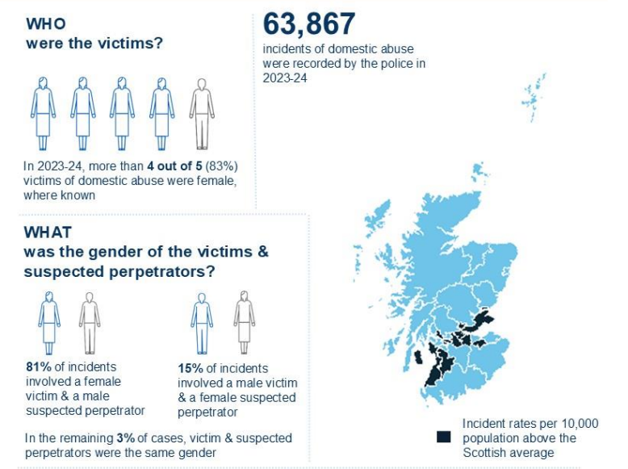
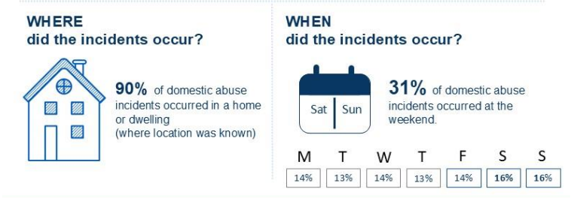
The police recorded 63,867 incidents of domestic abuse in 2023-24, an increase of 3% compared to the previous year.
It is estimated 3 women are murdered every week in the UK by an intimate partner.
Crimes recorded under the Domestic Abuse (Scotland) Act 2018 accounted for 5% of crimes and offences recorded as part of a domestic abuse incident in 2023-24.
Domestic Abuse remains one of the most under reported crimes in Scotland – so these numbers are just the tip of the Iceberg

Slide 12
GWA Numbers
Women’s Service: 1384 were referred to GWA during this reporting period which is a 14% increase on the previous year. Only 2.7% of those referred did not receive support from our service for various reasons.
Children and Young People’s Service: 101 children aged between 5 and 18 were referred to our dedicated CYP service which is a 14% increase on the previous year. Of these referrals only 2.9% did not receive support, with the main reason documented as waiting time.

Slide 13
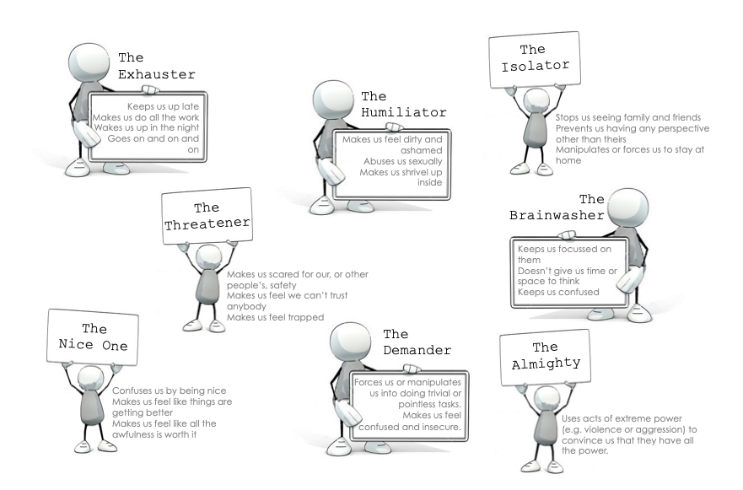

Slide 14
Six Stages Women Experiencing Violence Go Through
1 Managing the Situation
The point at which violence is first experienced is a crisis for the relationship between the woman and the perpetrator, and although some women end relationships at this point, the majority do not. They find, or accept, an explanation for the incident which allows for a future. They develop strategies to manage the situation and incidents of abuse.
2 Distortion of Perspective/Reality
Gradually more and more of a woman’s daily life and thought processes are affected by violence. Managing anxiety, trying to make sense of ‘why?’, takes up her energy and attention. Answering ‘why?’ often involves her taking responsibility. Coping is increasingly focused on trying to do and not do certain things, or defiantly acting certain ways knowing the consequences. Either approach means repeated abuse can be understood - by herself and others – as yet again, her responsibility.
3 Defining Abuse
It is often only after a number of assaults that women define the abuse as violence. This is not just about using the word violence, but locating herself as someone being victimised and the man as someone who is an abuser and events understood as a recurring feature.
4 Re-evaluating the Relationship
Once the relationship is understood as one in which abuse/violence occurs a re-evaluation process begins. Decisions take place in a changed context of meaning. The possibility of leaving temporarily or permanently, of engaging formal process to contain violence, becomes easier to contemplate.
5 Ending the Relationship
Most women make many attempts to end violent relationships and the reasons for returning include believing promises to change; the absence of acceptable, practical alternatives; pressure from others; the absence of effective protection.
6 Ending the Violence
Contrary to popular myth, ending a relationship does not always ensure the violence ends, it may in fact place women at greater risk of serious, and even fatal assault.

Slide 15
Intersectionality's and complexities for survivors
Why Doesn’t She Leave
Victim Blaming

Slide 16
Best Practice Response

Slide 17
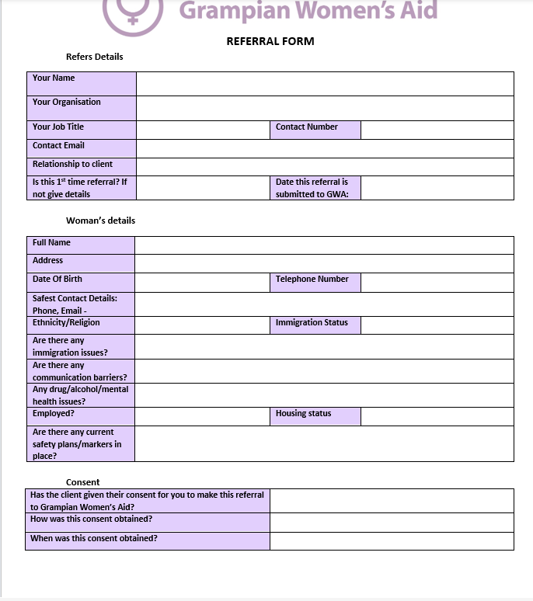
Referral Routes
Send in a completed referral form
Call us – 01224 593381
Email – referrals@grampianwomensaid.com

Slide 18
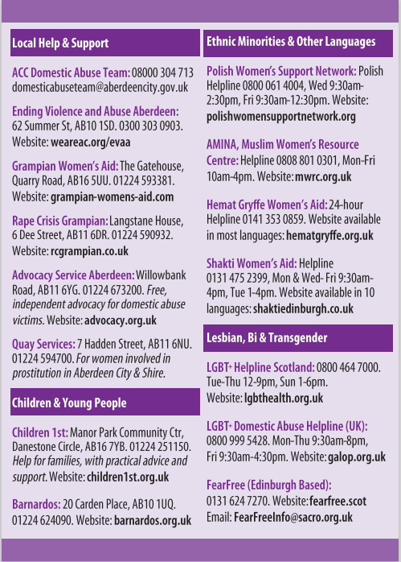
Local Support Out with GWA

Slide 19
What about the men?
Cyrenians EVAA Service – 0300 303 0903
DAT Team - 0800 030 4713
Men’s Advice Line – 0808 801 0327
AMIS - 03300 949 395
www.respect.uk.net

Slide 20
Interactive exercise

Slide 21
‘Pressing charges’ + ‘dropping charges’
Not like the TV!
Charges are a matter for the Crown Office and Procurator Fiscal Service
In Scotland, complainers cannot ‘press’ or ‘drop’ charges – charges are solely for the Crown Office and Procurator Fiscal Service. Not like other countries…
Views taken into consideration but not determinative.

Slide 22
Burden of proof
On Crown
Beyond reasonable doubt – very high standard.
The type of doubt that is based on reason.
A not proven/not guilty are both verdicts of acquittal.
The legal implications are exactly the same.

Slide 23
Difficulties in prosecution of domestic cases
Corroboration – requirement that there are two independent sources of evidence
Complainer may stop supporting prosecution
Other witnesses may have lifestyles which make attending court and giving evidence challenging

Slide 24
Victim Information Advice (VIA)
Once an accused appears in court, the complainer will be written to by VIA with dates in relation to court and also a note of the accused’s status – remanded or bailed etc.
The complainer can discuss options for giving evidence with VIA
VIA will keep the complainer updated throughout the life of the case – by call, text, email or letter depending on their preference
VIA will update the complainer on the verdict and outcome of case

Slide 25
Being a witness
Clinical staff may be asked to give evidence regarding injuries – often this can be agreed once we have medical records
Anyone encountering the public could give evidence regarding seeing someone in distress
May see additional relevant signs of abuse – for example, unlikely explanations for injuries

Slide 26
What can the court do?
Fine
Structured Deferred Sentence
Compensation Order
Community Payback Order – may include Caledonian Scheme
Custodial Sentence
Non Harassment Orders – can make recommendations but matter for Sheriff. Duration matter for Sheriff also.
Victim Impact Statements

