Slide 1
Operation Iris Progress against key objectives and milestone summary
January 2022
OBJECTIVES
A. Keep staff safe & help them to maximise wellbeing
B. Responding to demand on the health & care system
C. Protecting critical services & reducing harm

Slide 2
Contents
Executive Summary
Objective A: Keep staff safe & help them to maximise wellbeing
Objective B: Responding to demand on the health & care system
Objective C: Protecting critical services & reducing harm
Performance – compared to RMP4 milestones and trajectories

Slide 3
Executive Summary
Introduction
The purpose of the report is to enable the Board to review progress against the three key objective for Operation Iris and a comparison with the milestones and trajectories included with Remobilisation Plan (v4).
Context
As reported at the December Board meeting the challenges impacting on health and social care at this time are:
The winter pressures which peak during the months January to March
Continuing to operate within reduced bed capacity due to requirement to meet clinical standards in a COVID environment
The Impact of the Omicron COVID variant (alongside the Delta variant) of both patients and loss of staff due to high community spread.
Whilst the impact of winter and reduced capacity will remain until the spring, there are indications that community spread of Omicron, combined with uptake of the booster vaccinations, is resulting in a levelling off of the impact on hospital and ICU admissions. The steps we have taken under Operation Iris will continue to support our operational response, alongside our intelligence led modelling of the impact of COVID as community prevention measures are relaxed in the coming weeks.
Keep staff safe & help them to maximise wellbeing
The impact on our staff has been significant with the COVID response now having been in place for 2 years. To meet service requirements and address staff health and wellbeing we have established a dedicated workforce cell to co-ordinate the staffing of services and to oversee the We Care programme. With increasing spread of the Omicron variant we have had a higher level of staff absence in recent weeks due to staff requiring to isolate. This together with increasing activity due to winter pressures has been a significant challenge which has been managed through our established cross system working. The We Care programme continues to provide a wide range of support to staff and the most recent summary report is presented in the pack.
B. Responding to demand on the health & care system
All services across health and social care are operating at higher levels (relative to available capacity) than in prior years. Occupancy in our main hospital sites is on average about 95%, with similar high levels being experienced in community hospitals and care homes.
Similar pressures are being experienced in primary care and in the community, where there has been an increase in the number of hours of care that have been unable to be provided. The Grampian Operational Escalation and Pressures System is used to assess the system pressures and inform our whole system daily response meetings.
C. Protecting critical services & reducing harm
Since the last Board meeting, we have had a drop in performance against the 4hr target within our Emergency Departments. This has however improved in recent days due to support in terms of managing flow and additional capacity in the ED departments and support from our key partners. The support from the military has been a welcome and key element of our response.
Despite challenges around capacity, we continue to maintain access for emergency surgery and planned elective surgery for priority patients. The number of procedures that have been undertaken over January are higher than the comparable period last year.
In terms of access to Child and Adolescent Mental Health service we consistently remain above the national target and activity levels are higher than we had projected.
Remobilisation Plan milestones and trajectories
Whilst the remobilisation plan assumptions have changed in light of the impact of Omicron we have included in the pack a summary of our performance against the key milestones and trajectories.

Slide 4
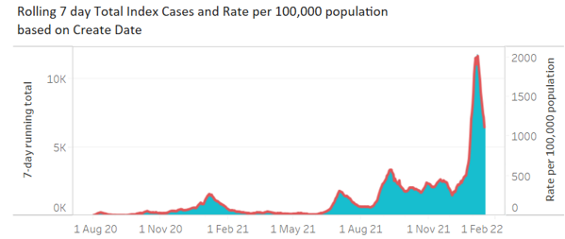
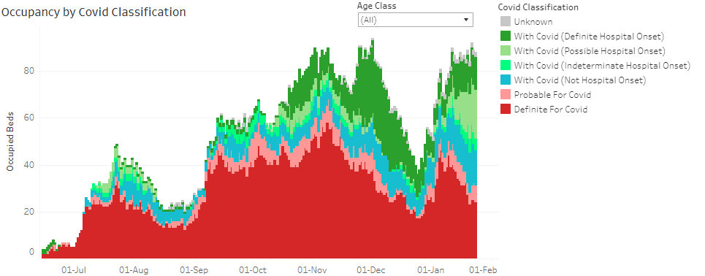
Covid cases across Grampian and Hospital Occupancy
Case numbers may be peaking and may be starting to drop
However, positivity rate remains high and caution as further COVID measures are relaxed.
Whilst there are very positive signs of the Omicron variant starting to diminish on a country wide basis it should be noted that the ongoing occupancy in our hospitals remains at some 90 patients.
The graph shows the very long and enduring high occupancy in our hospitals since October 2021.

Slide 5
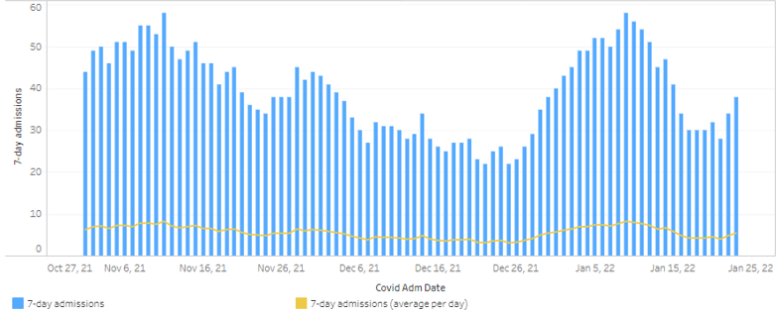
Reminder of where we are in terms of admissions ‘for’ COVID
Admissions “for” COVID
10 days ago, we had about 629 cases and had passed the apparent peak
It takes around 10 days before cases convert to admissions ‘FOR’ COVID

Slide 6
Objective A
Keep staff safe & help them to maximise wellbeing

Slide 7
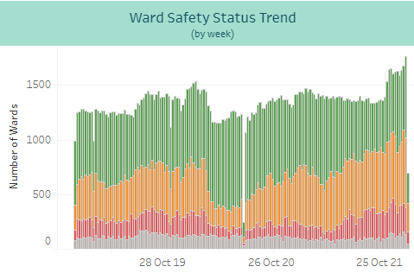
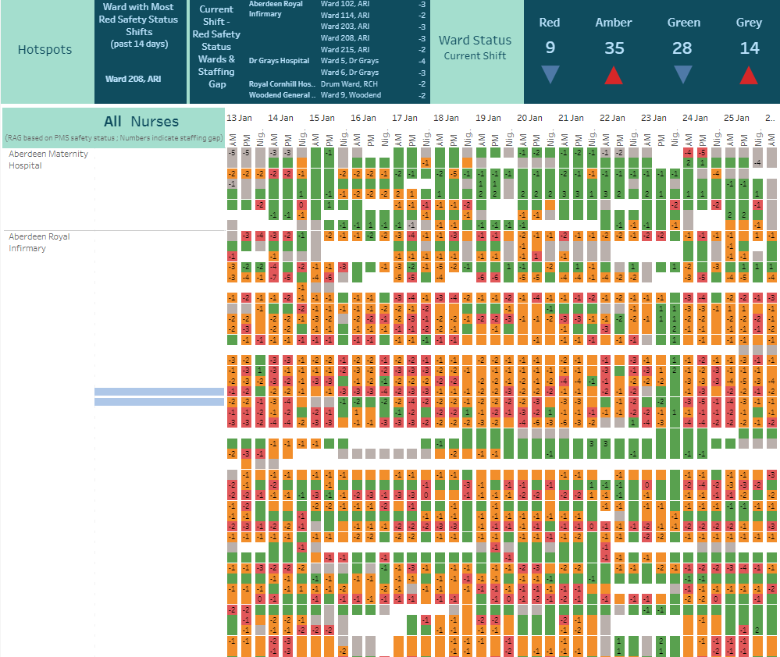
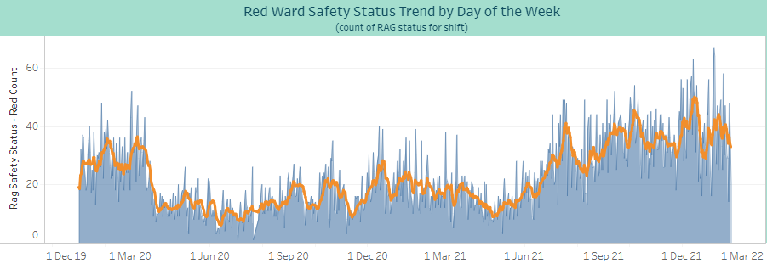
Ward Nurse Staffing (Registered & Unregistered)
The current data shows a slightly improved position but highlights that in a number of key areas there are gaps which are being supported by additional hours or redeployment of staff
The trend data continues to show a high proportion of wards (around 50%) with a red or amber RAG status
* Data sourced from PMS – snapshot taken 0810 26 January 2022

Slide 8
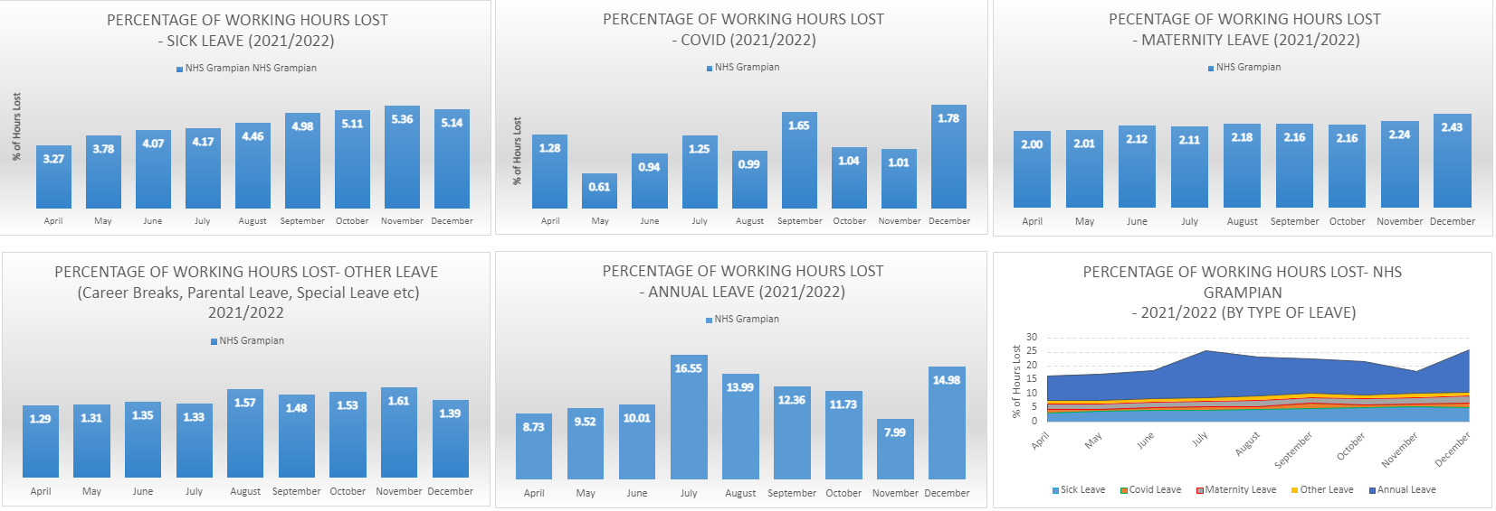
Staff absence to December 2021
* Charts updated on 20th of each month from SSTS – Last update 18th January 2022
Overall absence 25.72% in December, the highest for 2021/22 to date
1.78% hours lost to Covid in December, the highest level in 2021/22.
Sick leave fell slightly in December but remains at higher levels. Q3 2021/22 sick leave was 40% higher than Q1 2021/22
Data Source: NHSG Workforce Intelligence Team Data excludes staff vacancies

Slide 9
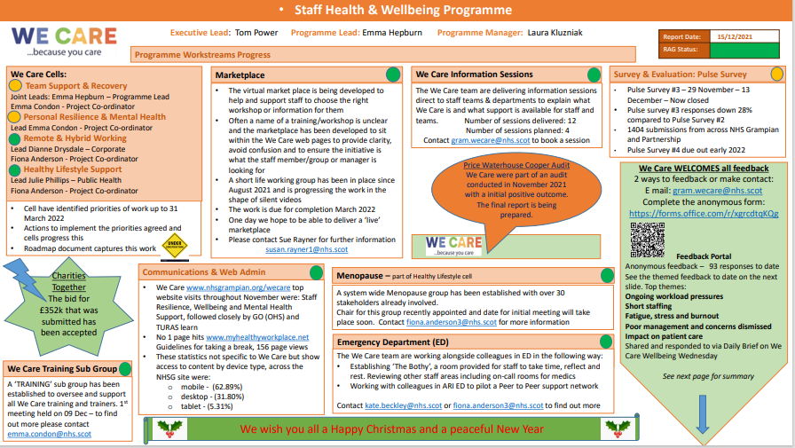

Slide 10
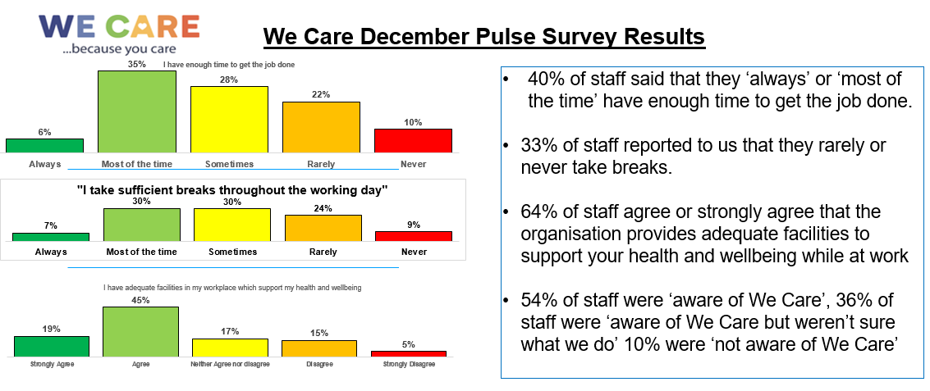

Slide 12
Objective B
Responding to demand on the health & care system

Slide 13
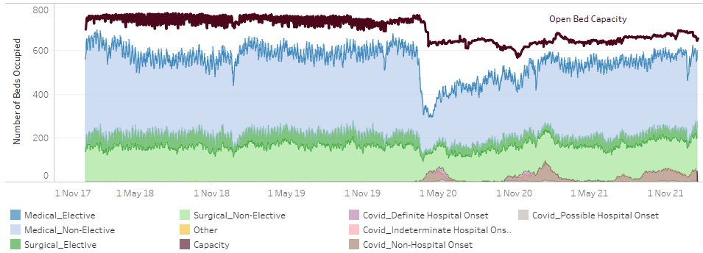
Bed pressures within ARI: Occupancy remains at very high levels
ARI trend at 18 Jan 16:40
ARI snapshot 26 Jan 08:15
All wards types remain at red RAG status and are at higher occupancy than last week (with the exception of ICU)

Slide 14
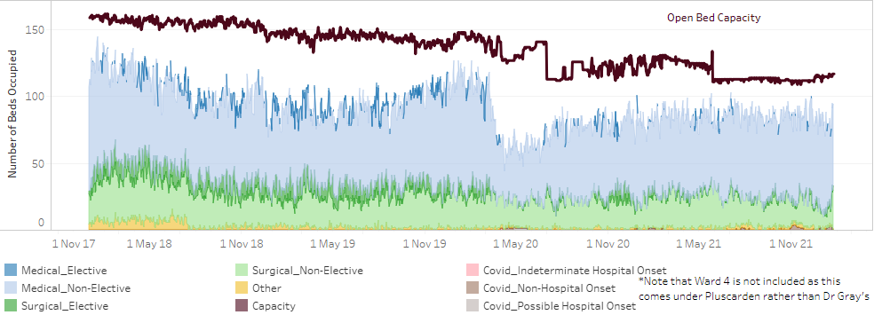
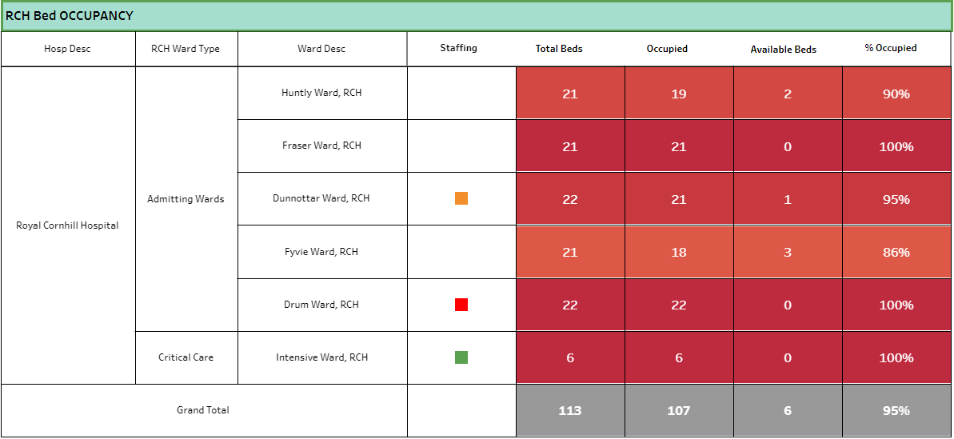
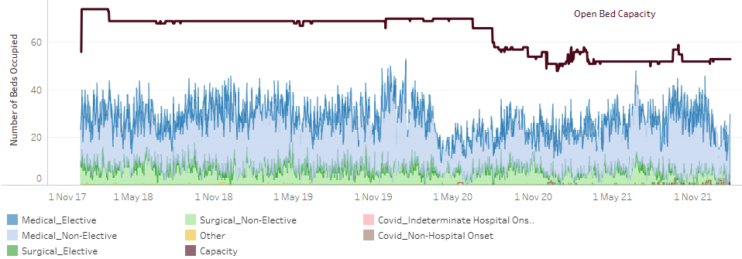
Dr Gray’s, RACH and Cornhill Occupancy
Dr Gray’s
Dr Gray’s and Cornhill occupancy levels remain very high
RACH continues to appear to have reasonable bed capacity available
Dr Gray’s trend at 25 Jan 16:40
Cornhill
RACH
Cornhill snapshot at 26 Jan 08:56
RACH trend at 25 Jan 16:40

Slide 15
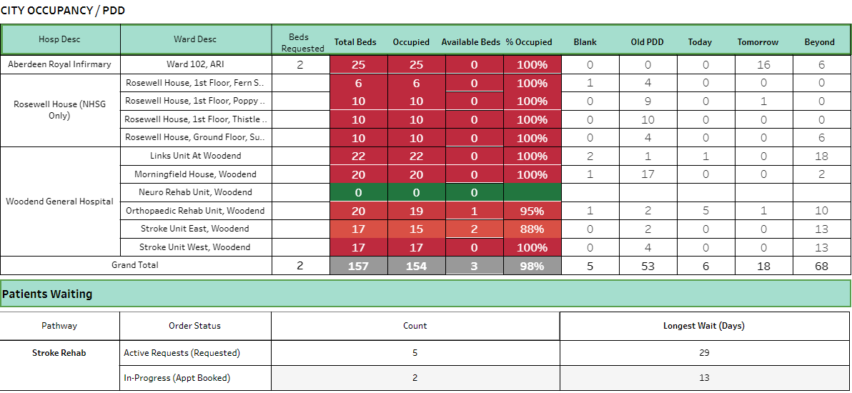
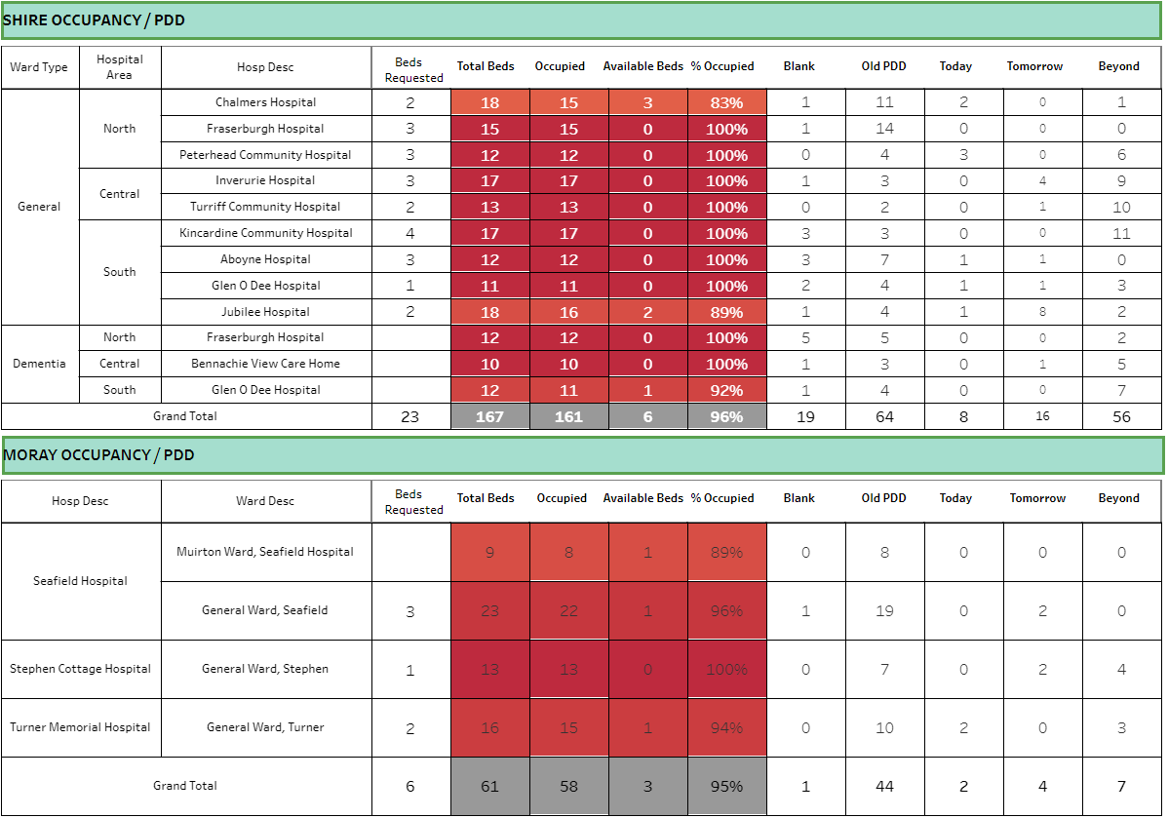
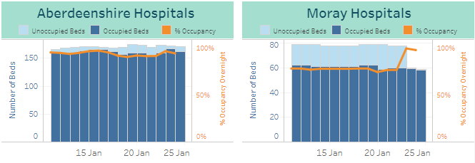
Community Hospitals Occupancy – very high levels of occupancy over a period of time
Snapshot - 26 January 08:55
Aberdeen City Occupancy is at 98%
Aberdeenshire Occupancy is at 96%
Moray Occupancy is at 95%
Shire Hospital Occupancy trend dipped slightly at the end of last week but has risen again to around 95%
Moray Hospitals occupancy trend remains at around 100%

Slide 16
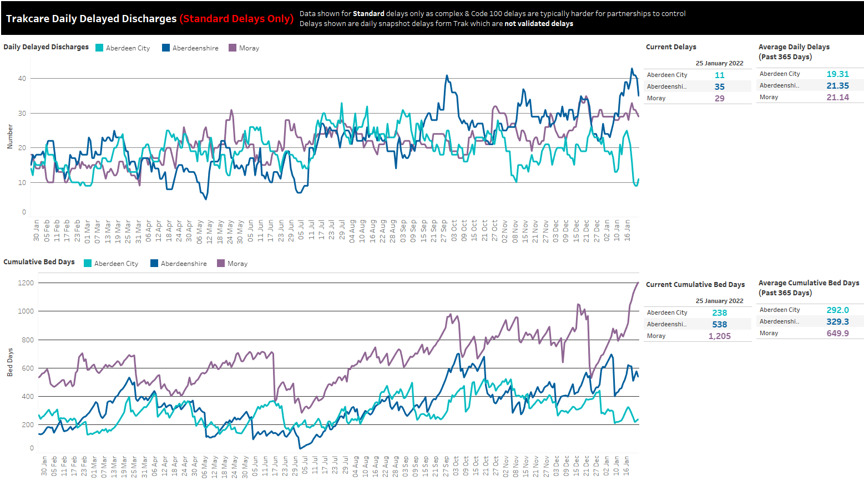
At 25th Jan:
Current delays remain much higher than average in Aberdeenshire and Moray, with a recent spike in Aberdeenshire which is now trending back down. City delays are below average.
Cumulative bed days remain higher than average in Aberdeenshire and Moray, City bed days below average.
Clear rise in Moray this week

Slide 17
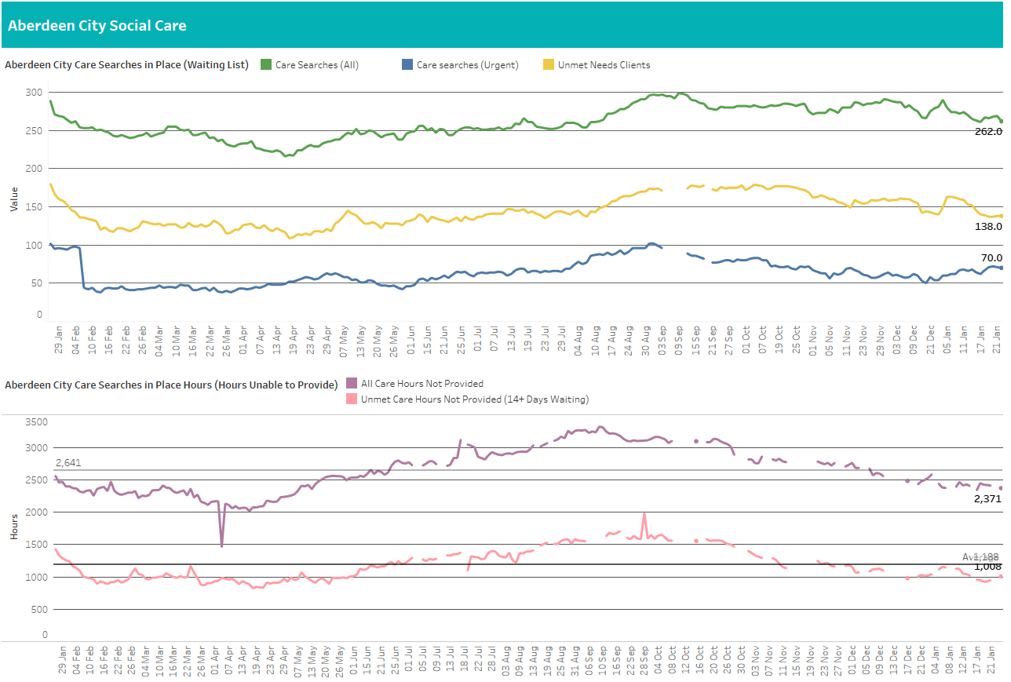
At 24 Jan: Fairly Stable
High numbers of clients waiting for care since last week (down 5, now 262), and above average for the year (261)
Clients waiting over 14 days also down 1 since last week, now 138, now below an average of 144 clients
Urgent care searches, currently at 70, above average of 63 clients
Weekly unprovided hours now 2,371 down 78 since last week and below the average of 2,644 for the year
1008 unprovided hours for clients who have waited over 14 days, up 58 since last week and below the average of 1,188 for the year

Slide 18
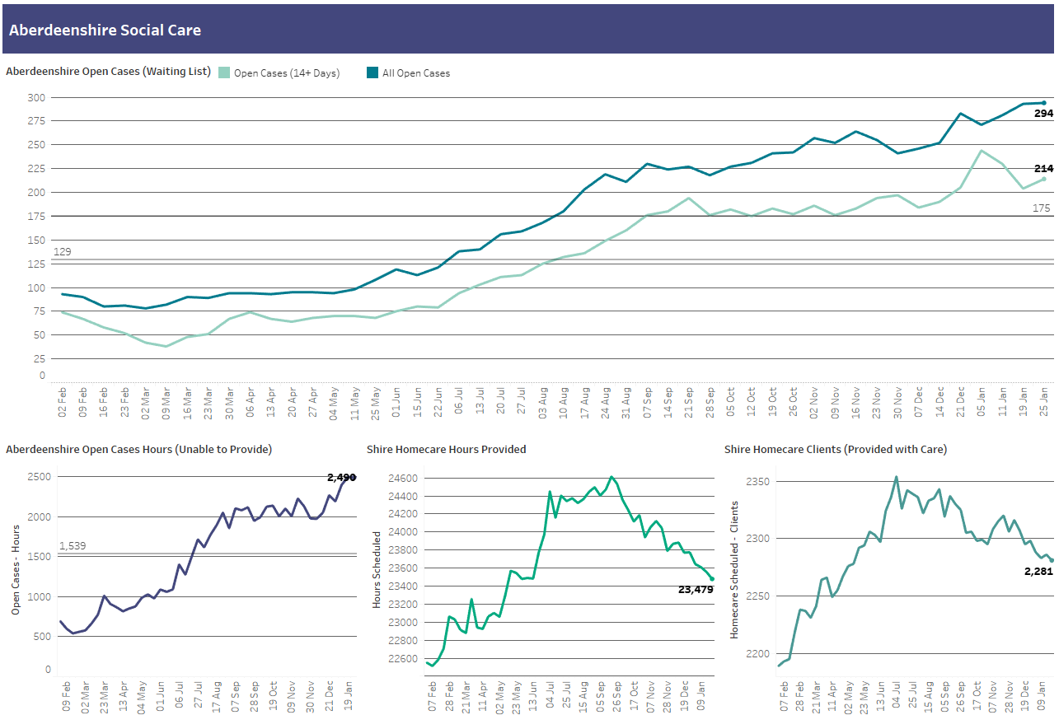
At 25 Jan:
Number of clients waiting for care is high at 294, up 1 from last week; 68% above average for year (175)
214 clients waiting over 14 days, defined as unmet need (up 10 from last week) but 66% above the average for the year (129)
Weekly unprovided hours down 6 to 2,490 and 62% above average for the year (1,539)
77 fewer hours provided to 5 fewer clients compared to last week

Slide 19
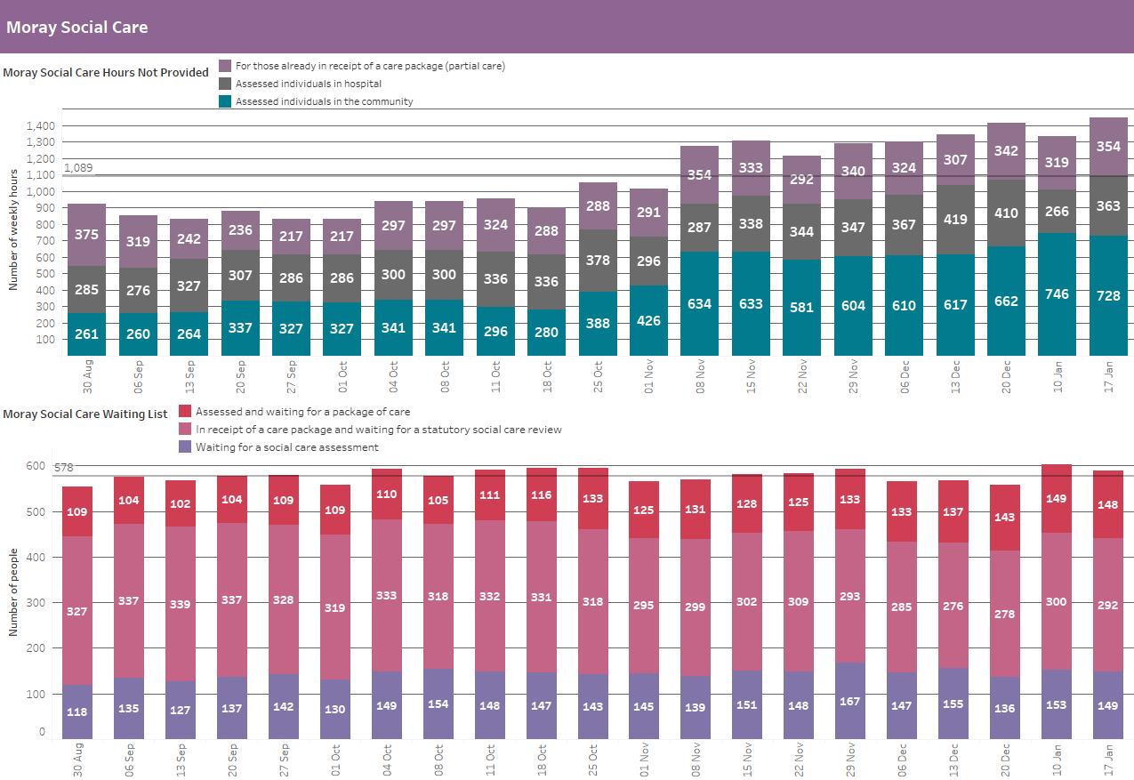
At 17 Jan:
Care not provided in the community rose by nearly 50% in early November, and with recent growth, now at 728 weekly hours
1,445 total hours not provided per week (up 114), and above an average of 1,089 since Aug
148 clients assessed, but waiting for care (down 1), above average of 122 since Aug
292 clients awaiting review (down 8), below average of 312
149 clients waiting for a social care assessment (down 4), above average of 144

Slide 20
Objective C
Protecting critical services & reducing harm

Slide 21
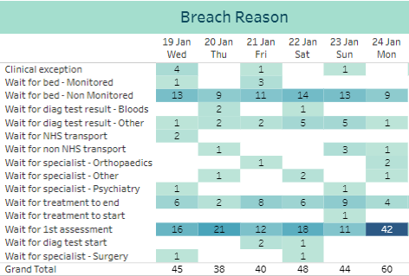
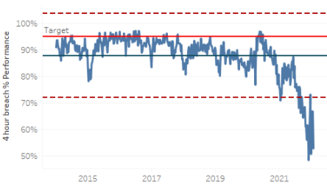
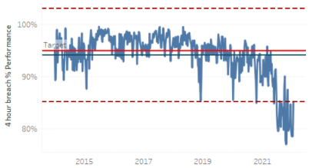
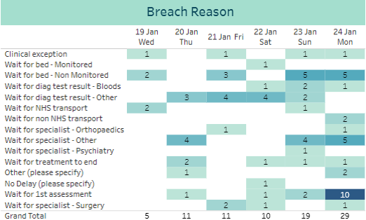
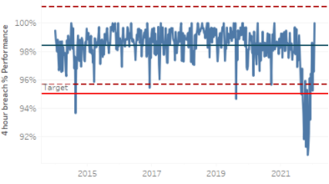
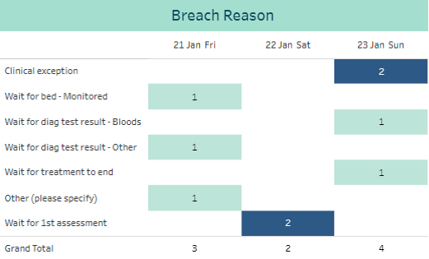
A&E Performance
ARI
Performance on 24/01 was 55%, a decrease from 59% on 18/01
Dr Grays
Performance on 24/01 was 63%, a decrease from 86% on 18/01
RACH
Performance on 24/01 was 100%

Slide 22
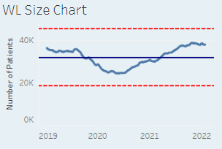
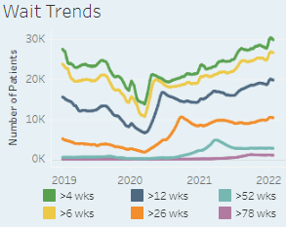
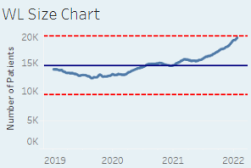
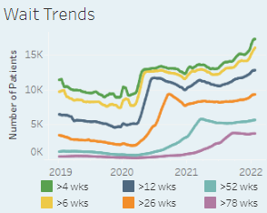
Waiting Times Overview
Outpatients (consultant-led)
Inpatients
The list size has increased by 91 patients since last week, and the slight fluctuations in recent weeks indicate a plateau level
The proportion of patients waiting over 12 weeks continues to fall, reducing from 52.3% to 51.9%
18 of the top 20 longest waiting patients are for GP Minor Surgery, 1 is for Plastic Surgery, and 1 for Neurology.
The longest waiting patient this week is a GP Minor Surgery patient waiting 1104 days
The list size continues its upwards trend, with an increase of 225 patients since last week’s report
The proportion of patients waiting over 12 weeks has remained constant at 66.2%
Of the top 20 longest waits, Urology accounts for 8, Plastic Surgery for 6, General Surgery 4 and Gynaecology for 2 patients.
The longest waiting patient this week is a Plastic Surgery ESCatS 3 patient waiting 1699 days

Slide 23
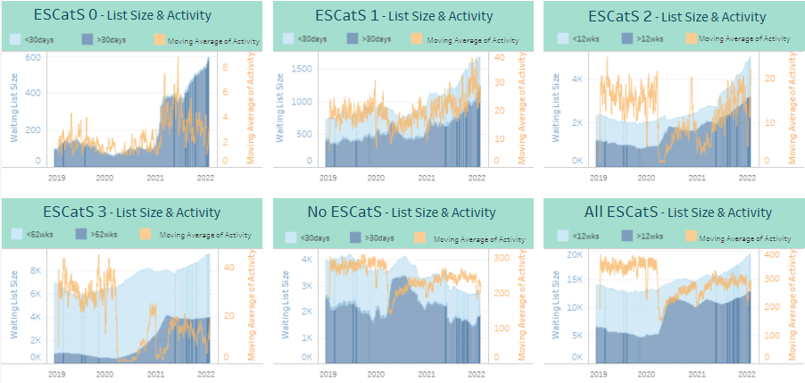
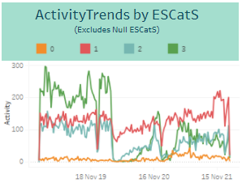
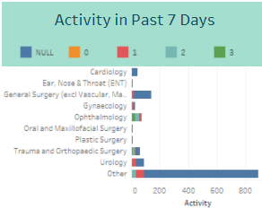
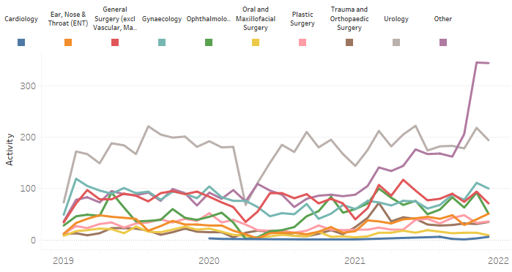
ESCatS Performance
ESCatS 0&1 Activity Trend
ESCatS 0&1 Waiting List size continues to increase across most specialties
The specialties causing the greatest increase in the EScatS 0&1 Activity 0ther category are Clinical and Medical Oncology.

Slide 24
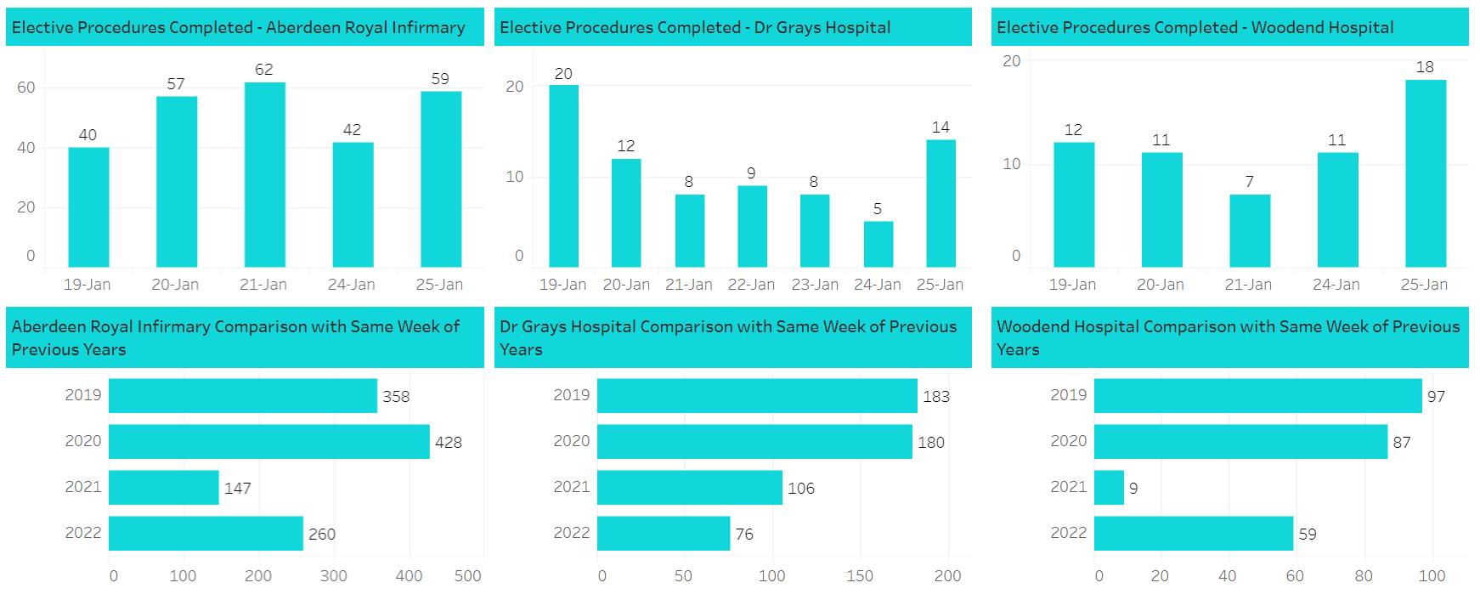
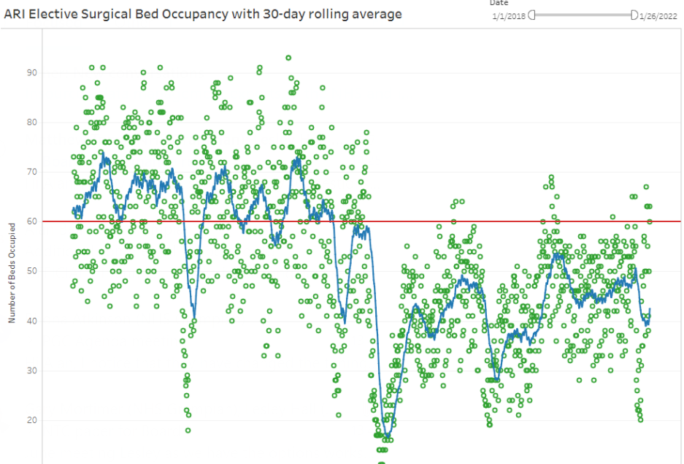
Surgical activity and capacity
Whilst the number of procedures being undertaken is less than pre-COVID, the activity is higher than during Operation Snowdrop last winter.
The tables to the left set out the activity undertaken during the last week, which reflects the position throughout January in comparison to prior years.
Bed capacity for elective surgery remains at levels significantly below pre-COVID levels but slightly higher than last winter.
The Operation Iris plan was based on a commitment to protecting access to surgical beds for both emergency and elective procedures.

Slide 25
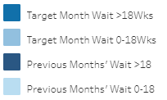
Mental Health Performance
Performance consistently meeting 90% target through 2021, with the exception of April.
Referrals at a consistent level of around 340 per month from September through to December
Performance remains amongst the highest in Scotland.
Percentage Compliance of all Psychological Therapies Patients Treated by Month
Performance just below the 90% target.

Slide 26
Remobilisation Plan (v4)
Quarterly progress report

Slide 27
Grampian RMP4 Milestone Progress Report (End of Dec 2021)
Aim of Report
To provide an overview of progress and highlight key risks/concerns in relation to delivery of the milestones set out within the agreed NHS Grampian Remobilisation Plan for 2021/22 (RMP4). Reports are submitted to the Chief Executive Team (CET) Oversight Boards on a monthly basis for exploration of key risks/concerns and provide the CET with the necessary assurance and oversight. A report is submitted to the Board via Performance Governance Committee and quarterly updates to the Scottish Government. Detailed information on progress against each milestone is contained within the accompanying Delivery Plan document.
Status of Milestones at 31st Dec 2021 (Quarter 3)
71% of the 441* milestones set out in the RMP4 for delivery by the end of March 2022 were completed or on track to be completed as of end of December 2021.
Delivery Against Projected Delivery of Trajectories at End Quarter 3
Summary of Quarter 3 position contained within next page. There has been continued positive trends in delayed discharges, CAMHS, emergency admissions, emergency length of stay and reduced A&E admissions. The following areas have deviated negatively from projected position:
4 hour standard predicted 89% vs. actual was 72% – work continues with the 90 day improvement collaborative
31 and 62 days cancer actual % rate lower than predicted (see overleaf)
Outpatient and TTG in a small number of specialities (see overleaf)
Key Achievements & Learning
G-OPES went live supporting real-time overview of pressures and facilitating real-time whole system decision making.
Whole system response to increased COVID incidence and the impacts of this on staff and the population. Staff have continued to go above and beyond to maintain delivery of services and respond to needs.
Real-time data and modelling have been key in supporting decision-making, agile planning and re-prioritising resources in light of the continuously changing picture of COVID, winter pressures and supporting delivery against Q3 RMP4 objectives.
Key Areas/Risks Affecting to Delivery
Of the 129 milestones reporting delay (minor/significant), the key themes resulting in this are:
Increasing system/winter pressures on services/staff
Staff absences, along with the need to deploy staff to maintain critical/protected services
Availability of funding for some areas
Slowing of local/national workstreams due to pressures
Detail on these are contained within the Delivery Plan submitted.
There are significant risks affecting delivery during Quarter 4 due to the impacts of the Omicron Wave which will reduce ability to deliver any actions other than those which are related to maintaining priorities set out in John Burns letter dated 10/12/21.
Next Steps & Focus for Quarter 4
Delivery will in the main focus on Operation Iris and the following 3 objectives within RMP4:
Keep staff safe & help them to maximise wellbeing
Responding to demand on the health & care system
Protecting critical services & reducing harm.
Monitor and as required, enact Omicron Surge Plan, based on triggers relating to high levels of staff absence and/or significant surge in demand.
Understand current health debt on population, services and the impact on our staff in light of current Omicron Wave
Review position and re-prioritise delivery of RMP4 milestones during March to focus Q1 of 2022/23 and inform recovery, re-mobilisation and renewal as part of 3 year Delivery Plan due July 2022.
Total Milestones: 441
Milestones Progress: | Sept-21 | Oct-21 | Dec-21
Complete | 8 | 24 | 86
On Track | 169 | 248 | 226
Minor Delay | 40 | 74 | 94
Significant Delay | 15 | 35 | 35
Unknown | 2 | 2 | 0
Proposal | 2 | 1 | 0

Slide 28
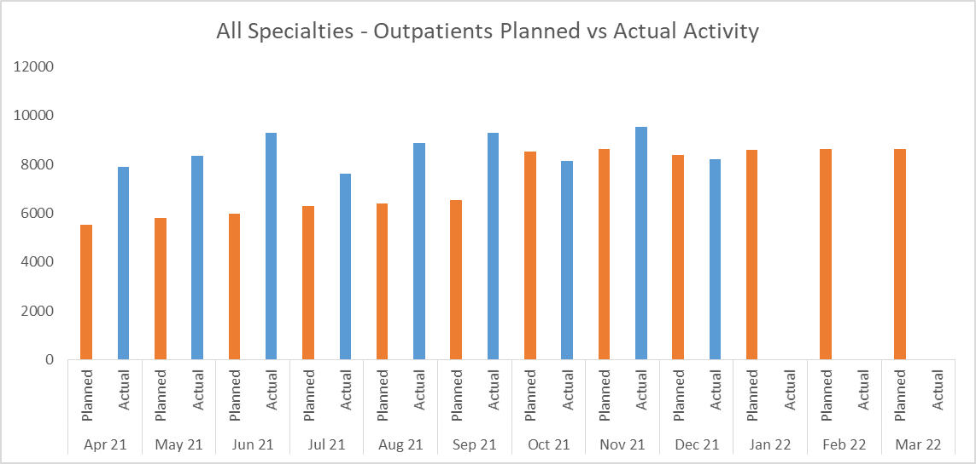
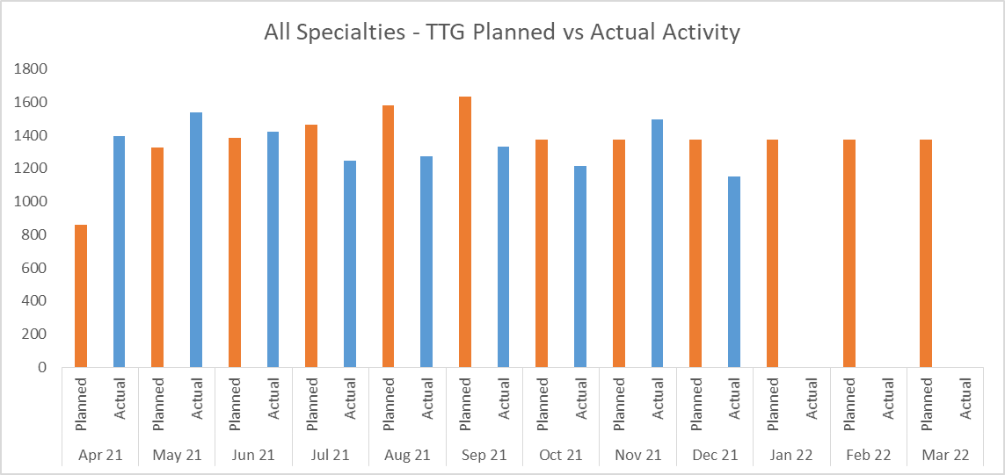
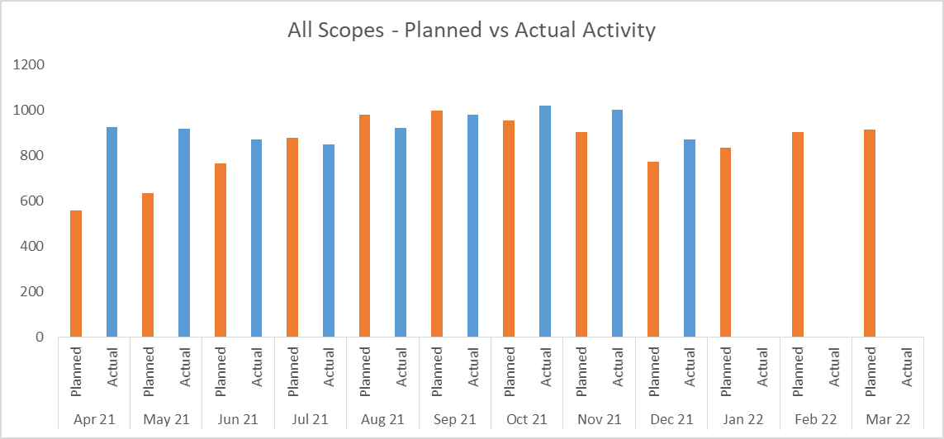
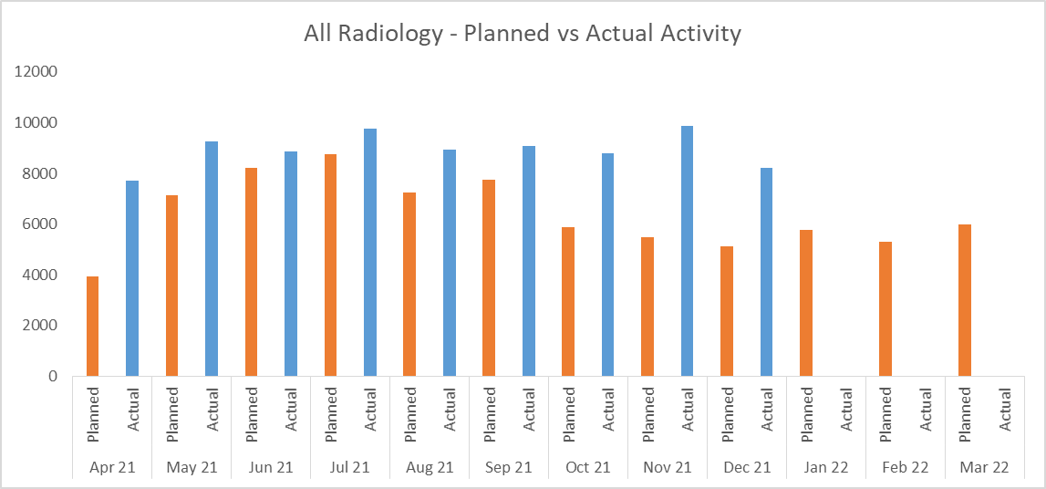
Grampian Updated Position on RMP4 Projections (End of Dec 2021)
Projections (Refer to Definitions datasheet) | Quarter 2 - 2021/22 |  | Quarter 3 - 2021/22
 | Projection | Actual | Projection | Actual
 | Quarter ending 30/09/2021 | Quarter ending 30/09/2021 | Quarter ending 31/12/2021 | Quarter ending 31/12/2021
A&E Attendances (Definitions as per Core Sites, unplanned attendances only) | 27,800 | 27,024 (↓ ) | 27,200 | 24,910 (↓ )
A&E 4-Hour Performance (%) (Definitions as per Core Sites, unplanned attendances only) | 91% | 79% (↓) | 89% | 72% (↓ )
Total Emergency Admissions (Definitions as per RAPID Datamart used in System Watch) | 12,240 | 11,978 (↓ ) | 12,730 | 10,972 (↓ )
Total Emergency Admission Mean Length of Stay (Definitions as per Discovery indicator attached) | 6.4 | 5.6 (↓ ) | 6.4 | 5.28 (↓ )
31 Day Cancer – Decision to treat to first treatment (Definitions as per published statistics) | 97.80% | 94.60% (↓ ) | 98.60% | 90.61% (↓ )
62 Day Cancer - Referral to First treatment (Definitions as per published statistics) | 83.50% | 77% (↓ ) | 87.50% | 72.45% (↓ )
CAMHS - First Treatment Appointments (patients treated within 52 weeks of referral)(Definitions as per published statistics) | 290 | 391 (↑) | 268 | 372 (↑)
CAMHS - Backlog First Treatment Appointments (patients treated after waiting 52+ weeks, if applicable) (Definitions as per published statistics) | 0 | 0 (=) | 0 | 0 (=)
CAMHS - Performance against the 18 week standard (%) (Definitions as per published statistics) | 90.30% | 95% (↑) | 90.30% | 95% (↑)
Psychological Therapies - First Treatment Appointments (patients treated within 52 weeks of referral) (Definitions as per published statistics) | 3,210 | 1,807 (↓ ) | 3,460 | 1,857 (↓ )
Psychological Therapies - Backlog First Treatment Appointments (patients treated after waiting 52+ weeks, if applicable) (Definitions as per published statistics) | 165 | 67 (↓ ) | 170 | 42 (↓ )
Psychological Therapies - Performance against the 18 week standard (%) (Definitions as per published statistics) | 90% | 89% (↓ ) | 90% | 87% (↓ )
Delayed Discharges at Month End (Total Delayed Discharges of Any Reason or Duration, per the Definition for Published Statistics) | Month ending 30/09/2021 | Actual Month ending 30/09/2021 | Month ending 31/12/2021 | Actual Month ending 31/12/2021
City: . | 20-25 | 32 (↑) | 20-25 | 19 (↓ )
Shire: . | 20-25 | 49 (↑) | 20-25 | 35 (↑)
Moray: . | 28 | 30 (↑) | 34 | 36 (↑)
Summary of Planned vs Actual Activity (Elective Care)
Key Negative Variances by Specialty
12 Weeks Outpatients Trajectory
Neurology
Gynaecology
Pain Management
52 Weeks Outpatients Trajectory
Urology
General Surgery
Diagnostics
MRI (6 weeks waits)
Cystoscopy (>52 week waits)
12 Weeks TTG
Urology
ENT
Ophthalmology
TTG
Trauma & Orthopaedics
Ophthalmology
NOP Activity
Dermatology
For further detailed breakdown by speciality, please see monthly Template 2 & 3 returns to Scottish Government sent TBC date

