Slide 1
NHSG System Pressures
Appendix 1
Data as at 9 November 2022
NHS Grampian Health Intelligence – Management Information

Slide 2
Weekly system summary update
GOPES metrics | The system was at level 4 for 25% of the week to 08/11, a similar level to the week prior. MUSC reported level 4 on the majority of occasions in the last week
Staff absences | After the small rise in early October, Covid-positive absences now appear to be trending down. Following the school holiday period, annual leave has decreased in the last week, and all other leave types are also decreasing. A reminder that caution should be applied to the most recent weeks’ data as there is a lag in absence data being input
SAS Turnaround Times | The 90th percentile turnaround time fell at ARI to 143 minutes, and at Dr Gray’s to 96 minutes. 11 ambulances were waiting at ARI at 4pm on Thursday 3rd November; the Call Before You Convey 4 week test of change started at 9am on 21st October
A&E Performance | Weekly 4-hour performance improved to 58.6% at ARI, and to 91.5% at RACH; Dr Gray’s performance fell to 69.7%. 8- and 12-hour breaches increased at Dr Gray’s but are at lower levels than observed during the first three weeks of October
Elective care | The Outpatient list size has decreased, to its lowest level since mid-August; the number of patients waiting over 104 weeks has increased for the fourth consecutive week. The TTG Inpatient list size has increased for the tenth consecutive week; the proportion of unavailable patients is now at the lowest level since early June; the number of patients waiting over 104 weeks has increased slightly
Cancer | Not updated this week
Mental Health | Not updated this week
Ward safety status | Proportion of wards reporting a red or amber RAG status decreased to 47.5%. Red RAG status reports increased slightly from the previous week to 19.3%, continuing the higher levels observed since mid-September
Hospital bed occupancy | Remains at very high levels across NHSG estate with some areas at, near, or above 100%. At 09/11, 17 patients in ICU (no Covid patients). The maximum number of beds available to use across all Grampian hospitals has increased slightly to 1816 (Dr Gray’s and Moray bed numbers remain under review)
Care home occupancy | Continues at high but stable levels across Grampian. 2 homes closed to admissions and 3 with control measures in place. It should be noted that returns to TURAS have been falling.
Delayed Discharges | Place Availability bed days are extremely high and rising. Shire delays down from extreme high 2 weeks ago however still very high. Moray and City delays trending down but both above yearly averages.
Social care | Hours not provided have increased in Moray and decreased in Shire. City currently transferring to a new system and facing IT issues so no update since 4th October
Covid | Local case data shows a reduction in recorded positive tests however case numbers should continue to be interpreted cautiously. Hospital admissions and occupancy have been trending down since mid-October. As at 09/11, no Covid patients in ICU. Number of ward closures at 09/11 due to Covid is 3
Flu | Grampian incidence rate remains below the Scotland-wide rate; the Scotland-wide rate is slowly increasing and remains higher than at the same week in pre-Covid years
NHS Grampian Health Intelligence – Management Information

Slide 3
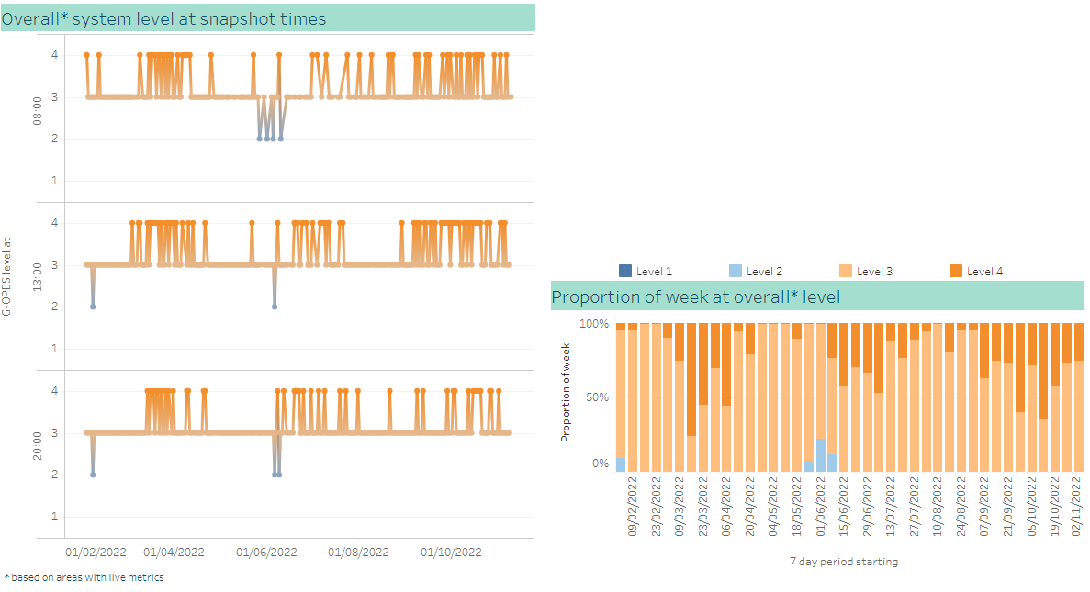
Overall G-OPES system pressure metrics
Overall system at level 4 for 25% of the last week
Over the last two weeks, the proportion of time the overall system has been at level 4 has fallen from recent highs, to 25%
MUSC reported level 4 on the majority of occasions in the last week
Royal Cornhill Hospital reported level 4 on multiple occasions in the last week
NHS Grampian Health Intelligence – Management Information

Slide 4
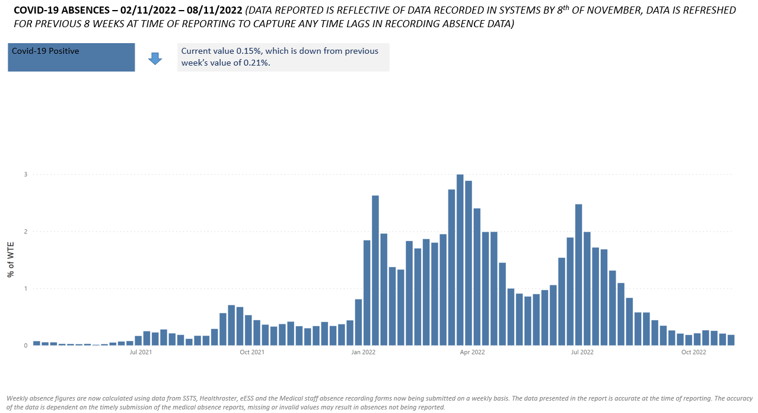
Workforce – COVID-19 absences
Indication of downward trend
From the 1st September current Covid special leave will be transitioned to sick leave (Covid related illness). From 1st September onwards only those with a new positive LFD will be granted special leave until such time as a test is negative, and then if the employee is still absent it will be recorded as sick leave.
As there is no longer a breakdown of the various Covid absence reasons, this chart now only shows Covid-19 positive absence data; all other Covid-19 related absences are included within sickness leave on the next page
NHS Grampian Health Intelligence – Management Information

Slide 5
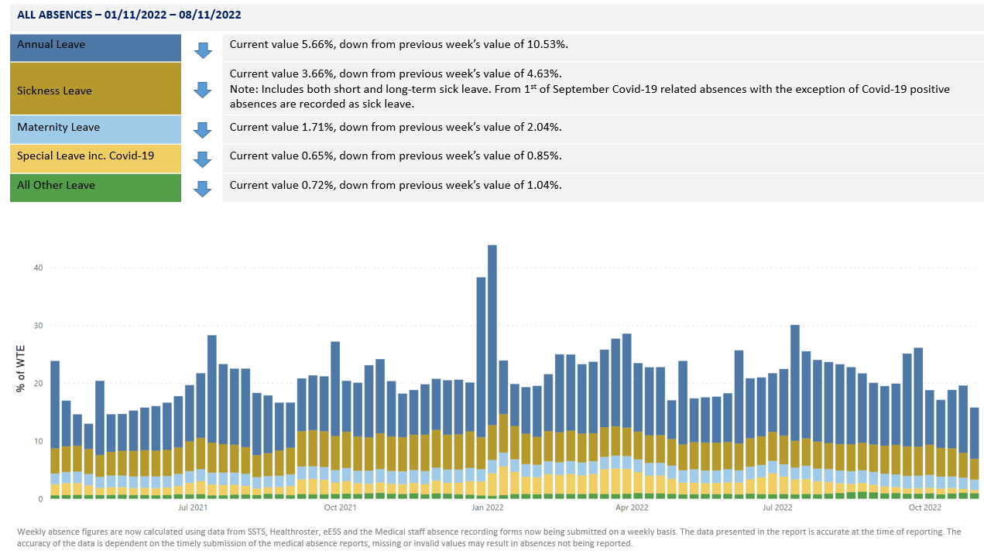
Workforce – all leave
Annual leave has decreased after the school holiday period; all other leave types decreasing
NHS Grampian Health Intelligence – Management Information

Slide 6
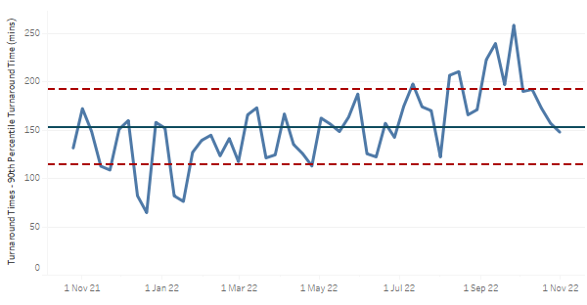
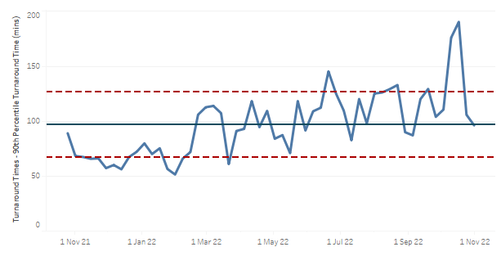
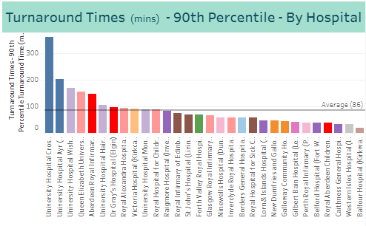
Scottish Ambulance Service turnaround times
90th percentile turnaround times have fallen at ARI and Dr Gray’s
ARI 90th percentile ambulance turnaround time fell for the third consecutive week, from 157 minutes to 148 minutes
Dr Gray’s 90th percentile ambulance has decreased from the high of 190 minutes reported a fortnight ago, to 96 minutes
ARI and Dr Gray’s 90th percentile ambulance turnaround times remain above the Scottish average (86 minutes)
NHS Grampian Health Intelligence – Management Information

Slide 7
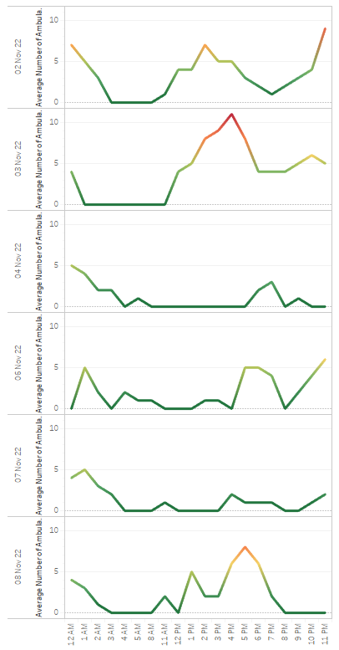
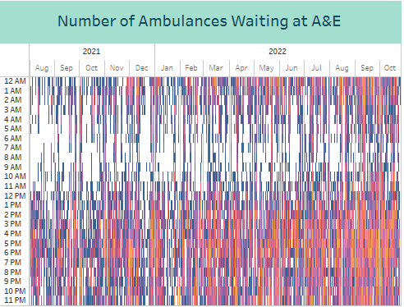
Ambulances Waiting at ARI
11 ambulances waiting at ARI on Thursday 3rd
In the last week, the number of ambulances waiting at ARI was highest on Thursday 3rd November with 11 ambulances waiting at 4pm
The daily peak of number of ambulances waiting continues to be at a generally lower level that we saw in early October; the Call Before You Convey 4 week test of change started at 9am on 21st October
NHS Grampian Health Intelligence – Management Information

Slide 8
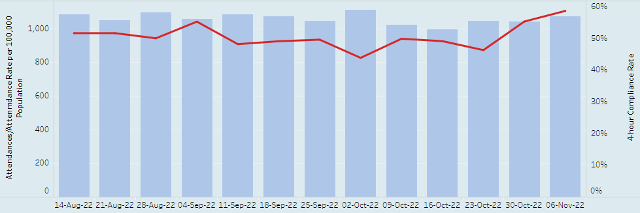
A&E 4 hour performance
Performance fell at Dr Gray’s; increase in 8- and 12-hour breachers at Dr Gray’s
ARI performance improved, from 55.3% to 58.6%, the highest weekly performance since early August
primary 4 hour breach reason remains ‘Wait for 1st assessment’
82 8-hour breaches in the last 7 days, a decrease from 133 the previous week
19 12-hour breaches in the last 7 days, an increase from 18 the previous week
Dr Gray’s performance fell, from 70.9% to 69.7%
primary 4 hour breach reason was ‘Wait for specialist - Other’
47 8-hour breaches in the last 7 days, an increase from 37 the previous week
18 12-hour breaches in the last 7 days, an increase from 15 the previous week
weekly 8- and 12-hour breaches at lower levels than observed during the first three weeks of October
RACH performance improved, from 91.2% to 91.5%, the fourth consecutive weekly increase
primary 4 hour breach reason remains ‘Wait for 1st assessment’
1 8-hour breach in the last 7 days, the same level as the previous week
no 12-hour breaches in the last 7 days, the same level as the previous week
NHS Grampian Health Intelligence – Management Information

Slide 9
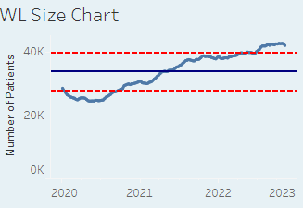
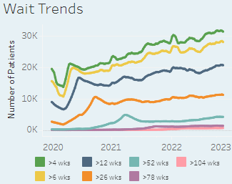
Elective Care – consultant-led Outpatients
Waiting list size has decreased
The list size has decreased by 614 patients since last week, the largest weekly reduction since mid-July, taking the list size to its lowest level since mid-August
The proportion of patients waiting over 12 weeks has increased fractionally, from 48.7% to 49.2%
The number of patients waiting over 104 weeks is 635 (1.51% of the waiting list), a slight increase from 629 the previous week (1.47% of the waiting list), and the fourth consecutive weekly increase
The proportion of patients unavailable (all reasons) has fallen to 0.6%, the lowest level since mid-April
The longest waiting patient has been waiting for 1,391 days (GP Minor Surgery) and is booked to come in
14 of the 20 longest waiting patients have been booked to come in
The longest waiting urgent/USC patient has been waiting 654 days (Urology) and is not yet booked to come in
17 of the 20 longest waiting urgent/USC patients have been booked to come in
NHS Grampian Health Intelligence – Management Information

Slide 10
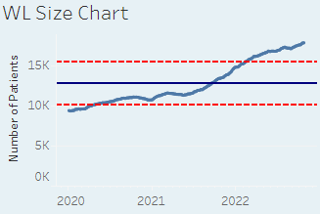
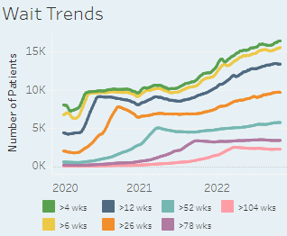
Elective Care – TTG Inpatients
Waiting list size continues to increase
The list size has increased by 145 patients since last week, the tenth consecutive weekly rise
The proportion of patients waiting over 12 weeks has decreased fractionally, to 74.7%
The number of patients waiting over 104 weeks is 2,275 (12.6% of the waiting list), a slight increase from 2,270 the previous week
The proportion of patients unavailable (all reasons) has decreased to 1.9%, the lowest level since early June
The longest waiting patient has been waiting for 1,986 days (Plastic Surgery ESCatS 3) and is not booked
None of the 20 longest waiting patients have been booked
The longest waiting urgent/USC patient has been waiting 636 days (Cardiology), and is not booked to come in
1 of the 20 longest waiting urgent/USC patients has been booked
NHS Grampian Health Intelligence – Management Information

Slide 11
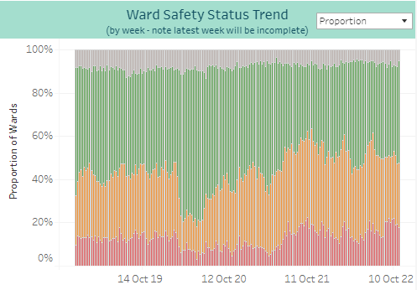
Ward Safety Status
Red RAG status level remains high
The overall trend data shows for the week beginning 31st October 47.5% of wards reported a red or amber RAG status, a decrease from 51.3% the previous week and a second consecutive weekly fall
This is the first week the proportion has fallen below 50% since the end of August
Red RAG status reports increased slightly from the previous week, to 19.3%, continuing the higher levels observed since mid-September
NHS Grampian Health Intelligence – Management Information

Slide 12
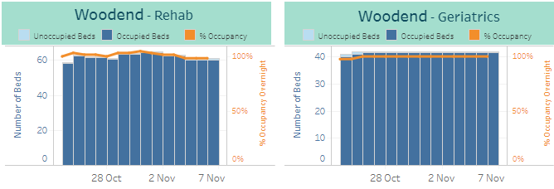
Hospital bed occupancy
Remains at very high levels with some areas at, near, or above 100%
ARI occupancy remains at very high levels
Rosewell House occupancy remains very high, exceeding 100% on occasion
Moray community hospital occupancy remains very high, exceeding 100% on occasion
Royal Cornhill occupancy regularly exceeding 100% since mid- September
Aberdeenshire community hospital occupancy remains high
Dr Gray’s occupancy remains high, increasing through the end of October
Woodend community occupancy remains very high, at or near 100%
RACH has reasonable capacity available ; occupancy level has been increasing through the second half of October
NHS Grampian Health Intelligence – Management Information
Royal Cornhill, Dr Gray’s and Moray bed numbers are currently under review

Slide 13
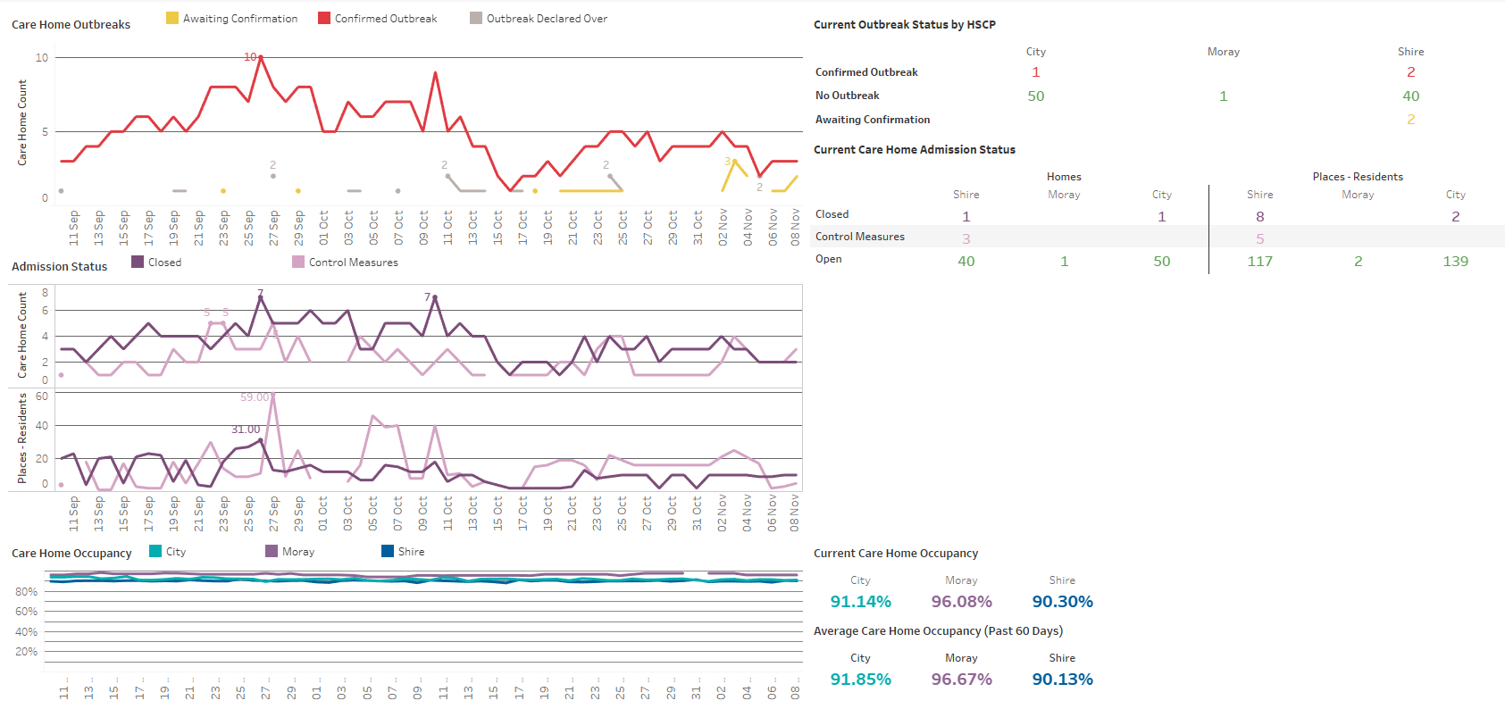
Care Home occupancy
Remains high; 2 homes closed to admissions
At 08 November:
Outbreaks down to 3, however have been hovering around 4-5 since last update.
Number of closed homes stable since last update, with 2 homes closed and 3 with control measures in place. Beds affected by closures also stable (calculated from places – current residents however note returns are very low.)
Returns to TURAS have been falling, especially in Moray (Registered Care Homes with Turas: 56 City, 68 Shire, 14 Moray)
Occupancy below 60 day average in City and Moray, above in Shire.
Care home data is from TURAS which is self reported and not assured centrally. Submission rates are not 100% and are lower at weekends.
NHS Grampian Health Intelligence – Management Information

Slide 14
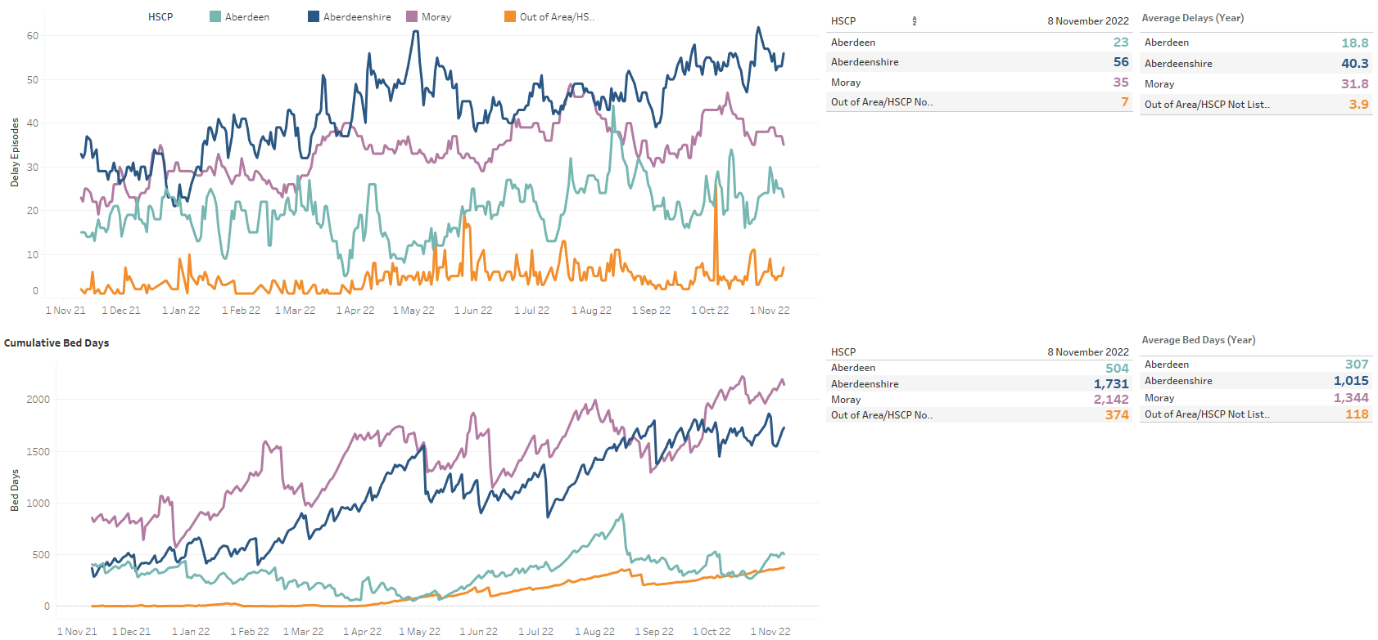
Delayed Discharges (standard delays only)
Shire delays down but very high, bed days trending up in all areas.
At 08 November:
Shire delays have dropped since last update but still very high and trending upwards.
Moray and City delays trending down over the past week after increasing the week before.
Moray delays 10% above yearly average, Shire delays 39% above yearly average, City 22% above yearly average
Moray and Shire bed days both trending up again after dropping.
Shire bed days 70% above the yearly average. Moray over 59% above yearly average.
City bed days have also increased since the last update and trending up, 65% above yearly average.
Out of area bed days have increased slightly this week.
Data shown for standard delays only as complex and Code 100 delays are typically harder for partnerships to control. Delays shown are daily snapshot delays from Trak which are not validated delays.
NHS Grampian Health Intelligence – Management Information

Slide 15
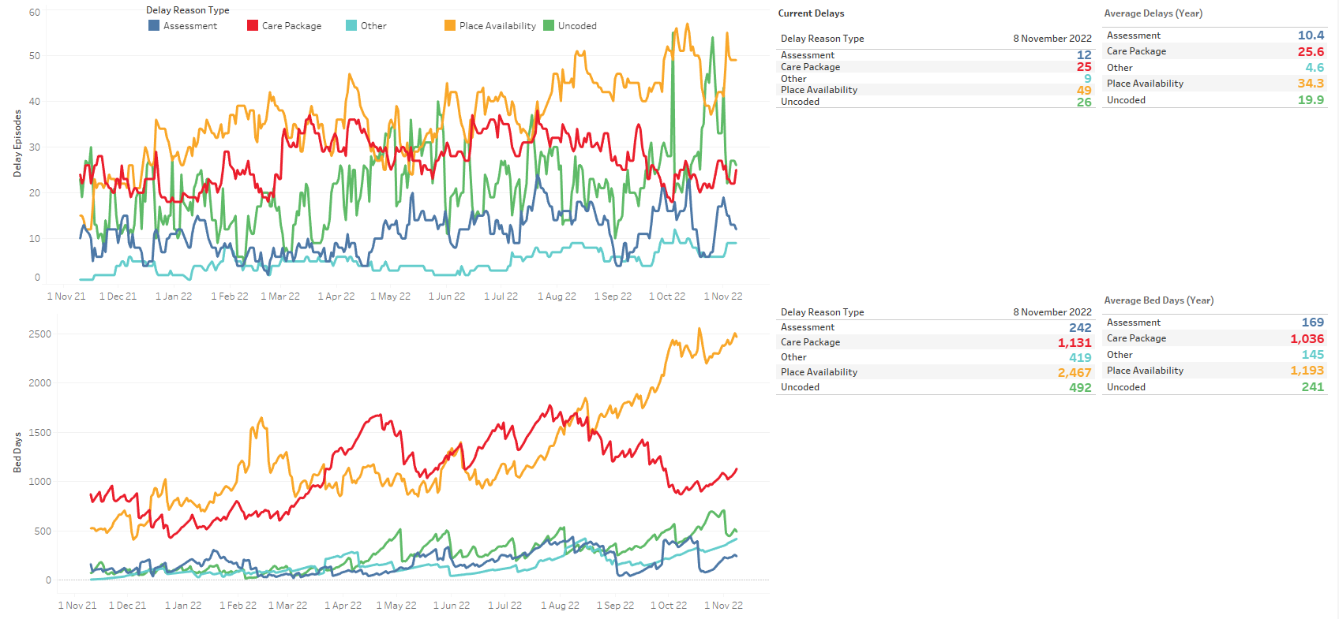
Delayed Discharges – Reason (NHSG standard delays only – out of area not included)
‘Place availability’ delays and bed days continue to rise significantly
At 25 October:
Place availability delays have increased again from previous fall. Now at 49 across NHSG – 26 in Shire, 13 in Moray, 10 in City.
Uncoded delays have dropped significantly from last month highs.
Care Package delays have increased slightly since last update.
Due to DD being snapshot at midnight, uncoded delays are over-represented as they are usually coded the following day, especially over the weekend/Monday.
Place availability bed days still extremely high and continuing to trend upwards. Uncoded bed days in Shire down.
Shire have 1,215 place availability bed days, 49% of PA total. Moray at 861, 35% of PA total. City at 391 bed days, 16% of the PA total.
Package bed days are close to yearly average but trending upwards. 1008 Care Package bed days are in Moray, 89% of the total.
133 uncoded bed days in Shire, 27% of total. Out of Area/HSCP not yet added uncoded bed days at 346, 70% of the total.
Data shown for standard delays only as complex and Code 100 delays are typically harder for partnerships to control. Delays shown are daily snapshot delays from Trak which are not validated delays.
NHS Grampian Health Intelligence – Management Information

Slide 16
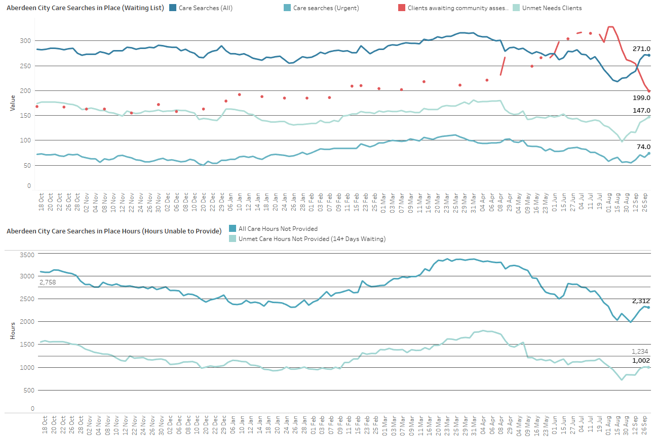
Aberdeen City Social Care
Very limited update this week due to system issues
IT issues in City with new D365 system affecting usual reporting. Updated figure on open hours below.
At 04 October:
Care searches down 1 last week to 271, below yearly average of 278.
147 waiting over 14 days last week, up 6.
Urgent care searches at 74 last week, up 8 on previous week.
Clients awaiting assessment continues to fall sharply.
07/11 - Weekly not provided hours at 2359.15, up 47 from last update.
All hours now at 2312, down 19 and below the average of 2758 for the year.
1002 not provided hours for clients waiting over 14 days, down 8 and below average of 1234 for the year.
For City, a care search is a record of a case where a care need has been identified but not fulfilled and how many hours of care are required (care search hours). These are weekly hours required per care search.
NHS Grampian Health Intelligence – Management Information

Slide 17
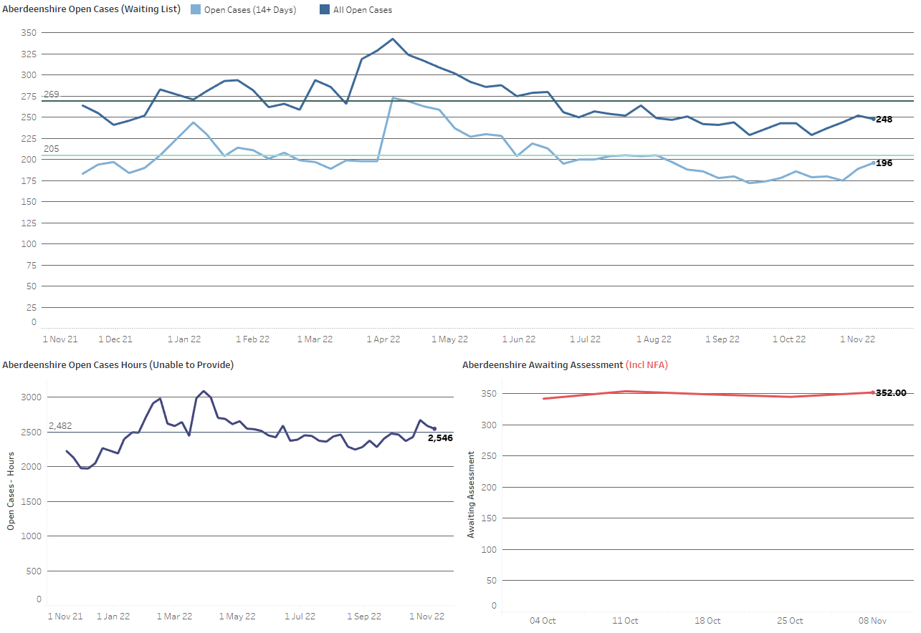
Aberdeenshire Social Care
Hours not provided have decreased over the last two weeks
At 08 November:
Now reporting awaiting assessment
352 awaiting assessment, up 7 from last week (slightly inflated figure – see note below)
248 open case clients waiting for care, down 4. Below the average for the year (269).
Open cases have fallen from April highs. Unmet cases appear to be trending upwards however still below yearly average.
196 clients waiting over 14 days, up 7 this week and 21 from last update. Below average for the year (204).
Weekly not provided hours at 2546, dropping for the past 2 weeks, down 126 since last fortnightly update, and above yearly average (2484).
Note: awaiting assessment figure is slightly inflated as it includes those who end up being NFA, and therefore not requiring an assessment – last 12 months around 30% of referrals resulted in NFA
Open cases are where a care need has been identified and recorded on CareFirst. Open Cases hours are the weekly hours assessed as required for each open case. Homecare hours are hours which Shire are currently providing.
NHS Grampian Health Intelligence – Management Information

Slide 18
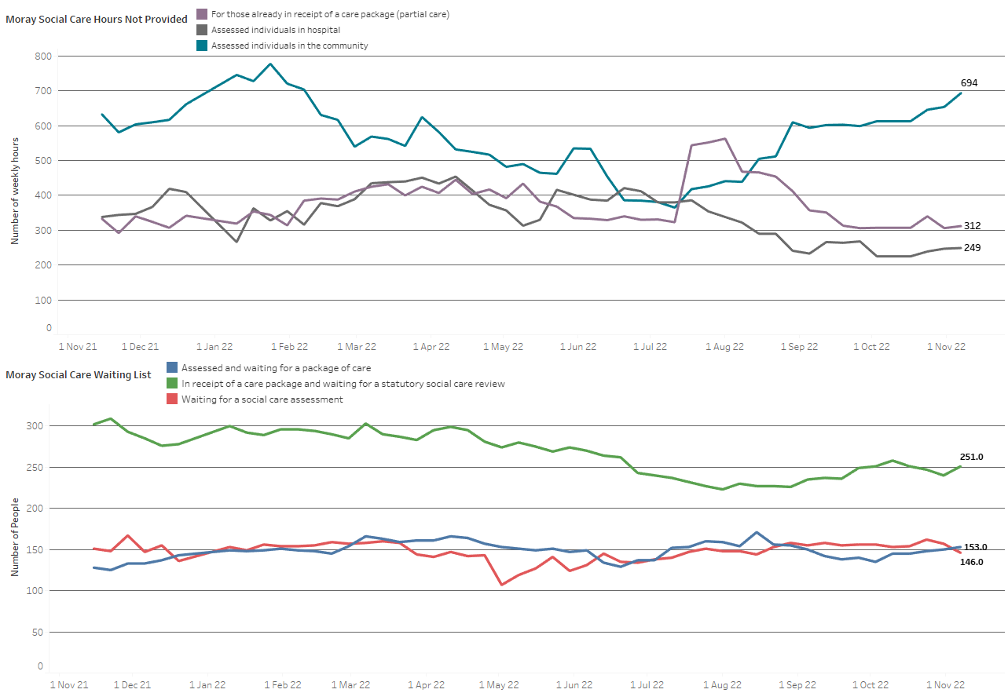
Moray Social Care
Hours not provided have increased, community hours not provided trending upwards since Sept
At 7 November:
1,255 total hours not provided per week, up 48.
694 care hours not provided in the community, up 40 increasing sharply this week.
Following increase through July and August, hours not provided in the community continuing to trend upwards
249 hours for those in hospital, up 2.
312 hours for those who already have partial care, also up 6.
146 clients assessed, but waiting for care, down 11.
251 clients awaiting review, up 11.
153 clients waiting for a social care assessment, up 3.
Hours are the number of weekly hours identified as required for that individual. No data is available for length of time on the waiting list to identify unmet need.
NHS Grampian Health Intelligence – Management Information

Slide 19
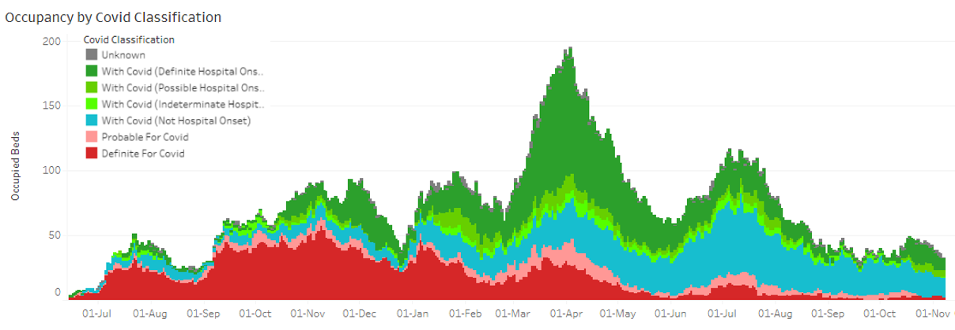
Covid summary
Admissions and occupancy trending down since mid-October
The Grampian 7-day rate has decreased over the last four weeks
In the seven days to 07/11 it was 26/100,000, compared to 50/100,000 the previous week and 53/100,000 the week before
As always, case numbers need to be interpreted cautiously due to far less testing being carried out in the community
The national ONS survey shows an uncertain trend in Scotland; in the week to 24th October (most recent data available) approximately 1 in 35 people in Scotland (2.69%) were estimated to have Covid over a 7-day period
This compares to 3.02% (approx. 1 in 35) the week before and 2.74% (approx. 1 in 35) the week before that
NB there is a 15-25% under-ascertainment of Covid infection among hospital admissions since April 2022. This is due to home LFD tests not being logged and no test on admission
With/For Covid admission classification should be used with caution. It is estimated that 10% of classifications may be impacted by data availability since 04/08
Hospital admissions have been trending down since mid-October
14 Covid admissions in the 7 days to 07/11, a decrease from 25 the week prior
Data to 06/11 shows admissions increased slightly in the 60-69 age group, but decreased in all other age groups
There were no admissions FOR Covid (probable and definite) in the 7 days to 07/11, a decrease from 2 the previous week; the majority of admissions remain WITH Covid (not hospital onset)
Hospital occupancy has been slowly trending down since mid-October
At 07/11, 33 occupied beds, a reduction from 43 a week previously; this is a decrease from the recent high of 49 on 18/10
2 of these were admissions FOR Covid (compared to 3 a week previously). Of those WITH Covid, 14 are definite or possible hospital onset (compared to 18 a week previously) and 16 not hospital onset (compared to 20 a week previously)
As at 09/11 there were no Covid patients in ICU
NHS Grampian Health Intelligence – Management Information

Slide 20
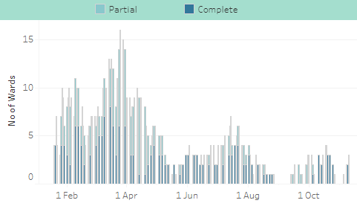
Infection Prevention & Control Ward Closures
3 ward closures
Ward closures due to Covid infection controls
As at 09/11, 3 complete ward closures due to Covid infection controls
Number of ward closures due to Covid infection controls fell to zero on 27th October, but have been increasing since 4th November
NHS Grampian Health Intelligence – Management Information

Slide 21
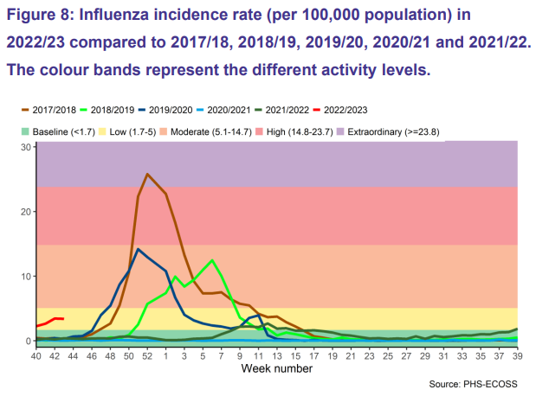
Flu summary
Scotland flu cases at higher levels than the same time in pre-Covid years
Week 43 (to 30/10/22)
Grampian activity levels for GP consultations for influenza-like illness remain at ‘baseline’ level
Incidence rate (per 100,000 population) for influenza remains at ‘baseline’ level for Grampian, below the Scotland level which remains at ‘low’
Whilst at the ‘low’ level, the Scotland-wide incidence rate is increasing weekly and is higher for weeks 40-43 than in pre-Covid years. This could be an indication that peak in cases will be earlier this year
NHS Grampian Health Intelligence – Management Information

