Slide 3
Executive Summary
Introduction
The purpose of the report is to enable the Board to review progress against the three key objectives for Operation Iris.
Context
At the February Board meeting we reported that there were signs that community spread of Omicron, combined with uptake of the booster vaccinations, was resulting in a levelling off of the impact on hospital and ICU admissions.
Unfortunately, in the period since that report, the impact of increased community transmission on staff absence and hospital admissions has been very significant and has continued to disrupt service delivery. There are now tentative signs that the rise of Covid in the community
A. Keep staff safe & help them to maximise wellbeing
The impact on our staff has been significant with the COVID response now having been in place for 2 years. Overall staff absence has increased during March, linked to the high level of Covid in the community requiring staff to self-isolate. The cross system working to manage very high demand has been very impressive, but we do not under-estimate the continuing impact on staff resilience as the high pressure period continues. The We Care programme continues to provide a wide range of support to staff., but the situation remains very uncertain.
B. Responding to demand on the health & care system
All services across health and social care are operating at higher levels (relative to available capacity) than in prior years. Occupancy in our main hospital sites is on average above 95%, with similar high levels being experienced in community hospitals and care homes. Covid hospital occupancy remains at extraordinary high levels, however the good news is that we are not seeing a continued acceleration in the number of new admissions with symptomatic disease
Similar pressures are being experienced in primary care and in the community, where there has been an increase in the number of hours of care that have been unable to be provided in both Moray and Aberdeenshire. Social care services in Aberdeenshire have been particularly impacted by staff absence and vacancies.
The Grampian Operational Escalation and Pressures System, used to assess the system pressures and inform our whole system daily response meetings, has been consistently at level 3 and 4 throughout February and March.
C. Protecting critical services & reducing harm
Since the last Board meeting, the continued pressure in Emergency Department and on flow through the system has intensified. There are significant variations in performance from day to day and we continue to work with partners to improve co-ordination.
Despite challenges around capacity, we continue to maintain access for emergency surgery and planned elective surgery for priority patients, although it is insufficient to keep up with demand. The Inpatient waiting list has recently fallen, for the first time since January and the proportion of patients waiting over 12 weeks has fallen slightly too.
In terms of access to Child and Adolescent Mental Health service we consistently remain above the national target.

Slide 4
Objective A
Keep staff safe & help them to maximise wellbeing

Slide 5
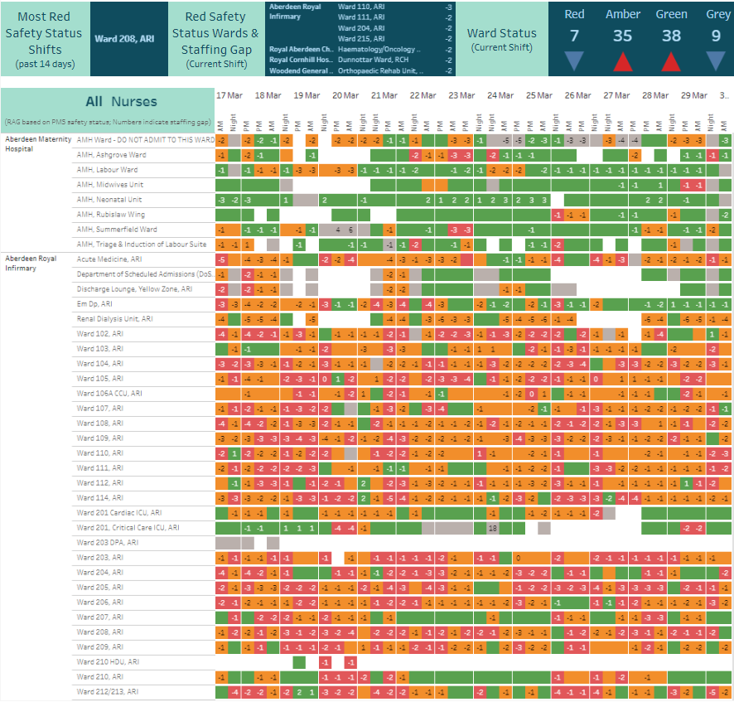
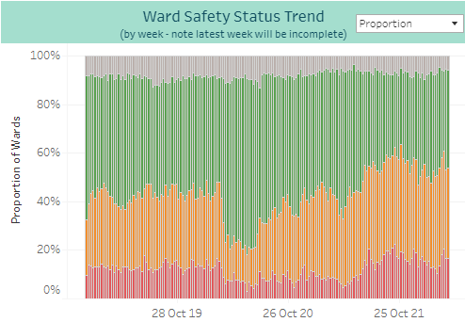
Ward Nurse Staffing (Registered & Unregistered)
The snapshot data shows a slightly improved position compared to last week’s report for red safety status shifts, but a slightly worse position for amber status.
Some wards continue to be short up to 5 nursing staff (eg Renal Dialysis Unit at ARI and Fraser Ward at RCH)
Mondays continue to experience the highest levels of red RAG status wards in 2022
The overall trend data continues to show over 50% of wards reporting a red or amber RAG status. However there is some indication of improvement: for the week beginning 21 March this was 53%, a reduction from 61% the week before.
* Data sourced from PMS – snapshot taken 09:20 30/03/2022
From the Nursing Workforce Dashboard – Ward Staffing: Nursing Workforce Summary - Tableau Server

Slide 6
ALL ABSENCES – 23/03/2022 – 29/03/2022 (DATA REPORTED IS REFLECTIVE OF DATA RECORDED IN SYSTEMS BY 29th MARCH, DATA IS REFRESHED FOR PREVIOUS 8 WEEKS AT TIME OF REPORTING TO CAPTURE ANY TIME LAGS IN RECORDING ABSENCE DATA)
Annual Leave |  | Current value 10.94%, down from previous week’s value of 12.66%.
Sickness Leave |  | Current value 2.84%, down from previous week’s value of 3.86%. Note: Includes both short and long-term sick leave.
Maternity Leave |  | Current value 1.75%, down from previous week’s value of 2.01%.
Special Leave inc. Covid-19 |  | Current value 2.71%, down from previous week’s value of 3.86%. 77% of special leave attributed to Covid-19.
All Other Leave |  | Current value 0.77%, down from previous week’s value of 1.15%.

Slide 7
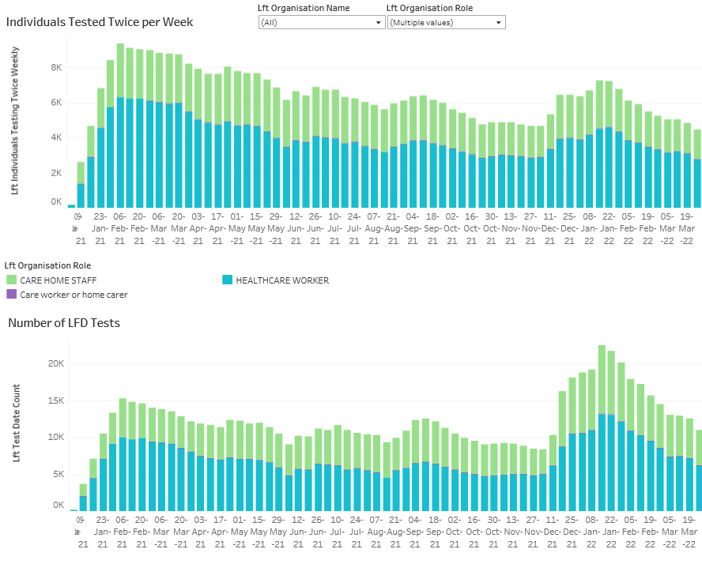
LFD testing in Grampian by role
Regular testing and reporting by Health Care Workers and Care Home Staff remains lower than last winter.
LFD testing continues to fall weekly across the organisation roles.
Click here to go to the Testing dashboard - nhsg-illum-pri/#/views/LFDTestResults/LFDTestsbyOrganisation?:iid=5

Slide 8
Objective B
Responding to demand on the health & care system

Slide 9
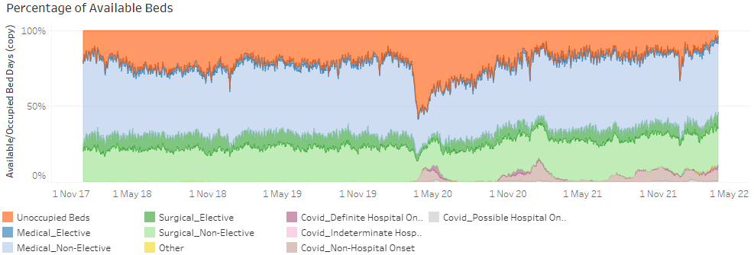
Bed pressures within ARI: Occupancy remains at very high levels, and continuing to rise
The overall trend data continues to show increasing occupancy levels
Trend at 29 Mar 16:51
From Illuminate report – occupancy

Slide 10
Dr Gray’s, RACH and Cornhill Occupancy
Dr Gray’s
occupancy levels remain very high, but have eased slightly in the last week
RACH
continued indication of a general increasing trend in occupancy, but appears to have reasonable bed capacity available
Cornhill
occupancy levels remain very high, continuing to increase
Trend at 29 Mar 16:51
Illuminate Occupancy reports

Slide 11
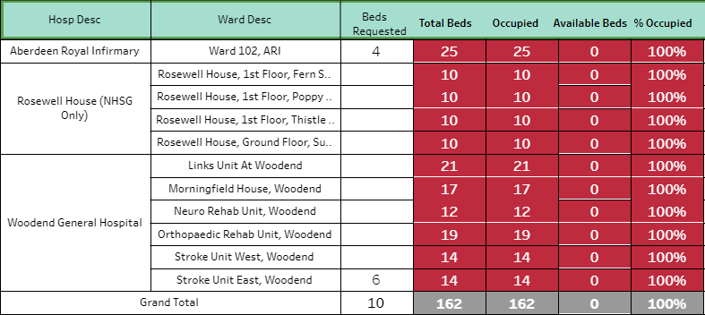
Community Hospital Occupancy
City
occupancy levels at 100%
Snapshot at 30 Mar 10:25
Aberdeenshire
occupancy levels remain very high, increasing over the last week
Moray
occupancy levels remain very high, increasing over the last week
Illuminate Occupancy and snapshot reports
Trends at 29 Mar 16:51

Slide 12
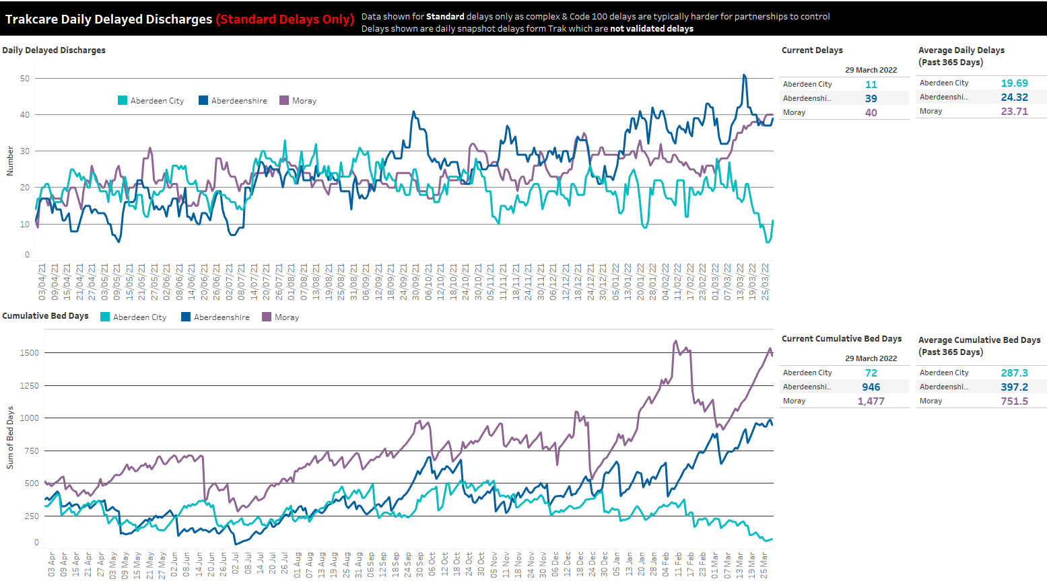
At 29 Mar:
Aberdeenshire delays stable after significant drop last week. City delays have decreased significantly. Moray delays rising steadily. Moray delays near double yearly average. City delays are well below average
Cumulative bed days remain significantly higher than average in Shire and Moray, lower in City.
Steep rise in Moray bed days, Shire bed days continue to rise steadily. City bed days have been trending downwards.

Slide 13
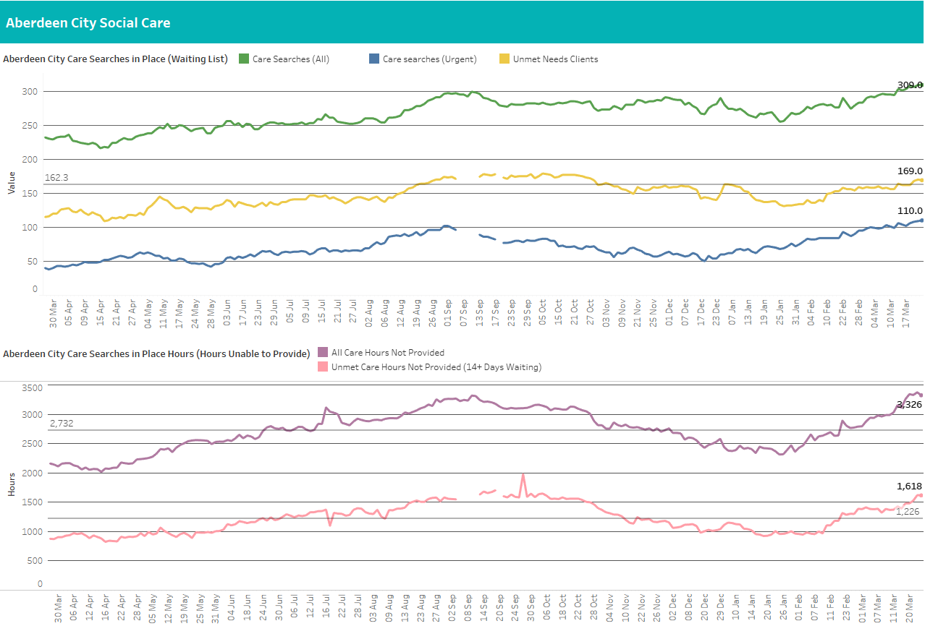
For City, a care search is a record of a case where a care need has been identified but not fulfilled and how many hours of care are required (care search hours). These are weekly hours required per care search.
At 28 March:
High numbers of clients waiting for care (up 3, now 309), and above average for the year (267)
Clients waiting over 14 days at 169 – up 1, above an average of 148 clients
Urgent care searches, currently at 110 and trending upwards, above average of 70 clients
Weekly unprovided hours now 3,326 down 96 since last week and remain above the average of 2,732 for the year
1,529 unprovided hours for clients who have waited over 14 days, up 91 since last week and above the average of 1,226 for the year

Slide 14
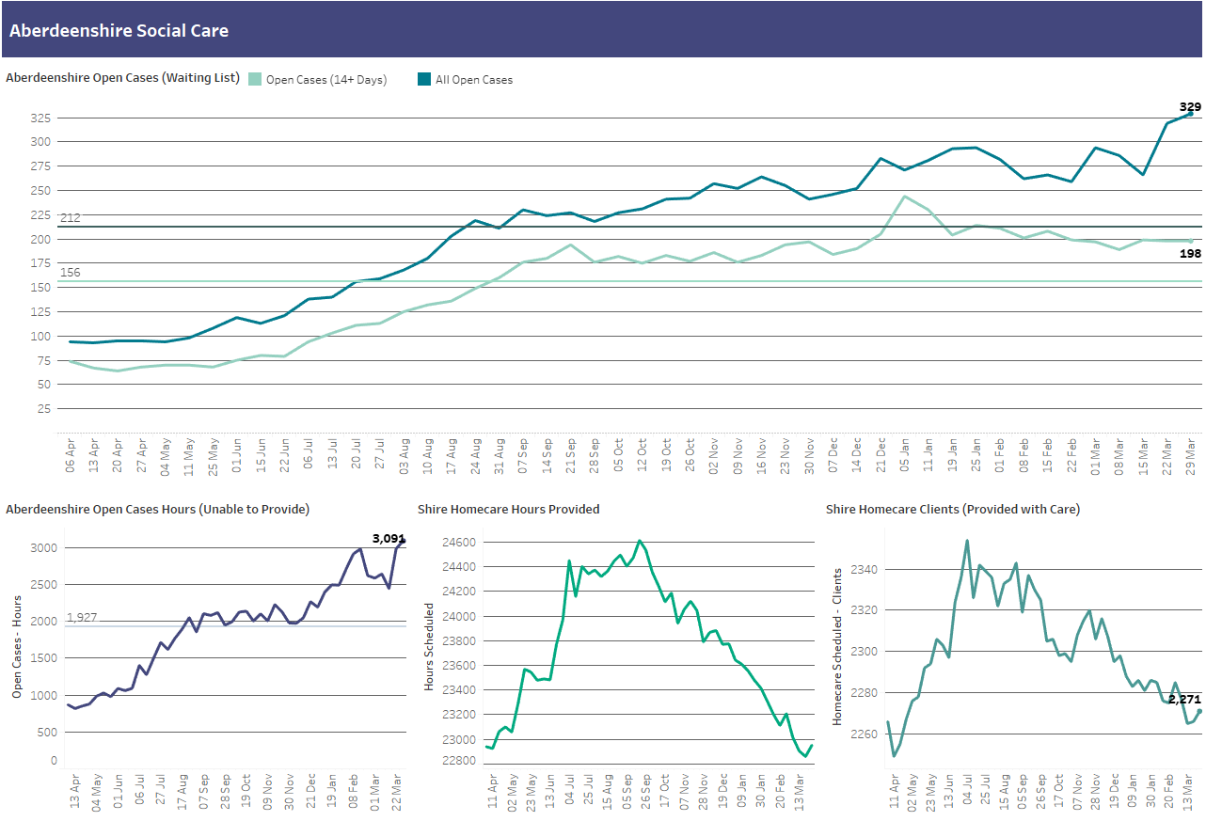
Open cases are where a care need has been identified and recorded on CareFirst. Open Cases hours are the weekly hours assessed as required for each open case. Homecare hours are hours which Shire are currently providing.
At 29 March:
(IT issues at Shire which affected reported numbers early March)
Number of clients waiting for care is at yearly high of 329, up 10 from last week; significantly above average for year (212)
198 clients waiting over 14 days, defined as unmet need (no change) but also significantly above the average for the year (150)
(IT issues at Shire which affected reported numbers early March)
Weekly unprovided hours at 3091 and significantly above average for the year (1,927).
92 more hours provided and 5 more client compared to last week

Slide 15
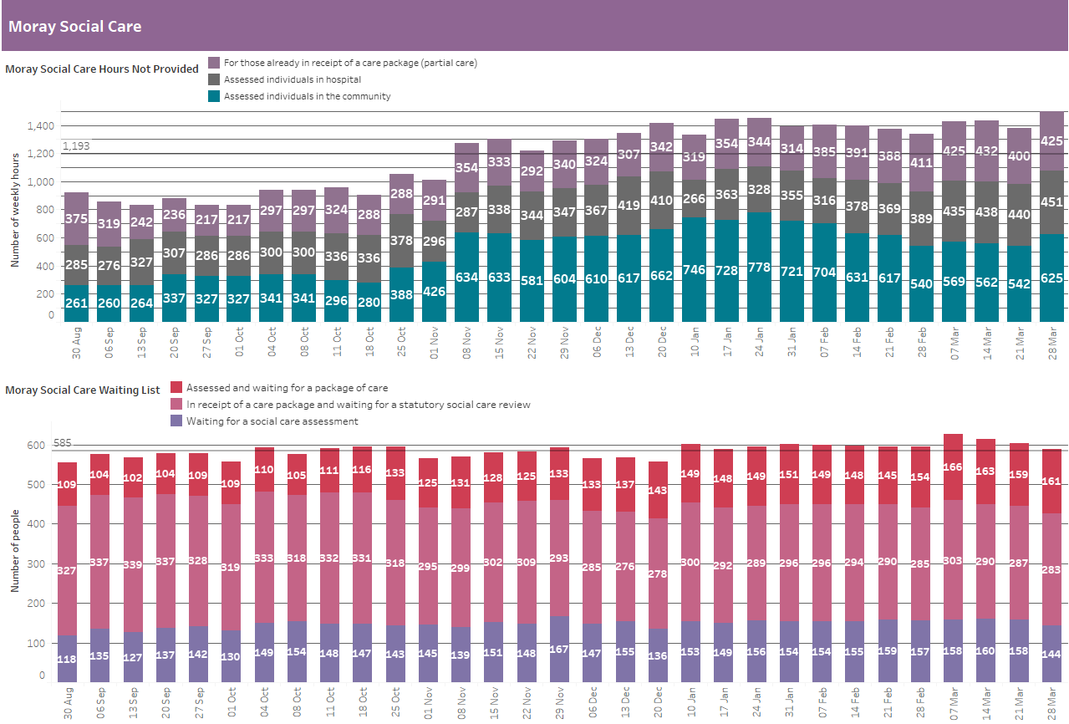
Hours are the number of weekly hours identified as required for that individual. No data is available for length of time on the waiting list to identify unmet need.
At 28 Mar:
Care hours not provided in the community up 83.
Hours for those in hospital is up 11 this week
1,501 total hours not provided per week (up 119), and above an average of 1,193 since Aug
161 clients assessed, but waiting for care (up 2), above average of 133 since Aug
283 clients awaiting review (down 4), below average of 305
144 clients waiting for a social care assessment (up 2), below average of 148

Slide 16
Objective B
COVID summary

Slide 17
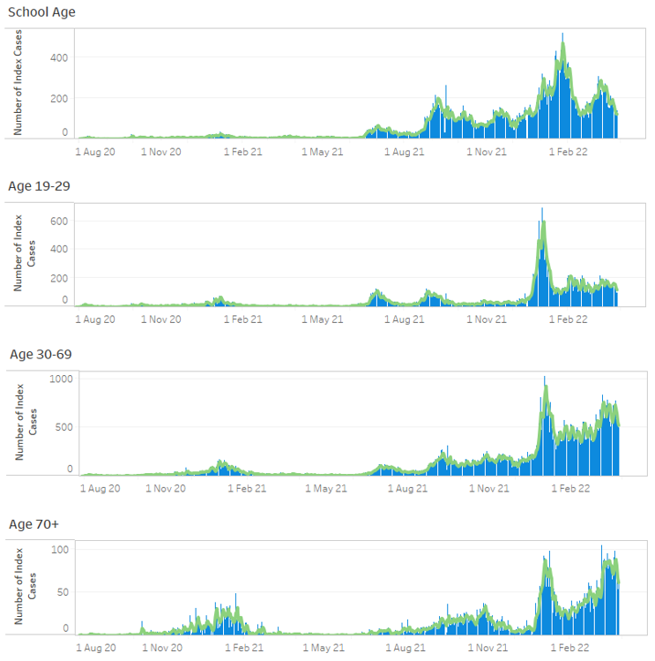
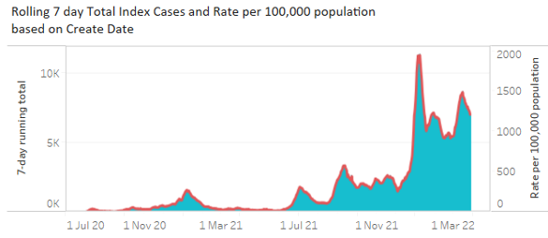
Covid cases across Grampian
7-day running case total has decreased in the last 2 weeks and now similar to that seen at the beginning of March
Improving case numbers across all ages but particularly children
Stable in 19yr+
Improving in 70yr+
Click here to go to the Illuminate report - Test and Protect Surveillance Report: Index Cases by Create Date - Tableau Server

Slide 18
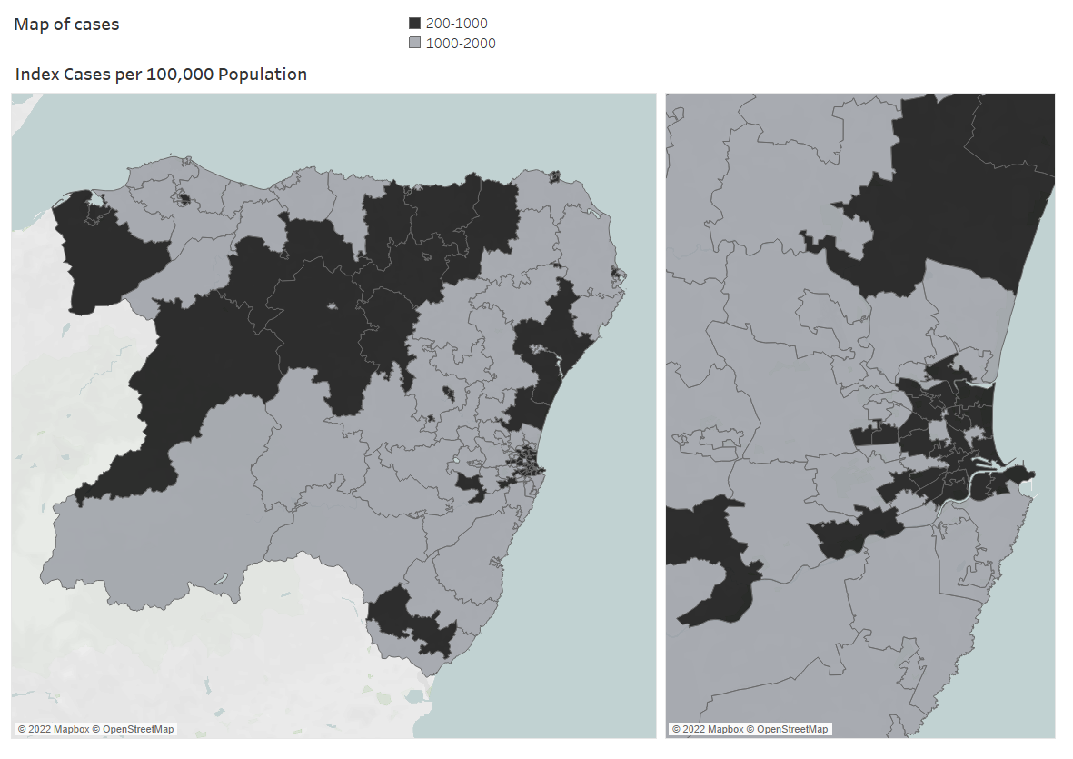
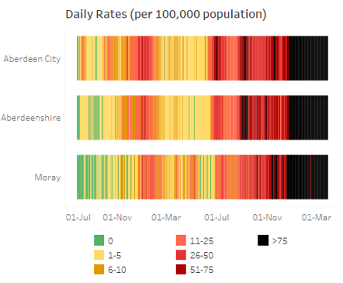
Covid cases across Grampian communities
Rates per 100,000 population have fallen in all localities compared to last week
Widespread community transmission remains
Rates
Aberdeen City: 1050
Aberdeenshire: 1193
Moray: 1281

Slide 19
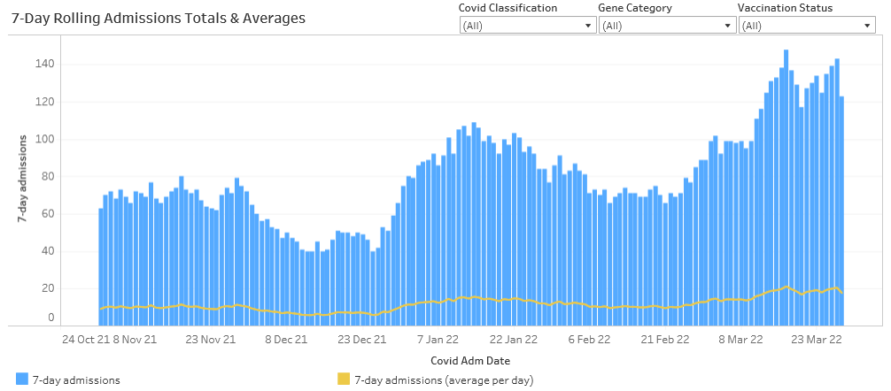
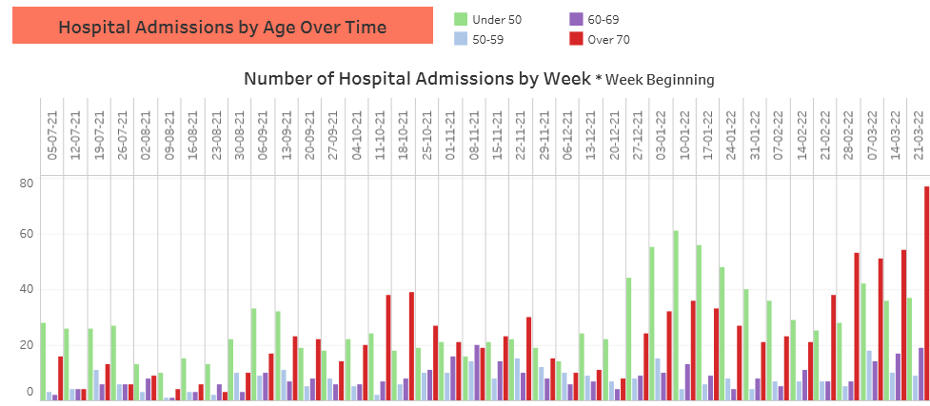
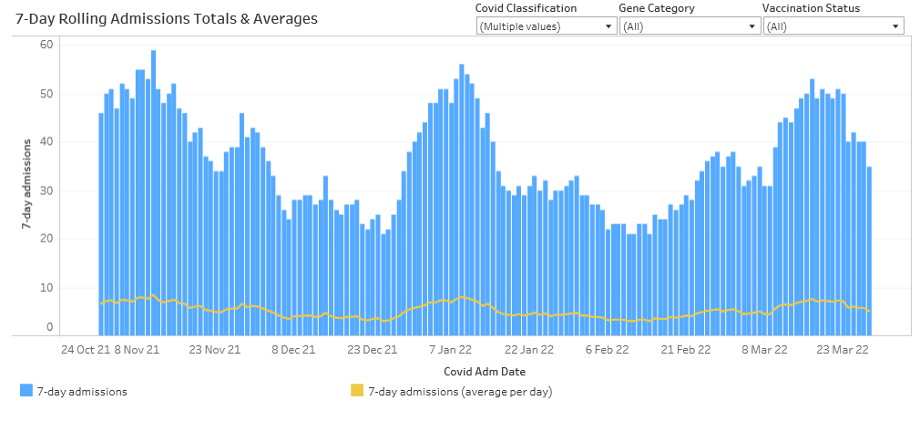
Hospital admissions
All admissions with Covid +ve test remain high. Too early to identify whether stabilising/falling
Admissions with COVID +ve test are increasing in age 60+yrs particularly driven by hospital onset
Admissions For symptomatic Covid have decreased in the last 10 days

Slide 20
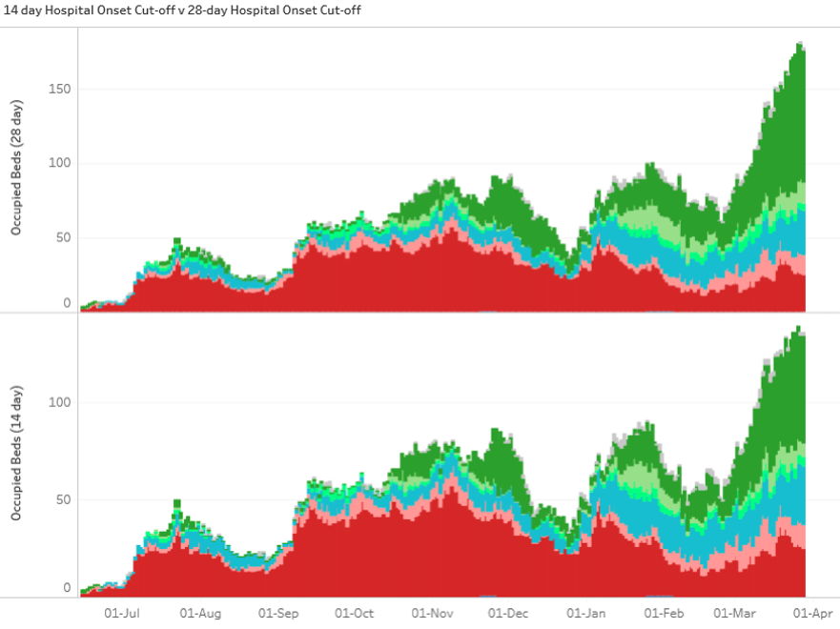
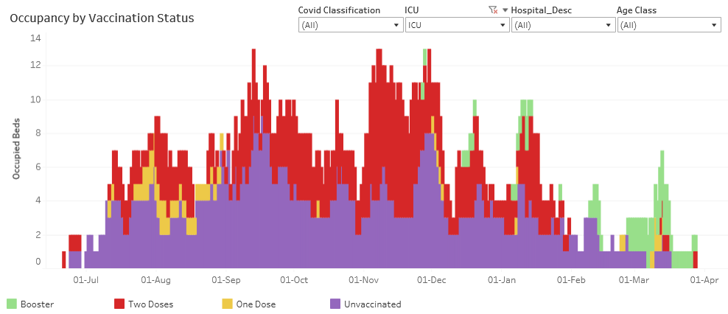
Covid occupancy
Covid occupancy is currently 181 in comparison to 82 at the end of February
‘Definite/Probable For Covid’ occupancy has fallen in the last week to 39 (previously 43) however there is a significant rise in those aged over 70
ICU occupancy has fallen in the last fortnight
Definite hospital onset = in hospital for at least 14 days prior to testing positive for the first time
Possible hospital onset = in hospital for 8-14 days prior to testing positive for the first time

Slide 21
Objective C
Protecting critical services & reducing harm

Slide 22
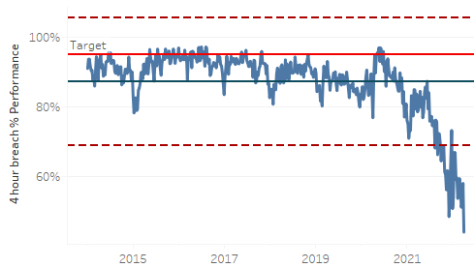
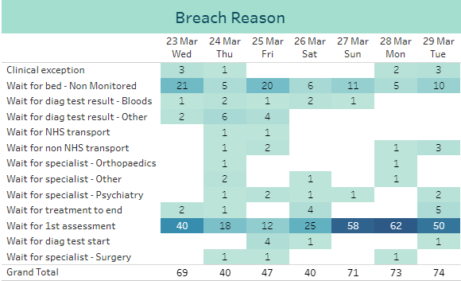
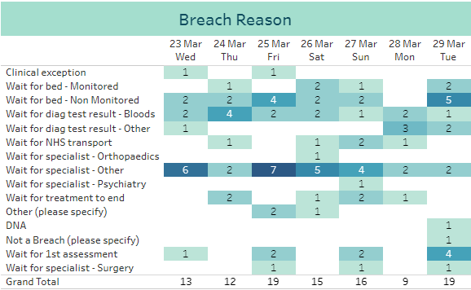
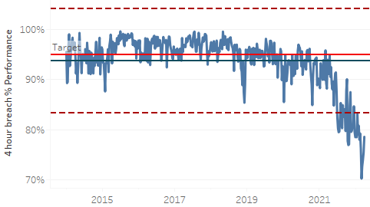
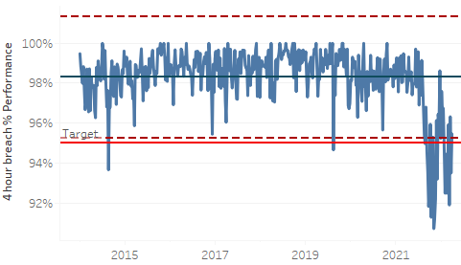
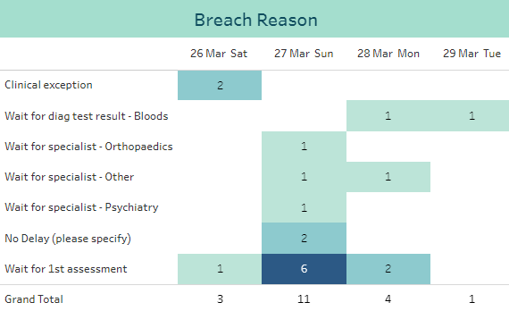
A&E Performance
ARI
Performance on 29/03 was 46%, a slight decrease from 49% on 22/03
Variation through the week: 74% Sat 26th, 41% Mon 28th
Primary breach reason remains ‘Wait for 1st assessment’
Performance on 29/03 was 71%, a decrease from 80 on 22/03
Variation through the week: 67% Fri 25th, 86% Mon 28th
Primary breach reasons is ‘Wait for specialist – Other’
Dr Grays
Performance on 29/03 was 97%, an increase from 93% on 22/03
Variation through the week: 100% Wed 23rd-Fri 25th, 80% Sun 27th
Primary breach reason remains ‘Wait for 1st assessment’
RACH
To view the dashboards click here - A&E SitRep Dashboard: A&E SitRep - Tableau Server USC Weekly Report: Page 1 - Tableau Server

Slide 23
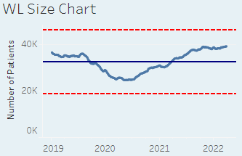
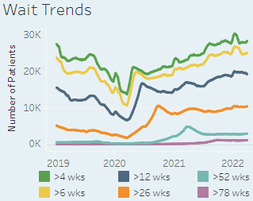
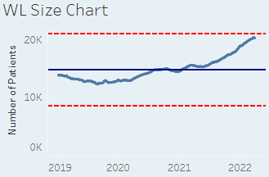
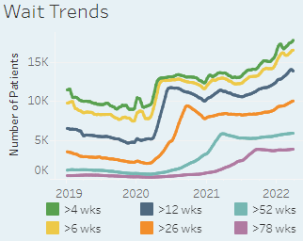
Waiting Times Overview
Click here - Waiting Times Dashboard: Waiting List KPIs - Tableau Server
Outpatients (consultant-led)
Inpatients
The list size has increased by 97 patients since last week, the fourth consecutive weekly increase
The proportion of patients waiting over 12 weeks continues to decrease, from 50.2% to 49.3%
The top 20 longest waiting patients are for GP Minor Surgery
The longest waiting patient this week is a GP Minor Surgery patient waiting 1167 days
The list size has fallen by 113 patients this week, the first reduction since 10th January
The proportion of patients waiting over 12 weeks has fallen slightly, from 68.2% to 67.7%
Of the top 20 longest waits, Urology accounts for 8, Plastic Surgery for 6, General Surgery 4 and Gynaecology for 2 patients.
The longest waiting patient this week is a Plastic Surgery ESCatS 3 patient waiting 1762 days

Slide 24
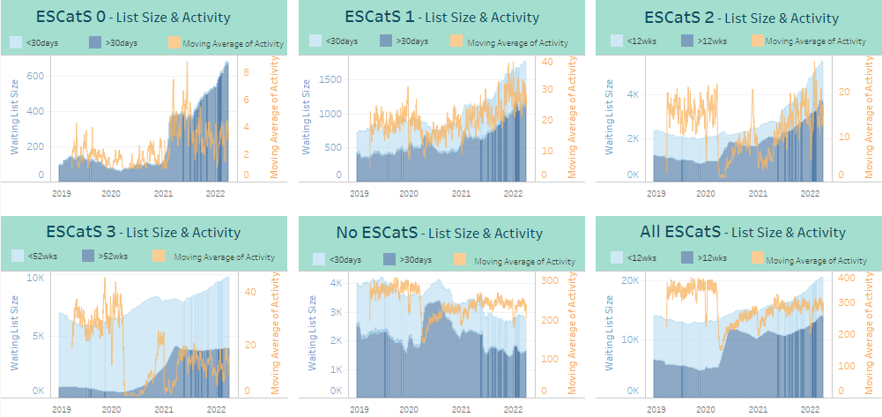
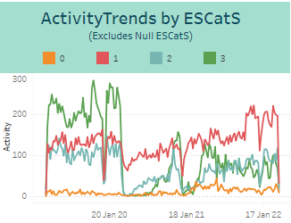
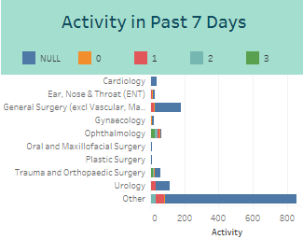
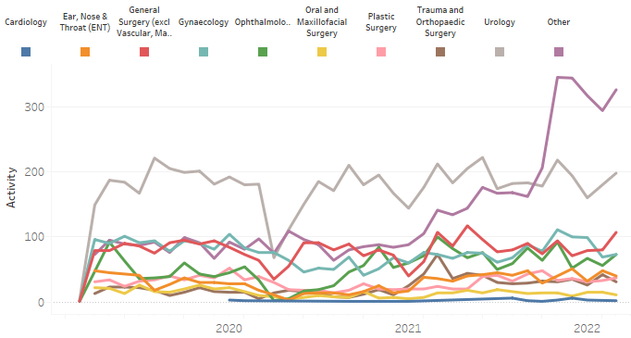
ESCatS Performance
Click here to go to the Tableau Illuminate Dashboard - Elective Care Overview: Elective Care Overview - Tableau Server
ESCatS 1 activity levels continue a general increasing trend
ESCatS 0&1 Waiting List size continues to increase across most specialties, but particularly so for General Surgery and Gynaecology
The specialty causing the greatest increase in the EScatS 0&1 Activity ‘other’ category is Medical Oncology
ESCatS 0&1 Activity Trend

Slide 25
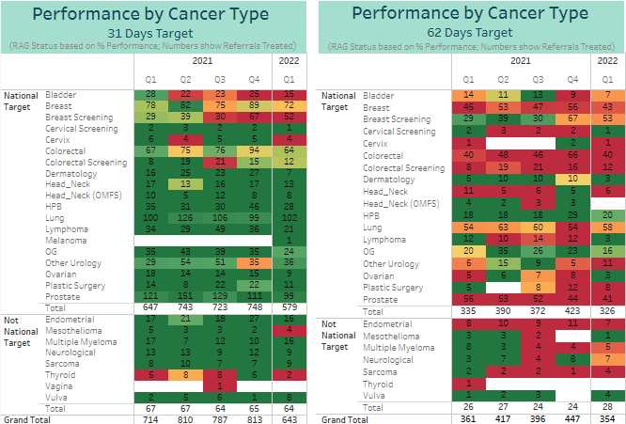
Cancer Performance
Click here to go to the Tableau Illuminate Dashboard - Elective Care Overview: Elective Care Overview - Tableau Server
Performance against the 31 day standard dropped throughout 2021
Having previously achieved the 95% target, performance fell from 94.6% in Q3 to 91% in Q4 2021, below the 95% target for the second successive quarter
In Q3 2021, Grampian was the only board not to meet the 95% target
Q1 2022 is incomplete, but the current performance level is 92%
Following improvement from Q1 to Q2 2021, performance against the 62 day standard then dropped through the rest of the year
Performance fell from 77% in Q3 to 71.8% in Q4 2021, with the 95% target not yet being achieved
In Q3 2021, Grampian reported the lowest performance of the mainland boards
Q1 2022 is incomplete, but the current performance level is 75%
Note: current quarter ongoing/incomplete

Slide 26
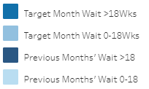
Mental Health Performance
Not updated this week
Compliance at 96% for February 2022
Performance consistently meeting 90% target through 2021, with the exception of April.
Compliance fell to 90% in October, with lower activity levels.
Activity levels increased by 30% from January to February
Referrals at a consistent level of around 340 per month from September through to January, however dropped by around 1/3 in February
Percentage Compliance of all Psychological Therapies Patients Treated by Month
Compliance at 79.9% for January 2022
Checks still underway on a small number of patient records (0.4%) for February, with compliance currently at 76.2%
Performance just below the 90% target from July 2021, with a drop in November
To view the dashboards click here - CAMHs Monthly Reports: CAMHs - Treated/Seen - Tableau Server All Ages PT & CAMHs Reports: Treatment - 18Wk Target Trends - Tableau Server

