Slide 1
Performance Report
Moving forward into 2021/22
1 April 2021

Slide 2
Summary
-
1. Introduction
The purpose of the report is to provide the
Board with a summary of the key elements of Operation Snowdrop from which the Board will transition from on 1 April. The summary covers the
Current COVID position
Vaccinations Programme
Test and Protect
Critical and Protected Services
Staff Health and Wellbeing
Surge and Flow
2. COVID position
In overall terms, all three local authority areas in Grampian have had a lower rate of prevalence of COVID that elsewhere in Scotland, with the position having improved since the peak of the 2nd national wave in January.
Whilst noting the positive position locally and the support we have had from the general public and key partners, COVID remains a global pandemic with variation in terms on new cases presenting across each continental area.
The current 7 day positivity rates in Aberdeen, Aberdeenshire and Moray are 1.4%, 1.4% and 1.8% respectively compared to the national average of 3.1%
-
3. Vaccination
218,000 people in Grampian have now been vaccinated representing 45% of the population. We would wish to acknowledge the significant efforts by our staff and partners at each vaccination site and the response from the public. The vaccination programme is key to protecting the public and reducing the impact of COVID.
4. Test and Protect
The Scottish Government FACTS remains in place and we continue to maintain our Test and Protect capacity (a combination of Tracing Teams, Public Health professionals and data intelligence).Our performance in terms of tracing remains high and consistent with the requirements set out by Scottish Government.
5. Surge and Flow
The winter plan approved by the Board has been implemented and has enabled beds and capacity to be available across the system for emergency admissions. This has been achieved through a whole system approach, additional support to care homes and the implementation of new pathways – frailty and urgent care redesign for example. Whilst performance against the 4 hour ED target has been challenging this has improved in recent weeks.
-
6. Critical and protected services
Elective Care
The capacity to treat our highest priority patients has increased with early indication of return to activity levels and bed capacity as in October/November 2020.
The next phase of our planned care remobilisation will begin in April 2021 with a ring-fenced surgical elective floor crucial to the delivery of increased theatre activity.
Cancer
The 31-day performance remains high at 98%. The number of patients waiting for treatment continues to steadily decrease. In recent weeks there has seen a significant increase in the number of cancer patients being treated. Whilst this has impacted the 62- day performance standard which has reduced to 75%, we are now focused on ensuring that all those patients who have been waiting are treated as quickly as possible.
CAMHS
96.3% of children or young persons have been seen within 18 weeks (NHS Scotland 73.1%) and we would acknowledge the significant redesign that has been undertaken to achieve this position.

Slide 3
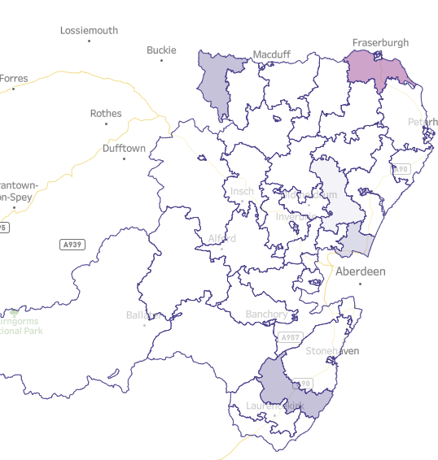
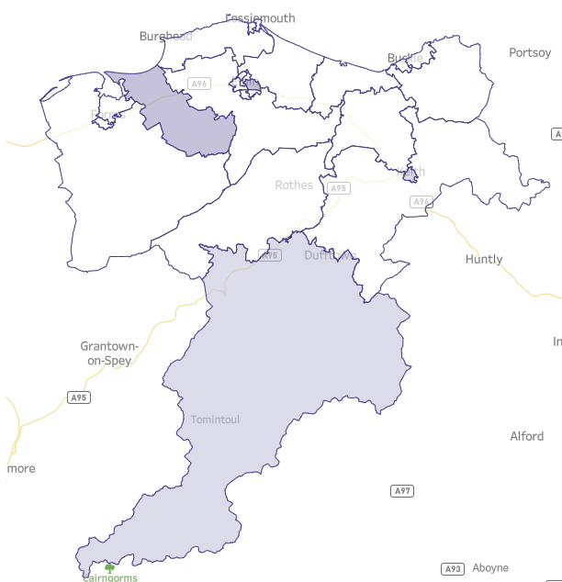
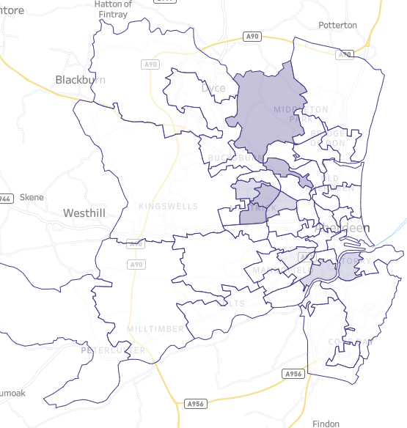
COVID - 7 day positivity rate 14 – 20 March (comparison to 2 – 8 Mar)
Aberdeenshire
Moray
Aberdeen City
7 day positive cases | Rate per 100,000 pop | 7 day positivity rate
84 (71) | 32.2 (27.5) | 1.4% (1.5%)
7 day positive cases | Rate per 100,000 pop | 7 day positivity rate
28 (30) | 29.3 (31.3) | 1.8% (2.1%)
7 day positive cases | Rate per 100,000 pop | 7 day positivity rate
75 (82) | 32.8 (35.9) | 1.4% (1.7%)

Slide 4
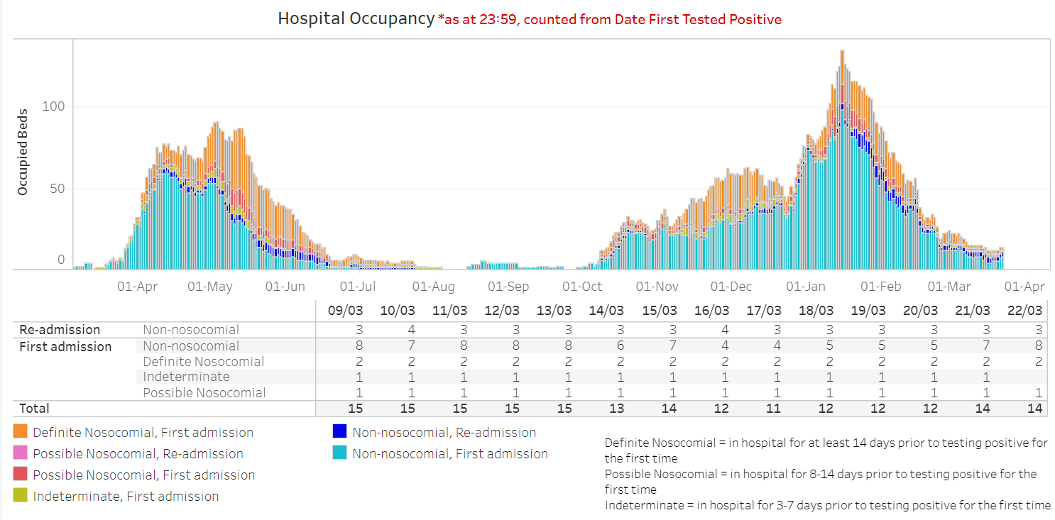
COVID - hospitalisations
1st wave
2nd wave
Aberdeen Lockdown

Slide 5
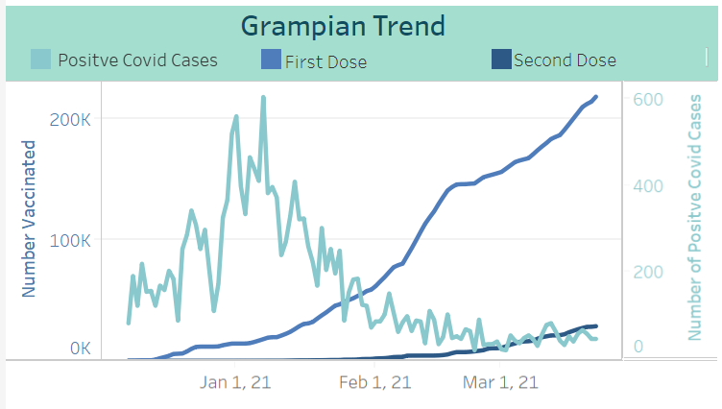
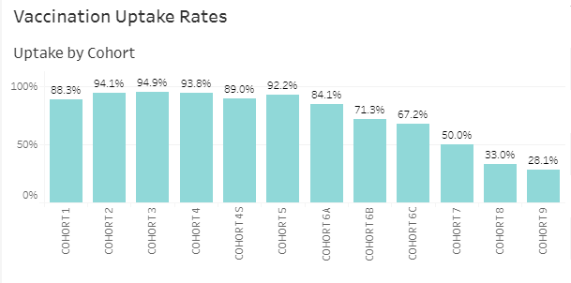
Vaccinations – as at 23 March (covering week 16 – 23 March)
Key messages - Prioritisation and appointments
We are following the JCVI (Joint Committee of Vaccination and Immunisation) priorities
NHS Scotland will invite people to allocated appointments (venue and time)
Members of the public do not need to seek an appointment
Unpaid carers can now register for a vaccine
Advice will be provided for those without their own transport
If you don’t have an appointment, please don’t come to a centre expecting to be ‘squeezed in’
Key messages – Vaccination
Everyone offered a vaccination should be encouraged to be vaccinated
NHSG and HSCPs have plans that can respond to additional vaccine volumes becoming available
The vaccines are safe and effective and have been through the appropriate assessments by the MHRA

Slide 6
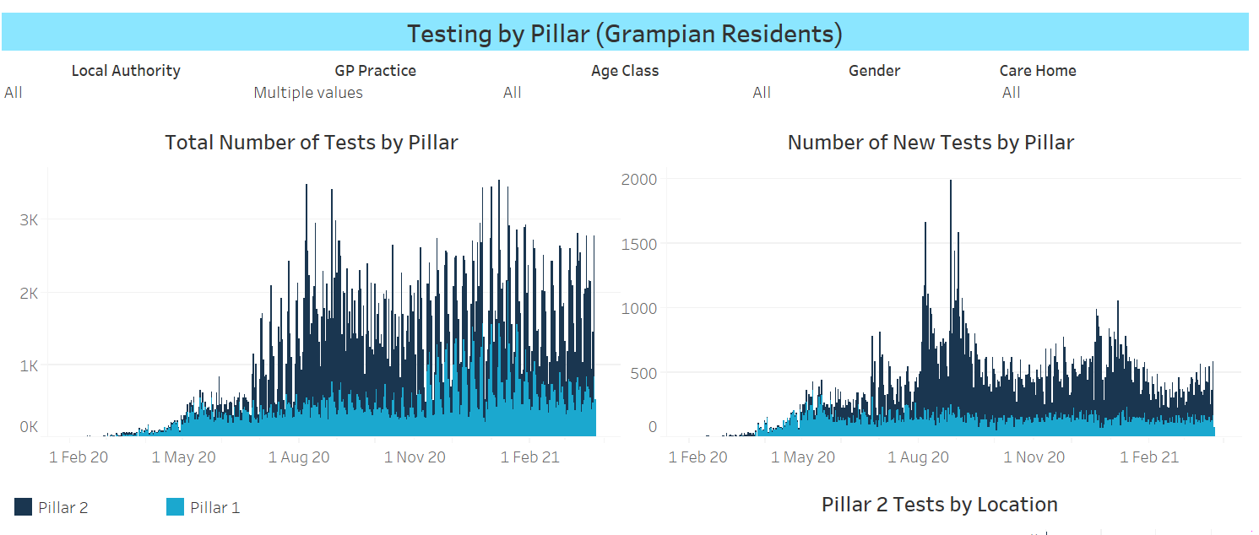
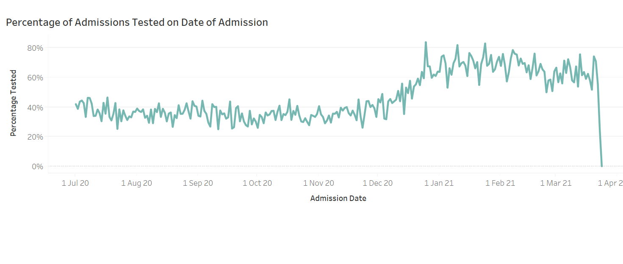
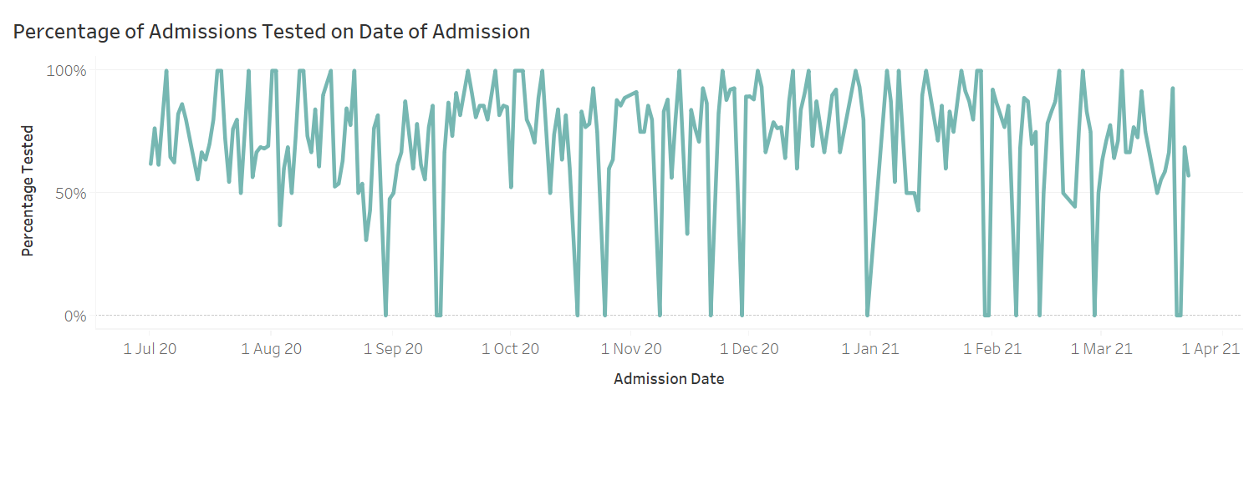
Test and Protect
Pillar 1 – NHS Testing Pillar 2 – UK Gov Testing
Emergency Admissions
Elective Admissions

Slide 7
Test and Protect
NHSG Asymptomatic staff surveillance
Care Home asymptomatic staff testing
HSCP | Staff Tested | Eligible & Available for Testing | % staff tested
Aberdeen City | 1771 | 1798 | 98.5%
Aberdeenshire | 2188 | 2244 | 97.5%
Moray | 551 | 640 | 86.1%
Grampian Total | 4510 | 4682 | 96.3%
Performance – Contact Tracing
95% of contacts reached within 72 hours of test being undertaken
More than 80% of contacts reached within 24 hours of test result being issued
Community Asymptomatic Testing (24 Feb) | Old Aberdeen | Peterhead | Keith | Forres | Buckie | Lossiemouth
Population | 14,530 | 20,039 | 4,734 | 10,488 | 9,677 | 9,060
Asymptomatic Testing Capacity per day | 110 | 240 | 240 | 240 | 240 | 240
Start date | 22-Feb | 26-Feb | 22-Feb | 01-Mar | 19-Mar | 11-Mar
End date |  |  | 12 Mar | 19 Mar
Number of people tested since deployment | 470 | 895 | 262 | 413 | 60 | 195
Number of positives detected since deployment | 0 | 3 | 0 | 0 | 4 | 2
Key Messages
SG testing strategy fully implemented in NHSG – this includes symptomatic testing using PCR tests and asymptomatic testing using both PCR and Lateral Flow Device (LFD) testing
Asymptomatic twice-weekly LFD testing for healthcare workers has moderate uptake – work ongoing to address this

Slide 8
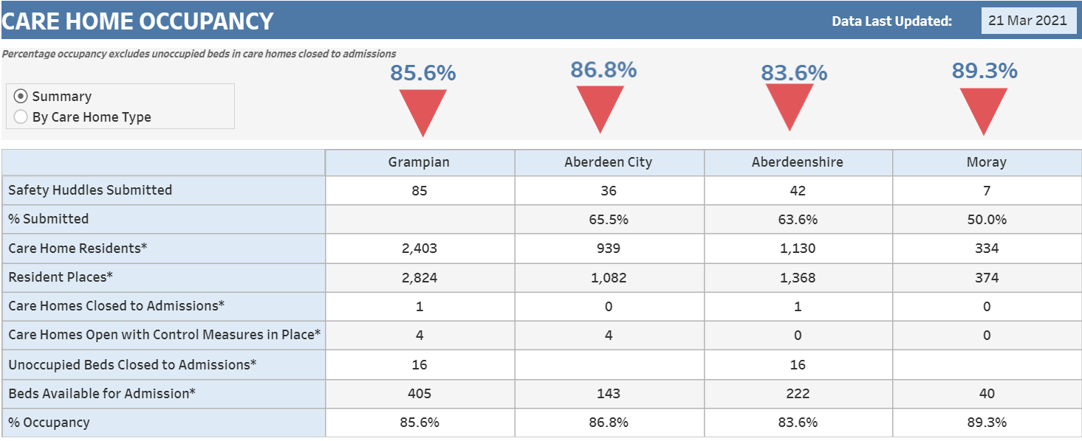
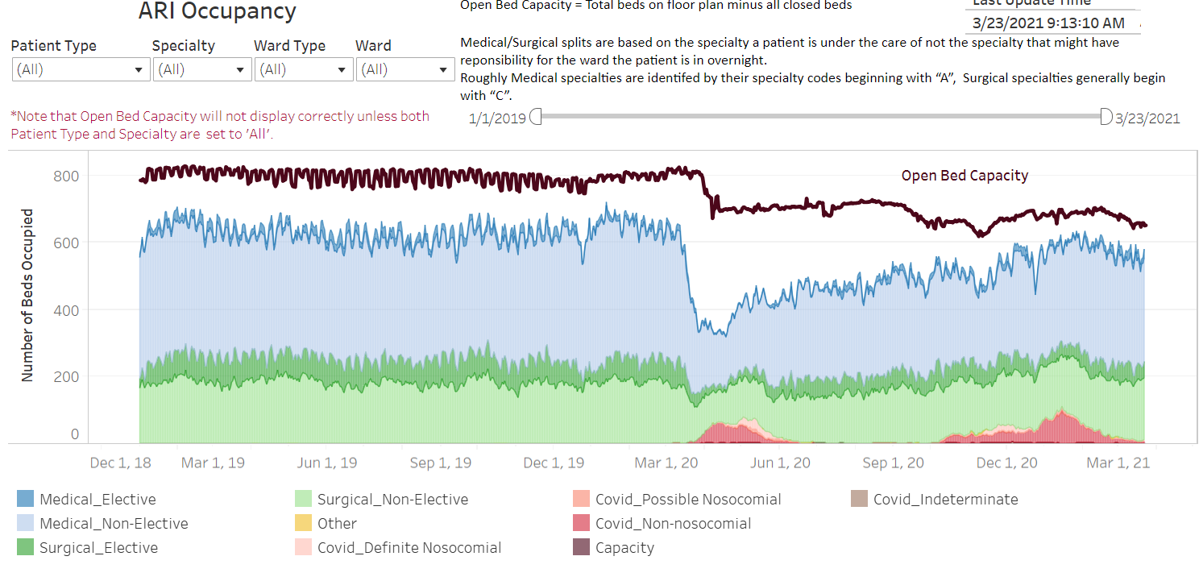
Surge and Flow
Key elements of the Winter Surge Plan
Redesigned Frailty Pathway and commissioned additional community beds
Redesign of Urgent Care was assisted in reducing attendances at the main Emergency Departments
COVID Demand high during December and January and has gradually reduced. Overall winter demand lower than in prior years (emergency admissions)
Flow out of main hospital sites in January was constrained by community capacity (community hospitals and care homes). Position has significantly improved and would acknowledge the joint working between care homes and our staff
Flexible, professional and dedicated staff and commitment to whole system working

Slide 9
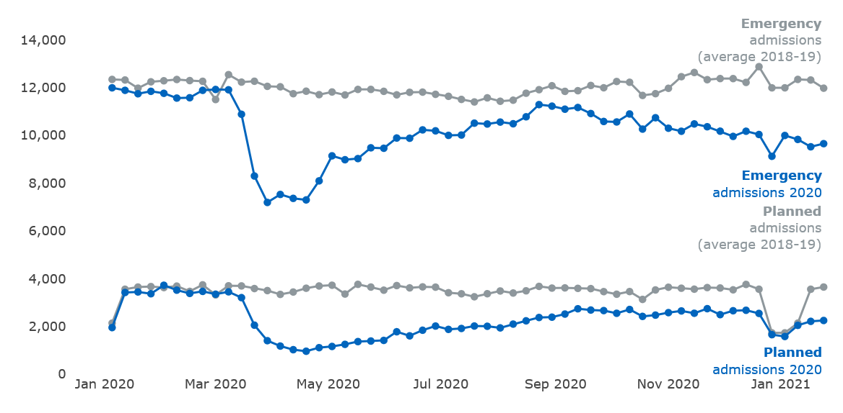
NHS Scotland – planned and emergency admissions
Hospital admission numbers give an indication of the wider impacts COVID-19 is having across the NHS.
Source: PHS Publications
Planned Admissions
All elective procedures were suspended when lockdown began in the 1st wave. The 'NHS is Open' campaign was launched on 24 April to encourage members of the public not to delay seeking medical advice.
The number of planned admissions increased after that and remained around 70% to 80% of normal levels from the week ending 6 September 2020 to the week ending 20 December 2020. The subsequent drop in planned admissions over the festive period was in line with previous years. Latest data shows that planned hospital admissions are at 62% of normal levels in the week ending 24 January 2021.
Emergency Admissions
The number of emergency admissions dropped to 60% of normal pre-COVID-19 levels in the week ending 29 March 2020. Emergency admissions then increased to a peak of 95% of normal levels in the week ending 23 August. Since then, emergency admissions have decreased slightly to 81% of normal levels in the week ending 24 January 2021.

Slide 10
Critical and Protected Services – planned care
Key areas of focus
Capacity building
Prioritisation
Patient engagement
Through whole system redesign 50 protected beds were established for highest priority surgical patients in February. As a result and a reducing bed requirement for COVID patients activity across all elective care classifications has increased during March.
For cancer patients we have secured dedicated capacity at Albyn Hospital, increased the urology service at Dr Grays and established additional clinics in the Breast service
In terms of Endoscopy – Weekend clinics at ARI & DGH and TAC service re-established at the Health Village
Grampian has a well established and test prioritisation system for planned care
This ensures that all urgent and priority patients are identified following determination of treatment and that patients are seen according to clinical need.
Capacity building has been targeted at urgent and priority patients (ESCAT 0 and 1 including cancer) and to address long waiting patients.
Patients on our treatment time guarantee waiting (~10k) have received a explanatory letter with an apology for the delay and highlighting escalation routes for them to raise concerns relating to their health.
Patients waiting over 52 weeks (~4k) are being contacted and invited to feedback on the quality of life impact on them to inform how we can reflect their needs into our remobilisation planning.

Slide 11
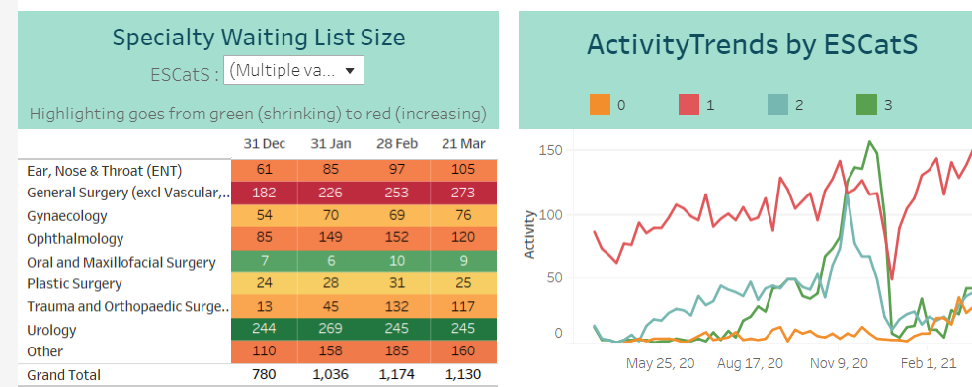
Critical and Protected Services – elective care
ESCAT 0 & 1 waiting list
As a result of the action being taken during March there has been
a reduction in the number of patients waiting for ESCatS 1 & 0 surgery
an increase in performance against 31 and 62 day cancer targets and
a reduction in the number of ESCatS 0 breaching their clinically acceptable date

Slide 12
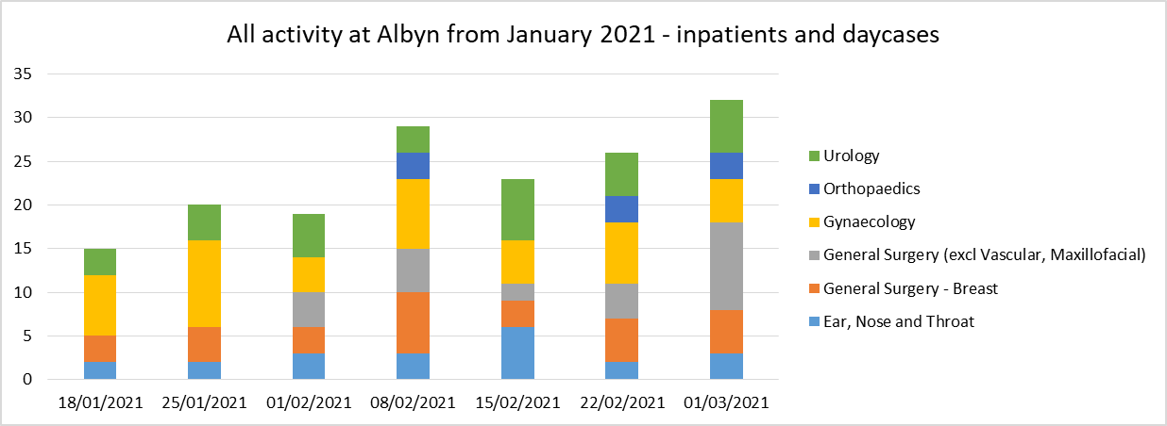
Critical and Protected Services – cancer
The COVID-19 pandemic has affected all NHS services and cancer waiting times continue to show challenges, particularly on the 62 day pathway. In addition the winter pressures and requirement for medical surge capacity impacted on the surgical footprint of the hospital.
Mitigations were put in place to ensure time critical treatments were protected and the cancer backlog was reduced.
These mitigations included increasing capacity as set out earlier. The impact of the additional activity at Albyn Hospital is noted below
The endoscopy waiting times for urgent suspected cancer (USC) patients have now reduced and plans are in place to ensure these waiting times are maintained with the move to three sessions days (AM, PM, Evening) at the Health Village.
Waiting times for Breast USC patients have halved from 6 weeks at the beginning of the year to 3 weeks. Funding has been approved from Scottish Government to continue with a 7 day working model in order to maintain waiting times.
As predicted the 62 day performance has decreased as the additional capacity has been utilised and patients on the backlog, who had already breached, were treated. The 31 day performance remains above the national standard.

Slide 13
Critical and Protected Services – Mental Health
Adult Mental Health – Royal Cornhill
Community Mental Health
As part of response to COVID pandemic Community Mental Health Services are currently delivered by multi-disciplinary Hubs - 2 Adult (18-65 yrs) and 1 Older Adult (65yrs+). Hubs provide specialist services and see patients from across all 3 localities, with most staff also aligned to groups of GP practices.
This has enabled access to be maintained to community health support following the 1st COVID lockdown in April and May 2020.
Length of stay has also increased. In December 2019, length of stay was 23.3 days, December 2020 length of stay has increased to 28.1 days – indicating a higher acuity of patients being admitted
% Occupancy in the Adult Wards has increased by 23% from the last 3 months in 2019 to the last 3 months in 2020.

Slide 14
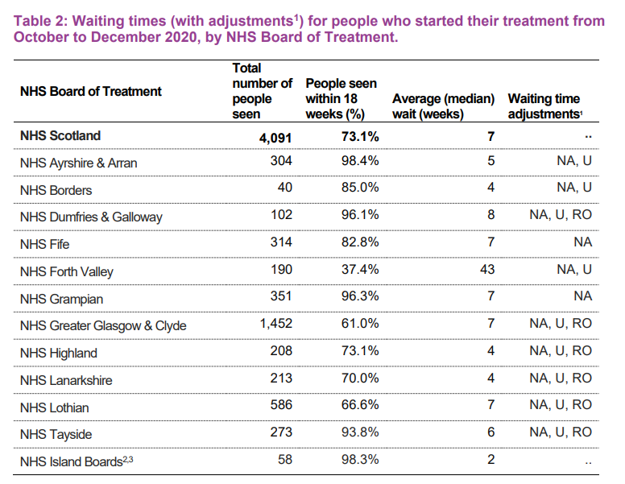
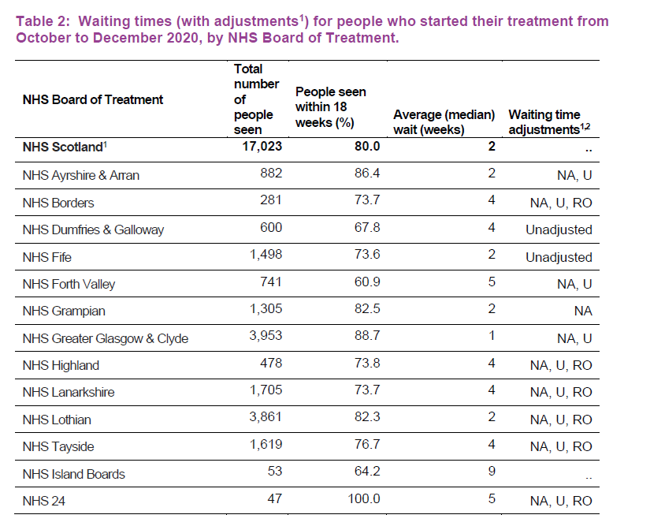
Critical and Protected Services – CAMHS & Psychological Therapies
Source: Public Health Scotland report – covering period October to December 2020

Slide 15
We Care, Because You Care

