Slide 1
Performance Report
26 July 2021

Slide 2
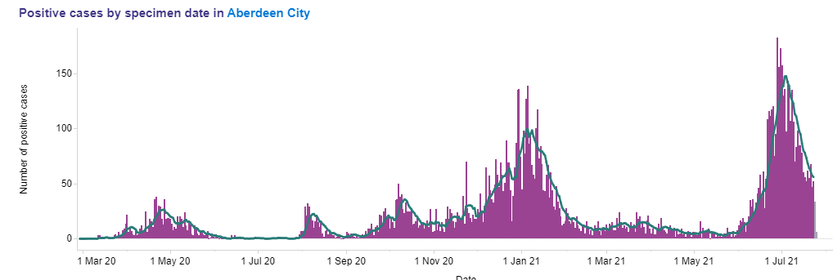
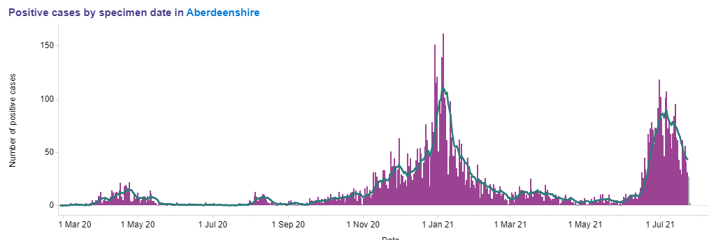
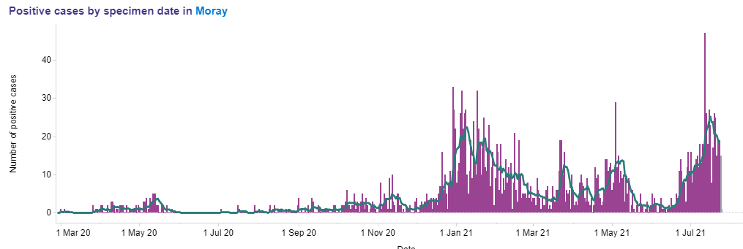
COVID - 7 day positivity
Aberdeen City
Aberdeenshire
Significant rise in COVID case rates during June and July related to a number of factors – easing of restrictions, movement of people and community transmission. Position has improved towards end of July with 7 day positivity rate reducing.
7 day positivity rate for Scotland at 24 July 6.9% (1 June 2.9% & 1 July 10.4%). Grampian rates are – Aberdeen City 5.6% (1 June 0.7% & 1 July 9.8%), Aberdeenshire 4.4% (1 June 0.5% & 1 July 6.5%) and Moray 6.3% (1 June 0.6% & 1 July 3.5%)
Moray

Slide 3
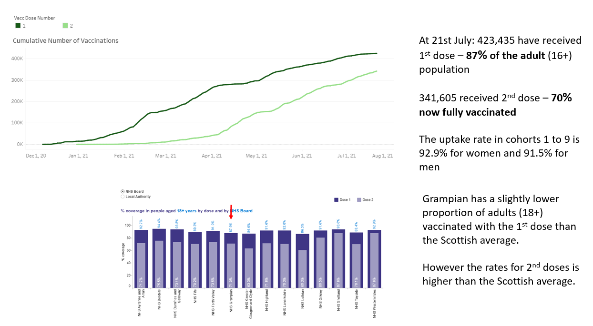
Vaccinations

Slide 4
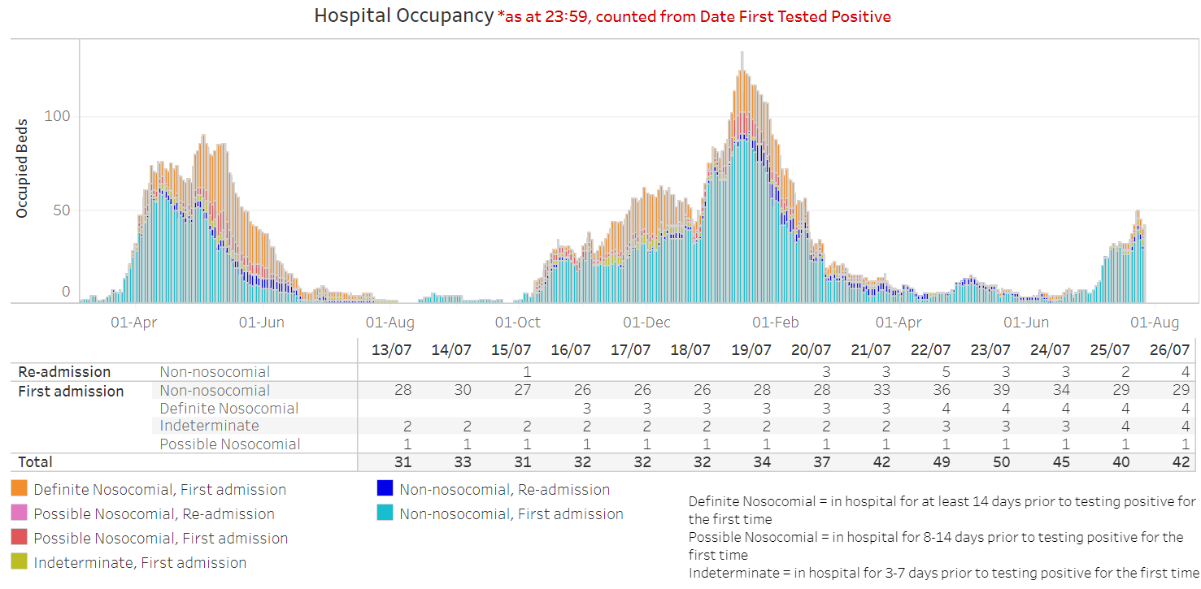
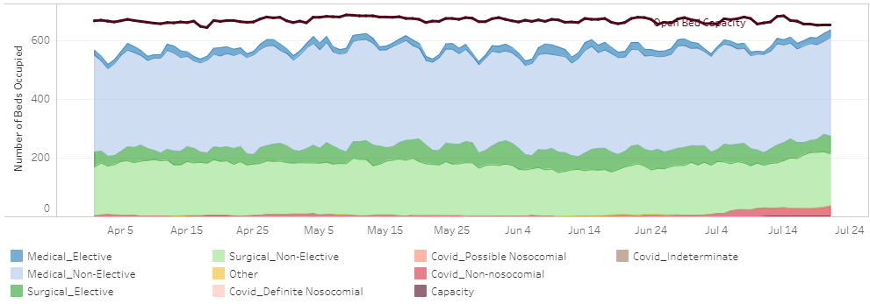
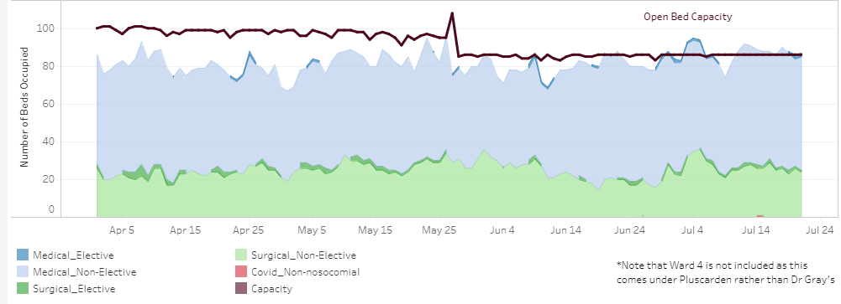
Surge and Flow
Implementing surge response to manage current situation where bed capacity remains reduced and staffing levels are impacted by self isolation
ARI bed occupancy 21st July: 36 COVID patients (6%); 78% non-elective patients (typically* 68%); 13% elective (typically 11%); 3% unoccupied beds (typically 20%)
Dr Gray’s bed occupancy (excluding paediatrics and neonatal/ maternity wards) 21st July: no Covid patients; 98% non-elective patients (typically* 67%); 3% elective patients (typically 10%); no unoccupied beds (typically 24%)
*based on July 2019
2nd wave
1st wave
3rd wave
Aberdeen Lockdown
Dr Gray’s Hospital
Aberdeen Royal Infirmary

Slide 5
Planned care
Key areas of focus
Capacity building
Prioritisation
Patient engagement
Through whole system redesign protected beds were established for highest priority surgical patients. As a result and a reducing bed requirement for COVID patients activity across all elective care classifications has increased since February.
Discussions have been progressed with the Scottish Government Access Team and Centre for Sustainable Delivery in support of our plans for increasing capacity and optimising use of existing resources.
Our plan depends on maintaining a number of protected beds for the highest priority surgical patients.
Grampian has an established and tested prioritisation system for planned care
This ensures that all urgent and priority patients are identified following determination of treatment and that patients are seen according to clinical need.
Capacity building has been targeted at urgent and priority patients (ESCAT 0 and 1 including cancer) and to address long waiting patients.
Patients on our treatment time guarantee waiting list (~10k) have received a explanatory letter with an apology for the delay and highlighting escalation routes for them to raise concerns relating to their health.
Patients waiting over 52 weeks (~4k) have also been contacted and invited to feedback on the quality of life impact on them to inform how we can reflect their needs into our remobilisation planning.
We are currently evaluating the feedback that has been received to inform our recovery and remobilisation plans and activities.

Slide 6
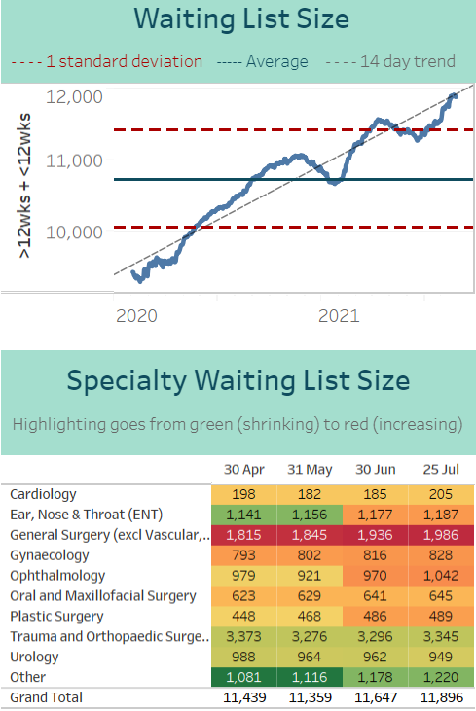
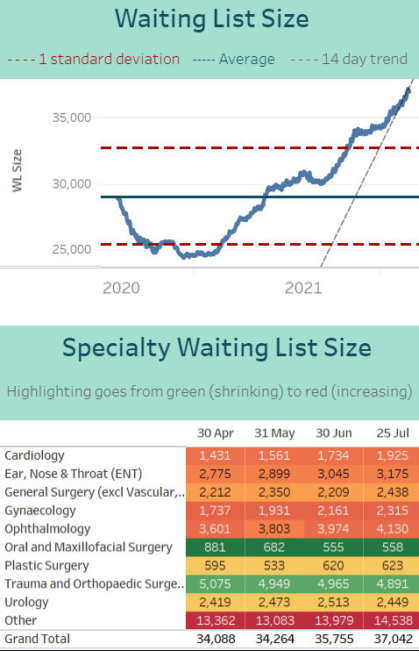
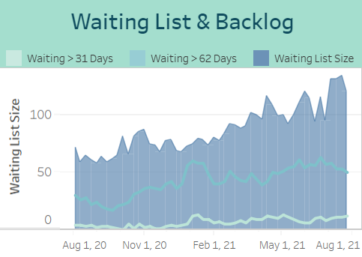
Planned Care
Treatment Time Guarantee
Outpatients
As a result of the action being taken as part of the remobilisation plan there has been
A stabilisation of the number of ESCAT 0 and 1 patients waiting for treatment and a small overall increase in waiting list
Steady performance against 31 and 62 day cancer targets but an overall increase in waiting list size as referrals return to pre-COVID level and
An increase in the overall waiting list size for a new outpatient appointment; with further steps being taken to identify ways to increase capacity. Near Me appointments continue to represent about 30% of overall outpatient appointments.
Cancer

Slide 7
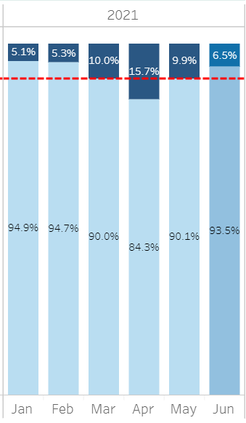
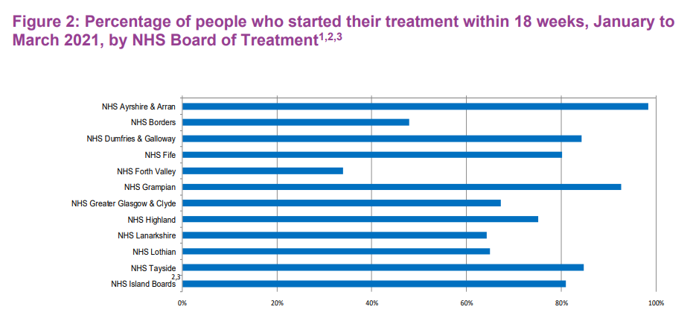
CAMHS
Performance during May and June has started to return to level recorded in Qtr 4 (2020/21)
National average for Qtr 4 was 72.5% (Grampian performance – 92.7%)
Focus of the services in addition to provision of access is developing plans for utilising +£2m funding made available by Scottish Government to increase capacity and access

Slide 8
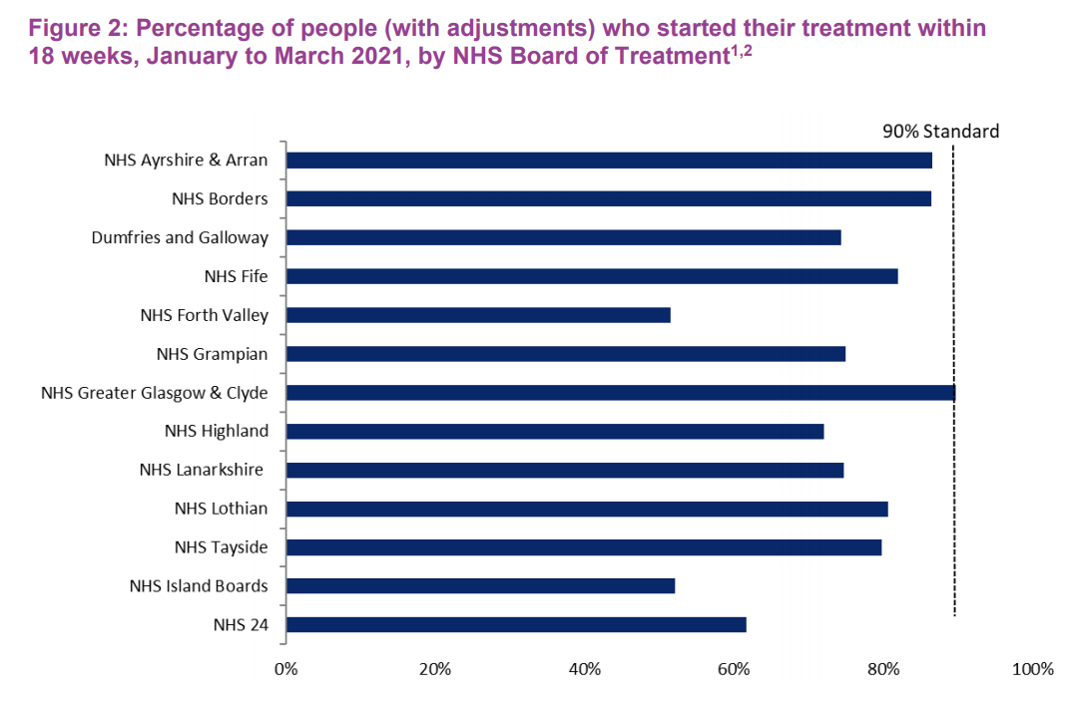
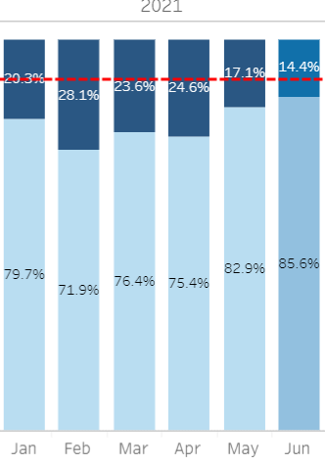
Psychological Therapies
Performance has improved in Qtr to 30 June 2021
National average for Qtr 4 was 80.4% (Grampian performance – 78%)
Focus on developing plans for utilising c£0.5m funding made available by SG to increase capacity and access
Decision taken to extend psychosocial hub beyond 31 July 2021

Slide 9
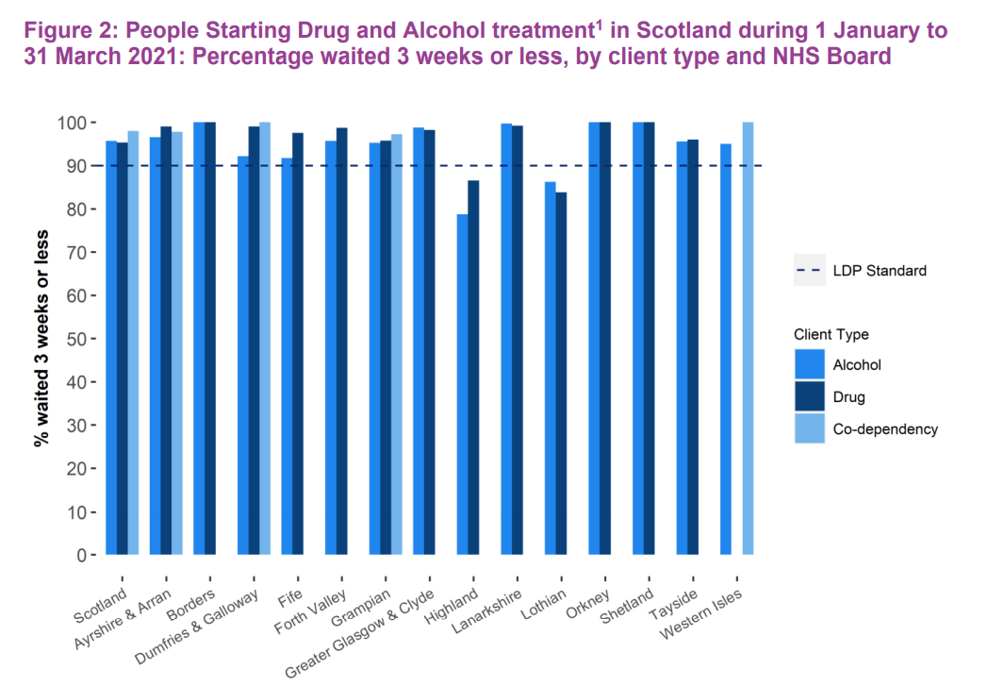
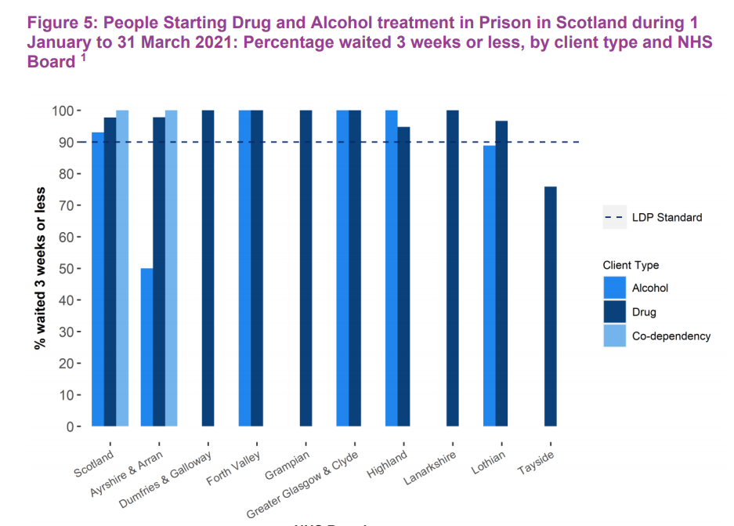
Access to drug and alcohol treatment
NHS boards in Scotland, with the exception of NHS Tayside, met the LDP standard in Prisons.

