Slide 1
NHS Grampian System Pressures Performance
Data as at 20 July 2022

Slide 2
Contents
Page 3 | Weekly System Summary
Page 4 | Grampian-Operational Pressures Escalation System (G-OPES) overview
Page 5 + 6 | Colleague absences
Page 7 | Scottish Ambulance Service (SAS) Turn Around times for Aberdeen Royal Infirmary (ARI) and Dr Gray’s Hospital (DGH)
Page 8 | ARI, Royal Aberdeen Children’s Hospital and DGH Emergency Departments’ A&E (ED) target performance
Page 9 + 10 | Elective care
Page 11 | Hospital Ward Safety Status
Page 12 + 13 | Hospital bed and care home occupancy levels
Page 14 + 15 | Delayed Discharges
Page 16 -18 | Social Care
Page 19 | Covid Summary
Page 20 | Infection, Prevention & Control Ward Closures

Slide 3
Weekly system summary update
GOPES metrics | The system was mainly at level 3 for the week to 19 July, with a notable decrease in level 4 compared to the previous week. MUSC continues to predominantly report at level 4
Staff absences | There continues to be a general decrease in Covid-positive absences through July, although individual weekly percentages have increased with the weekly SSTS refresh. Annual leave increased in early July (and is likely to show further increase following next week’s SSTS refresh)
SAS Turnaround Times | The 90th percentile turnaround times increased again for ARI, to a new high of 198 minutes; they fell again for Dr Gray’s (to 83 minutes). These remain above the Scottish average (78 minutes)
A&E Performance | Weekly 4-hour performance fell to 48.9% at ARI, improved to 78.1% at Dr Gray’s, and improved to 91.8% at RACH. 8- and 12-hour breaches fell at ARI but increased at Dr Gray’s
Elective care | The Outpatient list size has increased for the fifth consecutive week; the proportion of patients waiting over 12 weeks has decreased to 45.4% and the proportion of unavailable patients has decreased to 1.6%. The Inpatient list size has increased for the seventh consecutive week and is now; the proportion of patients waiting over 12 weeks has decreased, to 69.1% and the proportion of unavailable patients remains at 2.3%
Cancer | Not updated this week
Ward safety status | Proportion of wards reporting a red or amber RAG status last week increased for the sixth consecutive week to 58.1%
Hospital bed occupancy | Remains at very high levels across NHSG estate with some areas at, near, or over 100%. ARI occupancy levels have increased through July. At 20 July, 26 patients in ICU (including 2 Covid patients). The maximum number of beds available to use across all Grampian hospitals has fallen by 20, to 1812, primarily as a result of closures at Royal Cornhill Hospital (Dr Gray’s and Moray bed numbers remain under review)
Care home occupancy | Continues at high but stable levels across Grampian. 7 homes closed to admissions, and 3 homes with control measures in place
Delayed Discharges | Increase in number of delayed discharges and cumulative bed days for all localities and all above yearly averages. Continued fall in ‘Place availability’ delays and slight increase in ‘Care package’ delays; cumulative bed days for both are trending upwards
Social care | Hours not provided have continued to decrease in City and Shire; data shows a steep increase in Moray, which is being investigated
Covid | Local case data shows a further slight fall in recorded positive tests however case numbers should be interpreted cautiously. Hospital admissions remain high and continue to show a fluctuating pattern; the number admitted FOR Covid remains stable. Occupancy remains high, with signs of a plateau; of those WITH Covid, there has been a slight increase in definite or possible hospital onset cases. As at 20/07, 2 covid patients in ICU. Number of ward closures due to Covid decreased to 4 in the last week.
Mental Health | Not updated this week

Slide 4
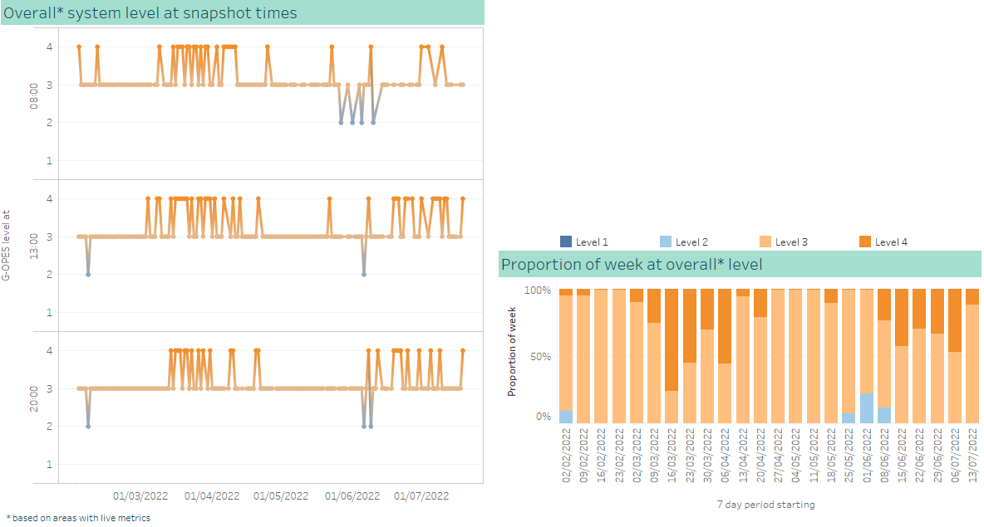
Overall G-OPES system pressure metrics
Decrease in level 4
The overall system has mainly been at level 3 for the week to 19th July, decrease in level 4 compared to the previous week
MUSC has consistently reported level 4 for the last week, with the exception of 8am on 14/07
AMH, ISCP and RCH have all reported level 4 on more than one occasion

Slide 5
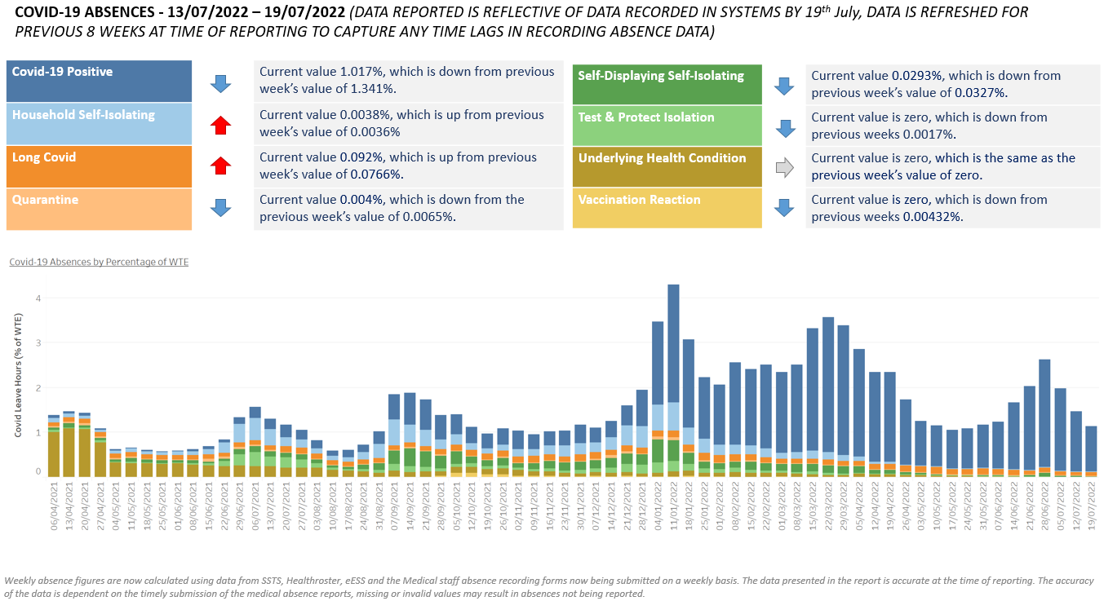
Workforce – COVID-19 absences
Covid-related absences remain high, but are decreasing

Slide 6
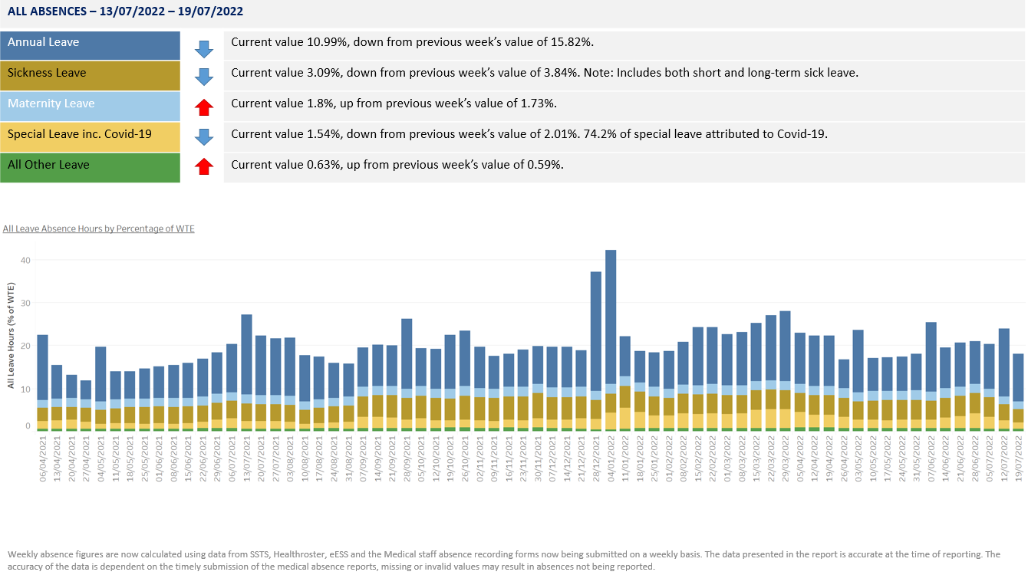
Workforce – all leave
Increase in annual leave in early July

Slide 7
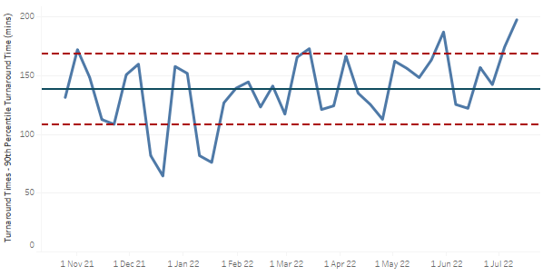
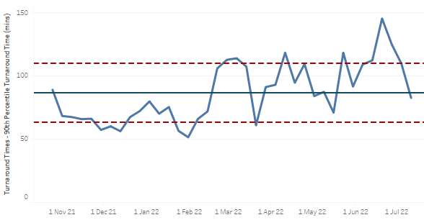
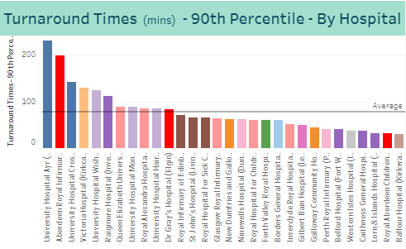
Scottish Ambulance Service turnaround times
ARI 90th percentile turnaround times at new high of 198 minutes
ARI 90th percentile ambulance turnaround time increased again, from 175 to 198 minutes
Dr Gray’s 90th percentile ambulance turnaround time fell again, from 110 to 83 minutes
ARI and Dr Gray’s 90th percentile ambulance turnaround times remain above the Scottish average (78 minutes)

Slide 8
A&E 4 hour performance
Fall in 8- and 12-hour breaches at ARI
ARI performance fell from 50.2% to 48.9%
primary 4 hour breach reason remains ‘Wait for 1st assessment’
91 8-hour breaches in the last week, a decrease from 150 the previous week
28 12-hour breaches in the last week, a decrease from 33 the previous week
updated chart not available this week
Dr Gray’s performance improved from 75.9% to 78.1%
primary 4 hour breach reason remains ‘Wait for bed – Non Monitored’
38 8-hour breaches in the last week, an increase from 32 the previous week
13 12-hour breaches in the last week, an increase from 11 the previous week
updated chart not available this week
RACH performance improved from 89.4% to 91.8%
primary 4 hour breach reason remains ‘Wait for 1st assessment’
No 8-hour breaches in the last week, a decrease from 1 the previous week*
No 12-hour breaches in the last week, the same as the previous week
updated chart not available this week

Slide 9
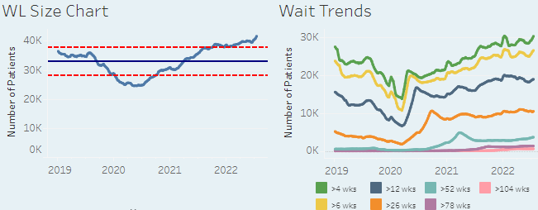
Elective Care – consultant-led Outpatients
Waiting list size increased for fifth consecutive week
The list size has increased by 748 patients, the fifth consecutive weekly increase
The proportion of patients waiting over 12 weeks has decreased, from 46% to 45.4%
The proportion of patients unavailable (all reasons) has decreased from 1.7% to 1.6%
Of the top 20 longest waits, GP Minor Surgery accounts for 19 patients and Urology for 1 patient
The longest waiting patient this week is an unbooked GP Minor Surgery patient waiting 1279 days

Slide 10
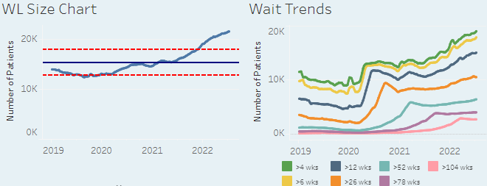
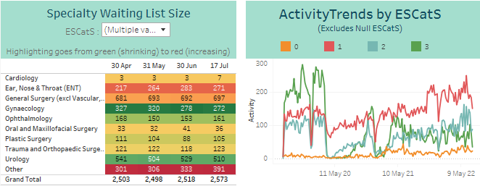
Elective Care – all Inpatients
Waiting list size has increased for the seventh consecutive week
The list size has increased by 188 patients, a seventh consecutive weekly rise
The proportion of patients waiting over 12 weeks fell from 69.5% to 69.1%
The proportion of patients unavailable (all reasons) remains at 2.3%
Of the top 20 longest waits, Urology accounts for 8, Plastic Surgery for 6, General Surgery for 4, Gynaecology for 2 patients
The longest waiting patient this week is an unbooked Plastic Surgery ESCatS 3 patient waiting 1874 days
Overall ESCatS 0&1 Waiting List size showing indication of slight increase (ENT and General Surgery)
ESCatS 1 activity had been increasing but has dropped slightly at the end of June/start of July. The overall ESCatS1 activity level remains higher than in 2019
Specialty Waiting List Size shown for ESCatS 0 and 1 patients

Slide 11
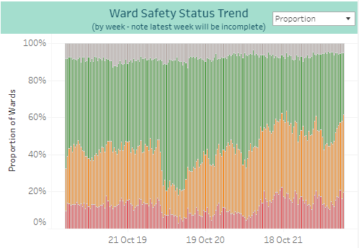
Ward Safety Status
Red & Amber RAG status: sixth consecutive weekly increase
The overall trend data shows for the week beginning 11 July 58.1% of wards reported a red or amber RAG status, an increase from 57.2% the week before
This is the highest level since early March and the sixth consecutive weekly increase
Red RAG status reports decreased from 21% to 16.3% for the same period

Slide 12
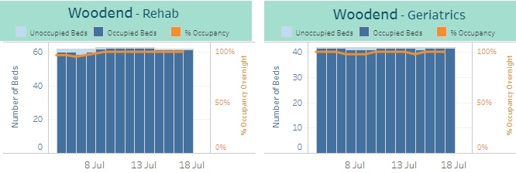
Hospital bed occupancy
Remains at very high levels with some areas at, near, or above 100%
ARI occupancy remains at very high levels, and has been increasing through July
Rosewell House occupancy remains very high, at or near 100%
Moray community hospital occupancy remains very high, at or near 100%
Royal Cornhill occupancy remains very high, continuing to exceed 100% in recent weeks
Aberdeenshire community hospital occupancy remains high
Dr Gray’s hospital occupancy remains very high
Woodend community occupancy remains very high, reaching 100% in the last week
RACH continues to have reasonable capacity available
Dr Gray’s and Moray bed numbers are currently under review

Slide 13
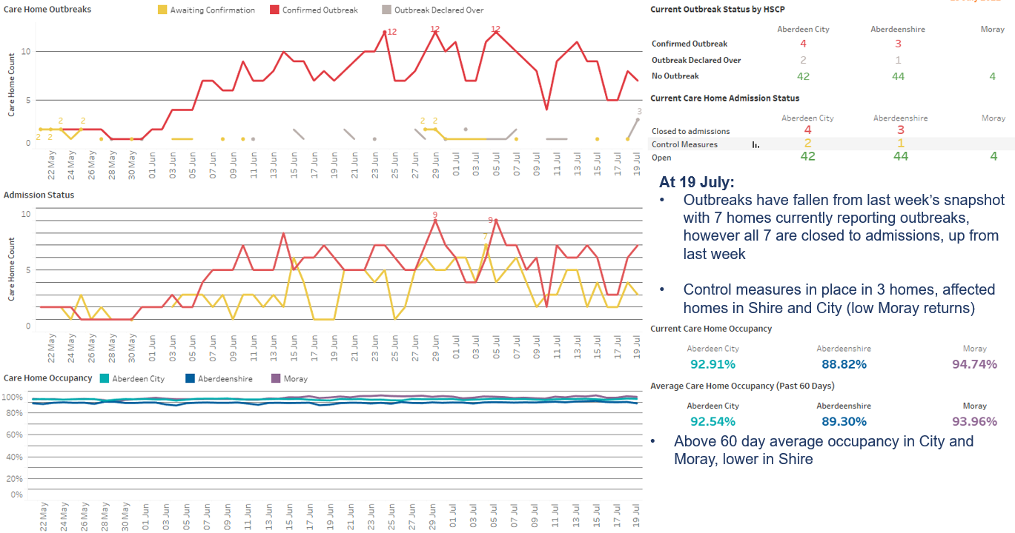
Care Home occupancy
Remains high; 7 homes closed to admissions
Care home data is from TURAS which is self reported and not assured centrally. Submission rates are not 100% and are lower at weekends.

Slide 14
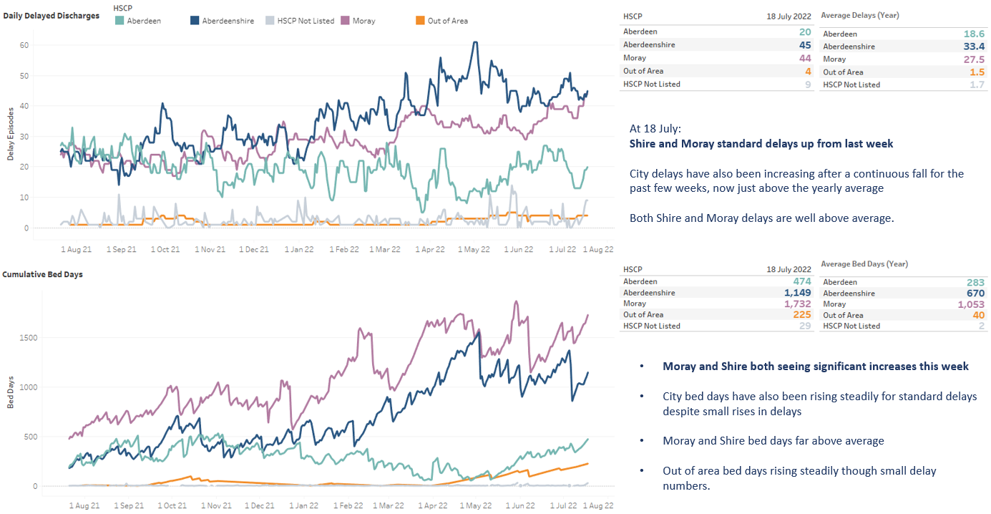
Delayed Discharges (standard delays only)
Increase in all localities
Data shown for standard delays only as complex and Code 100 delays are typically harder for partnerships to control. Delays shown are daily snapshot delays from Trak which are not validated delays.

Slide 15
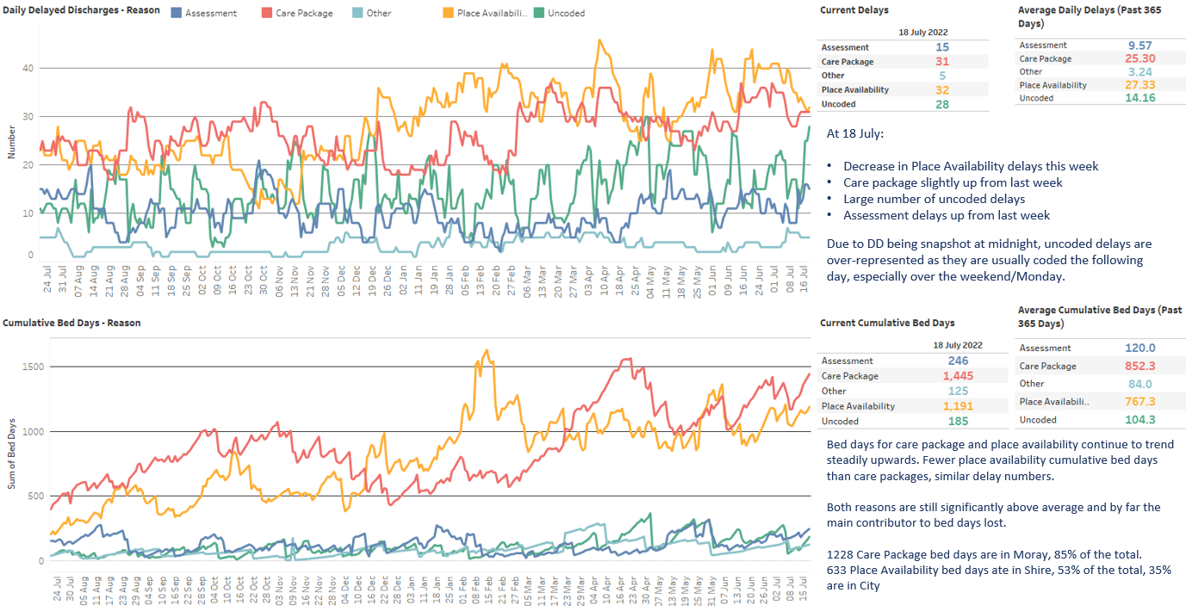
Delayed Discharges – Reason (standard delays only)
Continued fall in ‘Place Availability’ delays
Data shown for standard delays only as complex and Code 100 delays are typically harder for partnerships to control. Delays shown are daily snapshot delays from Trak which are not validated delays.

Slide 16
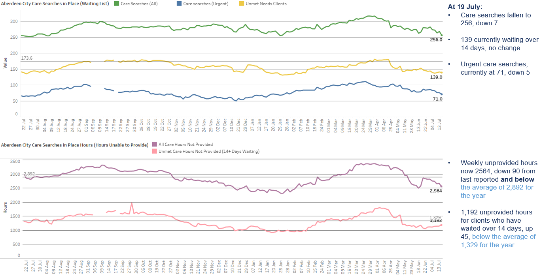
Aberdeen City Social Care
Hours not provided continue to decrease
For City, a care search is a record of a case where a care need has been identified but not fulfilled and how many hours of care are required (care search hours). These are weekly hours required per care search.

Slide 17
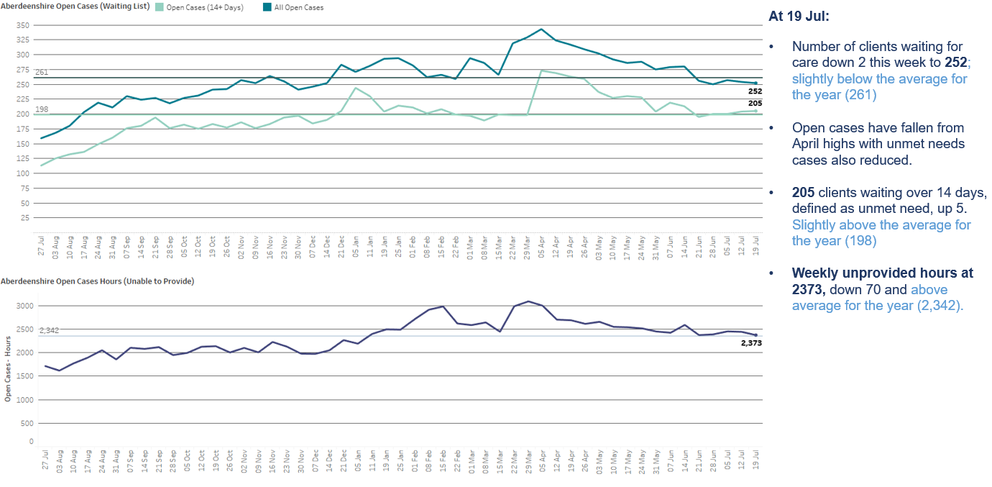
Aberdeenshire Social Care
Hours not provided continue to decrease
Open cases are where a care need has been identified and recorded on CareFirst. Open Cases hours are the weekly hours assessed as required for each open case. Homecare hours are hours which Shire are currently providing.

Slide 18
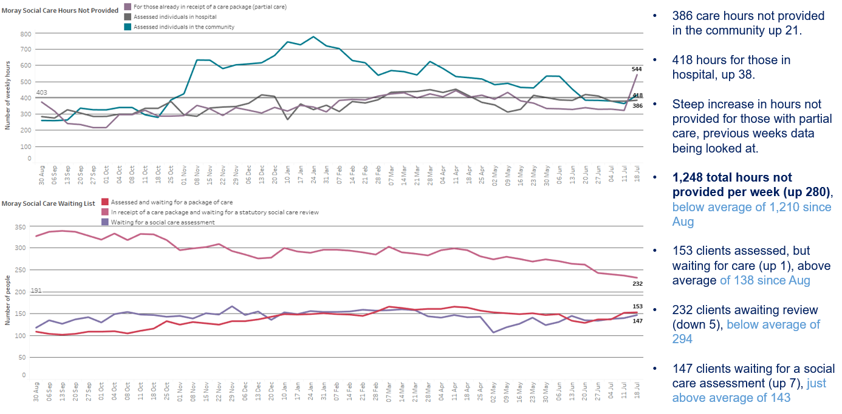
Moray Social Care
Hours not provided have increased
Hours are the number of weekly hours identified as required for that individual. No data is available for length of time on the waiting list to identify unmet need.

Slide 19
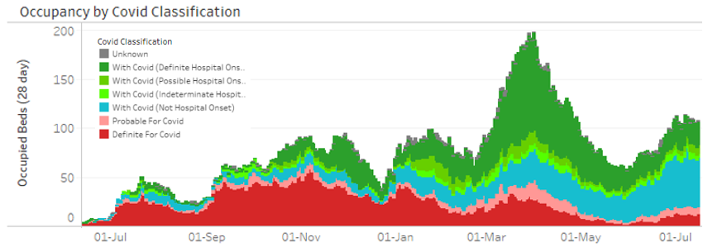
Covid summary
Admissions and occupancy remain high
Local case data continue to show a slight fall in recorded positive tests
7-day rate to 17/07 was 216/100,000, which is down from 279/100,000 the previous week and 318/100,000 the week before. This is still higher than the rates seen during May and early June
As always, case numbers need to be interpreted cautiously due to far less testing being carried out in the community. Testing may be further impacted by the school holiday period, which could act as a disincentive to testing
The national ONS survey shows an ongoing rise in cases in Scotland in the week to 7th July, with approx. 1 in 16 in Scotland estimated to have COVID over a 7-day period
The rise may be slowing: it was 1 in 17 the previous week, and 1 in 18 the week before)
NB there is a 15-25% under-ascertainment of Covid infection among hospital admissions since April 2022. This is due to home LFD tests not being logged and no test on admission
Hospital admissions remain high and continue to show a fluctuating pattern
82 covid admissions in the 7 days to 19/07, the same level as a week prior but with a rise and fall in between. This is still higher than admission levels in May and early June
There were 17 admissions FOR covid (probable and definite) in the 7 days to 19/07, compared to 18 the previous week; the majority of admissions remain WITH covid (not hospital onset)
Hospital occupancy remains high, with signs of a plateau
At 19/07, 108 occupied beds (vs 112 a week previously)
19 of these were admissions FOR covid (compared to 21 a week previously). Of those WITH covid, 33 are definite or possible hospital onset (compared to 28 a week previously) and 54 not hospital onset (compared to 63 a week previously)

Slide 20
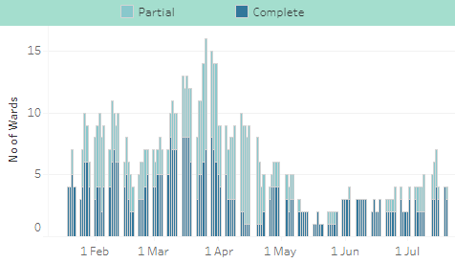
Infection Prevention & Control Ward Closures
Ward closures decreased to 4
Ward closures due to Covid infection controls
As at 19/07, 4 ward closures due to Covid infection controls
The number of ward closures increased to 7 last week but has since fallen back to 4
All current ward closures due to a suspected or confirmed outbreak of infection are Covid-related

